Slide 1
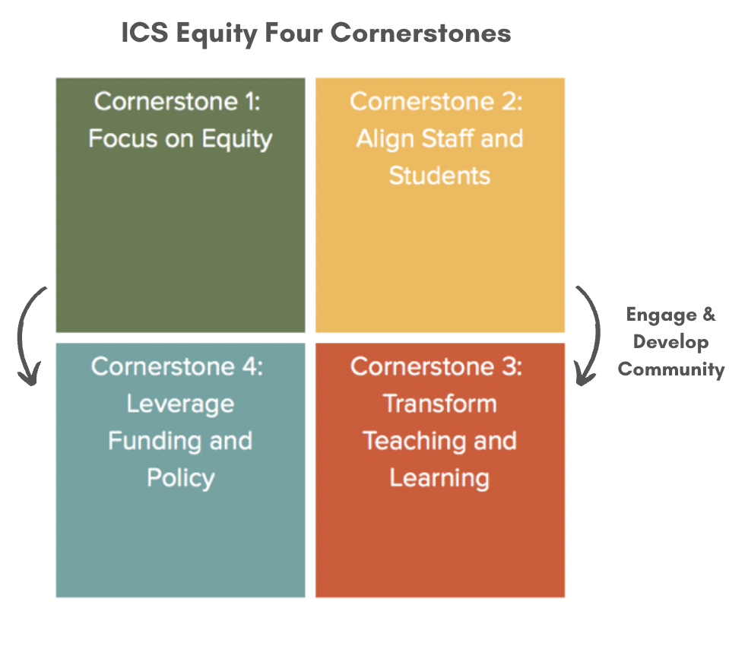
Integrated Comprehensive Systems for Equity –
Four Cornerstones
Beyond piecemeal, “Initiatives”, “Models”, and Approaches that try to “fix” students and educators to instead Systems Change for All.

Slide 2
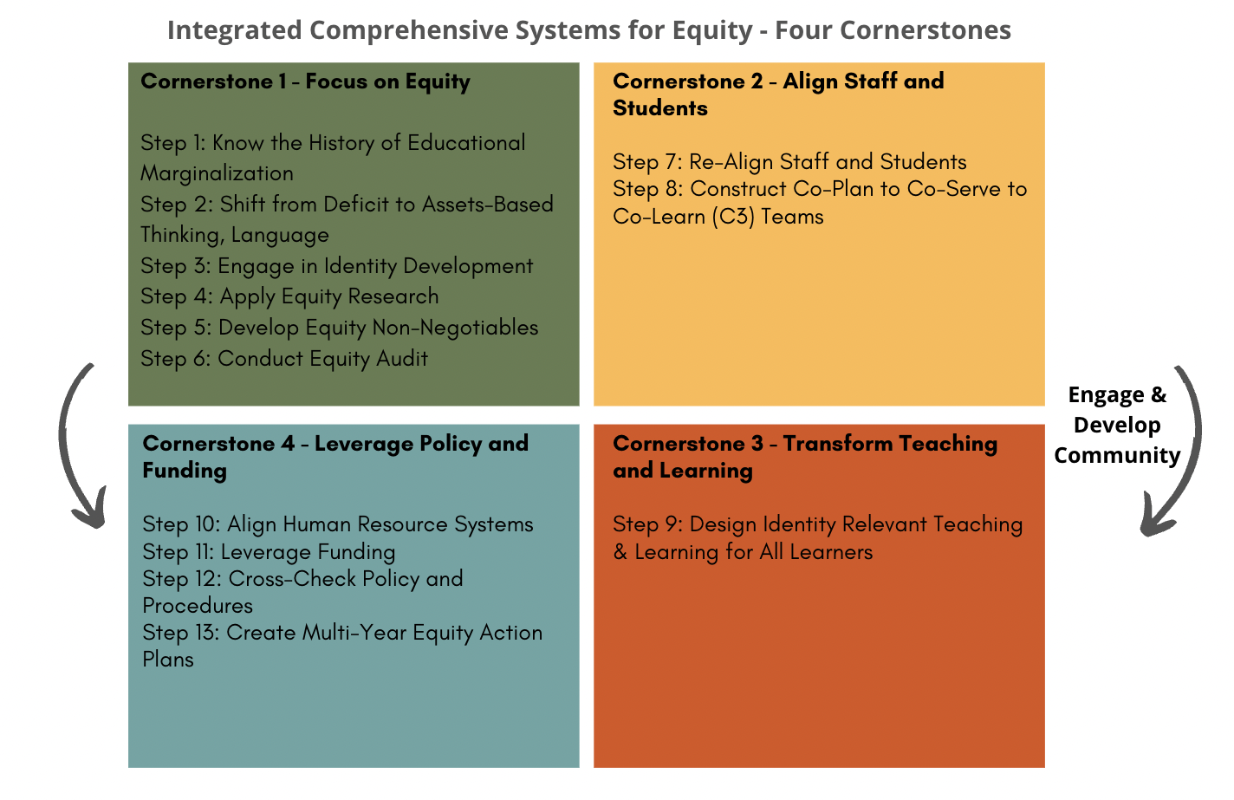
Integrated Comprehensive Systems for Equity –
Four Cornerstones
Year 1
Year 2
Year 2 and 3
Year 2 and 3

Slide 3
ICS Equity Implementation Process –
Implementation Science
ICS Institute Part II - Co-Plan to Co-Serve to Co-Learn (C3):
DLT, SLT
DLT - District Modules
SLT - Facilitate Modules with Staff
ICS Team Coaching:
3 years
(4 times per year)
Introduction to ICS:
2.5 hours
DLT, Principals, and Board
3 Day Institute Part I:
DLT, SLT, and Board
Community Ally Academy:
4 evening sessions
School Board Academy:
Four - 3 hour sessions
Additional Professional Development as Needed (e.g., students with significant disabilities, students with challenging behaviors, new staff orientation, etc.)

Slide 4
ICS Systems Change:
7 Key Features
1.
a. A Framework – Not piecemeal
b. A Process – Step by Step to guide the work
  c. Not an “Initiative”, Not a “Model”, Not a “Program”, Not a “Diversity Workshop”– systems change for all anchors all work in setting

Slide 5
ICS Systems Change:
7 Key Features (Continued)
2. Research/Evidence-Based
- Grounded in over 45 years of research
- Outcome data from Districts/Schools implementing the research

Slide 6
ICS Systems Change:
7 Key Features (Continued)
3. Systems Change for All
  a. High-quality teaching and learning for all students and increasing achievement for all students

Slide 7
ICS Systems Change:
7 Key Features (Continued)
All Districts Have Strengths
4. And, in all districts, all students can achieve more.
Please see the following slides for examples from districts.

Slide 8
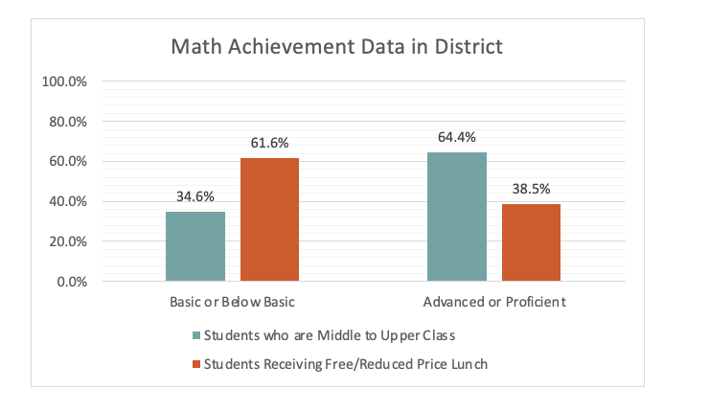
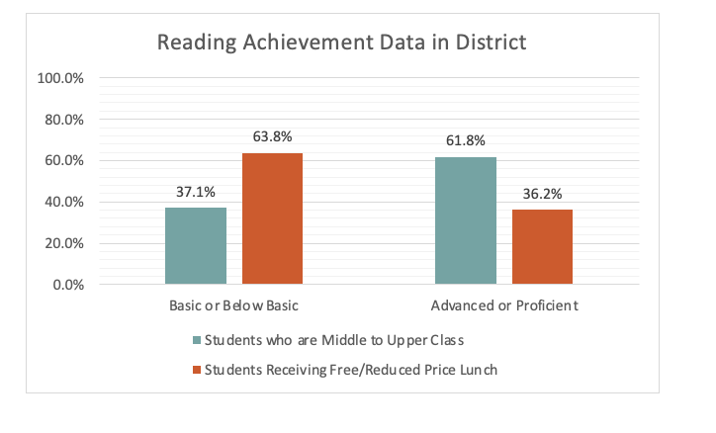
District Examples
These examples show that all students in our districts can be achieving more and that this work will advance the learning of all students in the district.
(Please note the students who are middle/upper class and scored basic/below basic).

Slide 9
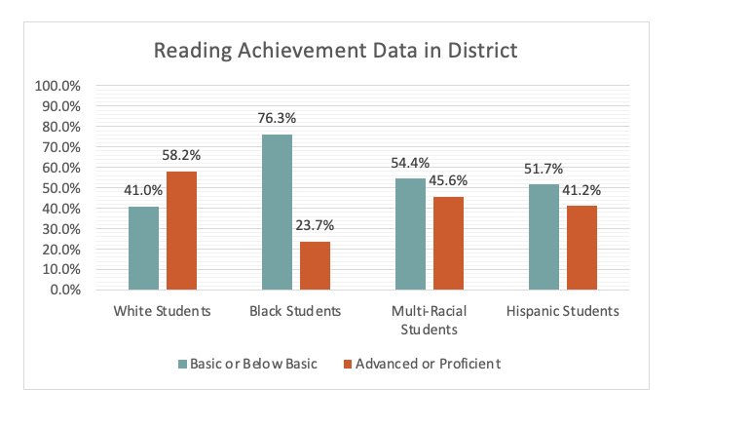
District Examples
Please note the White students scoring basic/below basic.

Slide 10
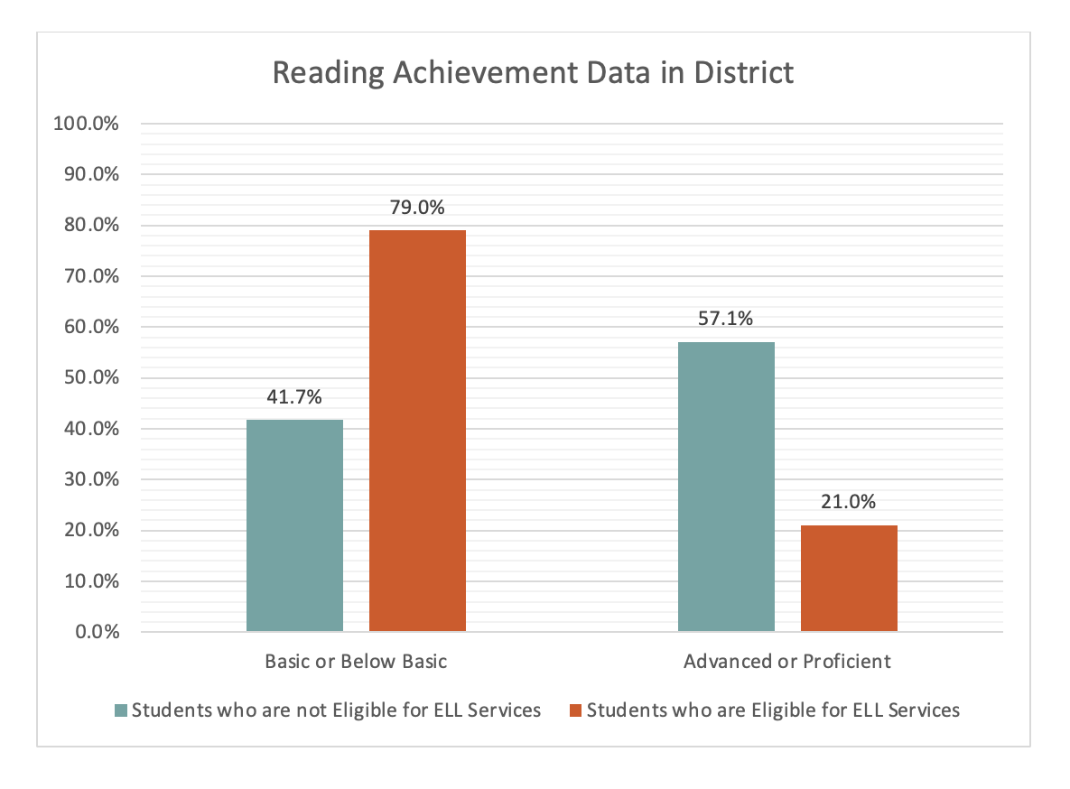
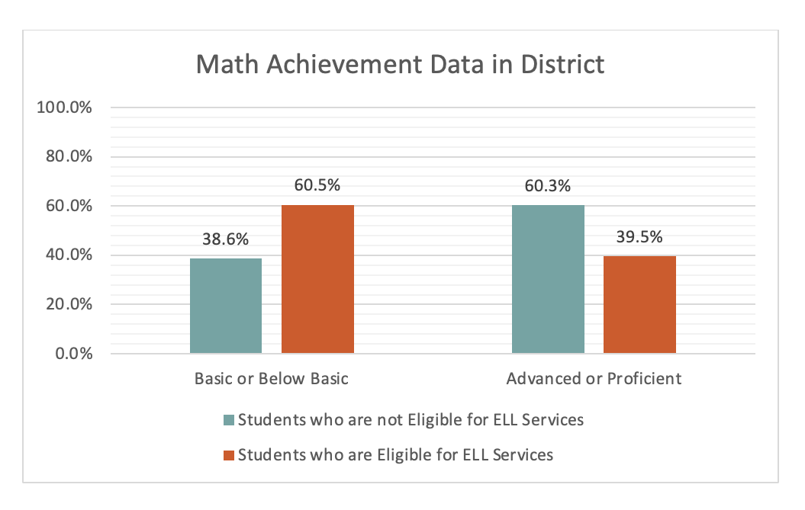
District Examples
Please note the students for whom English is their home language scoring basic/below basic.

Slide 11
ICS Systems Change:
7 Key Features (Continued)
5. When systems change is done well, all students achieve more. No one loses.
This work is about all students.
Please see the following slides for examples from districts.

Slide 12
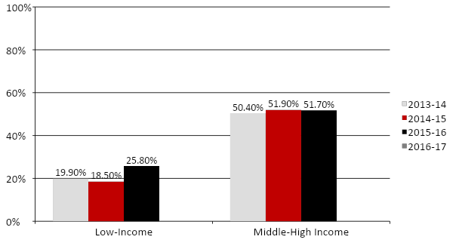
River Bluff H.S. - Percentage of Student Group Enrolled in 1+ AP/Honors Course

Slide 13
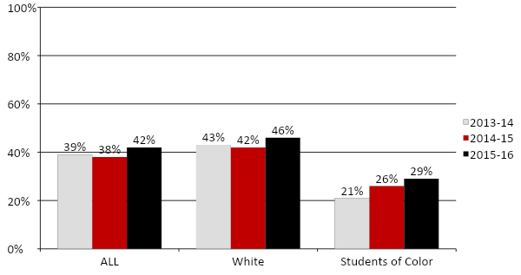
River Bluff H.S. - Percentage of Student Group Enrolled in 1+ AP/Honors Course

Slide 14
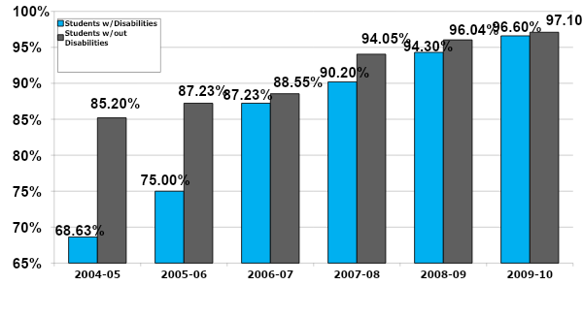
Templeton School District - Graduation Rate Increase

Slide 15
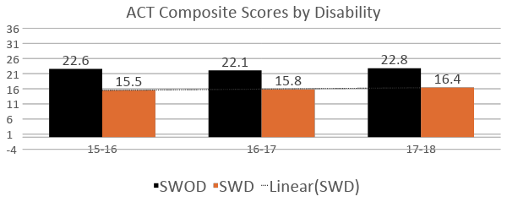
Equity Outcome:
ACT Test Score Across Ability

Slide 16
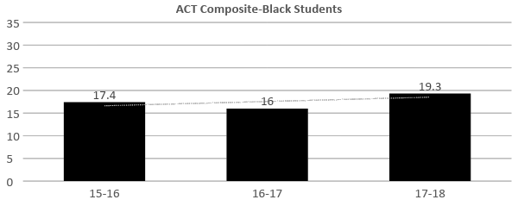
Equity Outcome: Positive Equity
Change in ACT Test Data Across Race

Slide 17
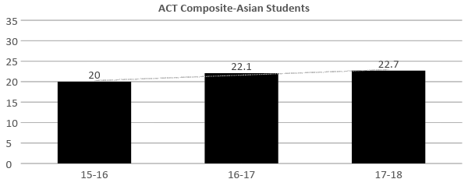
Equity Outcome: Positive Equity
Change in ACT Test Data Across Race

Slide 18
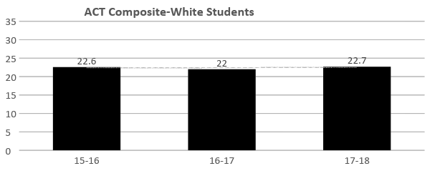
Equity Outcome: Positive Equity
Change in ACT Test Data Across Race

Slide 19
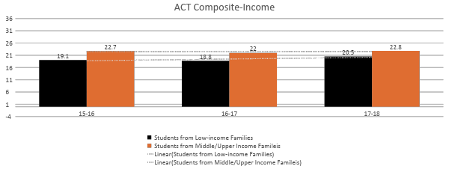
Equity Outcome: Positive Equity
Change in ACT Test Data Across Income

Slide 20
ICS Systems Change:
7 Key Features (Continued)
6. Develop the District’s Internal Collective Capacity vs. Piecemeal Outside Consultants
- District Leadership Team, School Leadership Team
- Participate in Institutes at 2 Levels
- Learn about the work
- Learn to lead the work with staff

Slide 21
ICS Systems Change:
7 Key Features (Continued)
7. Accountability
          a. Equity audit data
          b. Updated annually
          c. Expect measurable progress for all students

Slide 22
Integrated Comprehensive Systems for Equity –
Four Cornerstones
Beyond piecemeal, “Initiatives”, “Models”, and Approaches that try to “fix” students and educators to instead Systems Change for All.

Slide 23

Provide a Framework to Bring Together District/School Efforts
“Beyond Initiative Fatigue”

Slide 24
Provide a Framework and Process To Advance School Improvement Plan and District Strategic Plan

