Slide 1
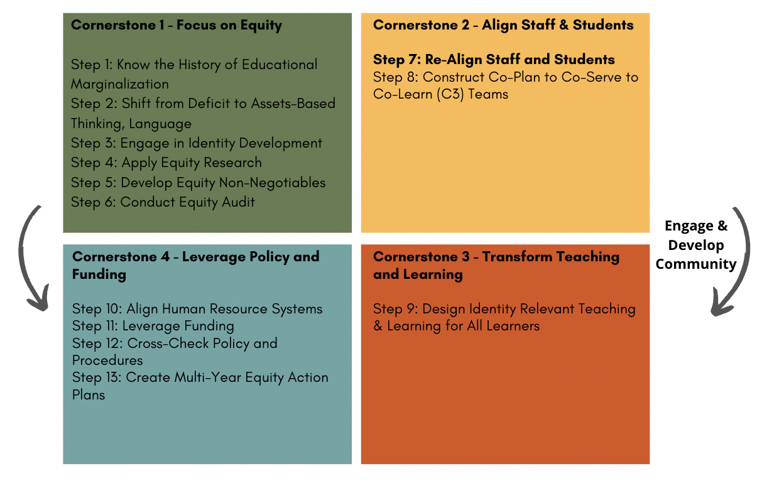
ICS Equity Institute Part 2 Digital Module 7/Step 7: Re-Align Staff and Students

Slide 3
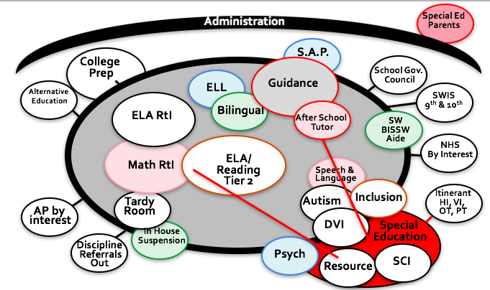
C3 Proactive Structure

Slide 4
History of Inclusion
1970’s - 1980’s: Mainstreaming
1980’s – 1985: REI (Regular Education Initiative)
1985’s – 1990’s: Inclusion
1990’s – 2000: Full Inclusion
How this work is different:
We are changing the core of teaching and learning; the child does not have to fit into a Normative that does not see them.

Slide 5
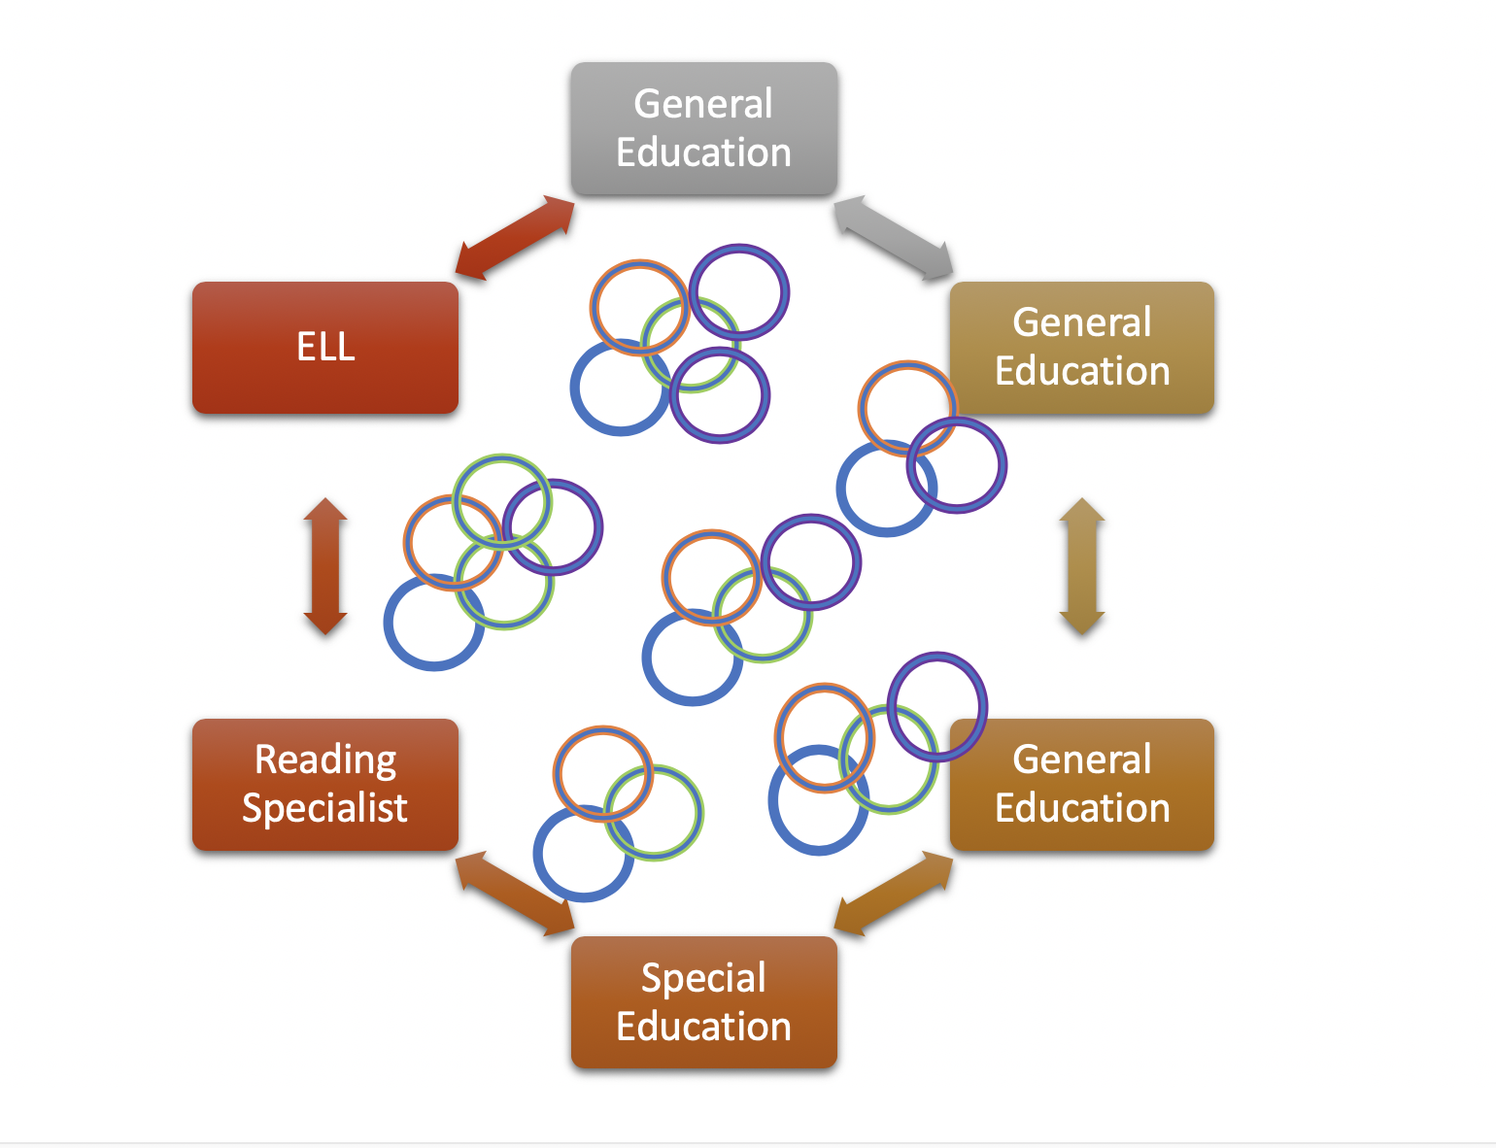
By Year
By Grade Level
By Content
By Educator Expertise
By Student Proportional Make Up
Yet:
Consistent for Comprehensive IRTL
Most important Teams in the School
Necessary for Equity

Slide 6
Practice Developing Co-Plan to Co-Serve Teams
All forms are at the end of Digital Module 7 We will go step-by-step through the realignment
Beginning first with Elementary then Secondary
Then your teams will have time to complete the realignment activity

Slide 7
Previously Completed: Stages and Steps the School Leadership Teams Work through to Re-imagine and Intentionally Create C3 Teams for Elementary and Middle School
Stage 1: List Staff and Certification
Step a: List all staff in the school (general and special educators, title staff, reading and math interventionist, Learners who are Learning English, at-risk, speech and language, advance learners support, etc.)
Stage 2: Delineate List Staff and Student Data
Step b: List all grade levels in your school
Step c: List the number of students in each grade level
Step d: List number of students by disabilities, ELL, receiving Tier 2 and 3 interventions, and advanced learners

Slide 8
Stages and Steps the School Leadership Teams Work through to Re-imagine and Intentionally Create C3 Teams for Elementary and Middle School
Stage 3: Creating of Co-Plan to Co-Serve to Co-Learn Teams (C3) by Grade Level
Step a. Identify the grade level that C3 Teams will be created
Step b. List the staff that will be aligned to each team
Step c. Summarize the creation of the Co-Plan to Co-Serve to Co-Learn (C3) Teams
Stage 4: Creating Proportional Representation in Tier 1/Every Classroom
Step a: Design a plan for proportional representation of all students in the core of teaching and learning

Slide 9
Align Staff (State FTE) to Function as Co-Plan and Co-Serve (C3) Teams Based on the Needs of Students and Staff Expertise
The alignment of staff :
1. Acknowledge the needs of the students at each grade level
2. Attend to the expertise of the general education teachers at each grade level.
3. Create teams that have complimentary skills across individuals.
4. Develop the Collective Equity Capacity
As an example, if the content teachers assigned to that grade level do not have a strong reading background, then it may be important to align the reading specialist to that specific grade level team for a greater percentage of time, and less time on a team where teachers have such expertise. As a second example, , if there is a child at a specific grade level who has a specific need, such as autism; it will be important to align the special educator to that team who has a greater expertise and certification (when appropriate) in the area of autism.

Slide 10
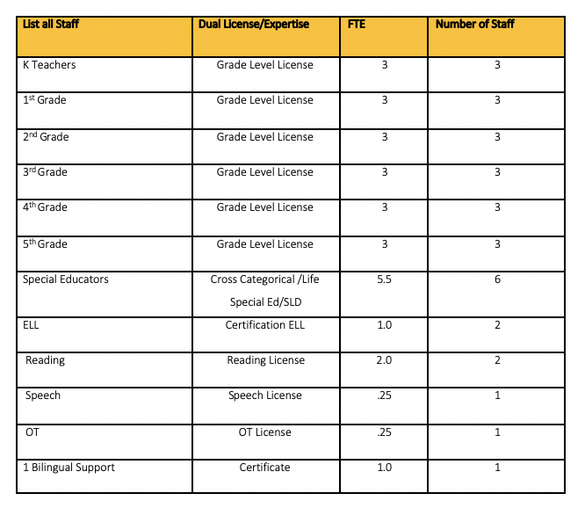

Slide 11
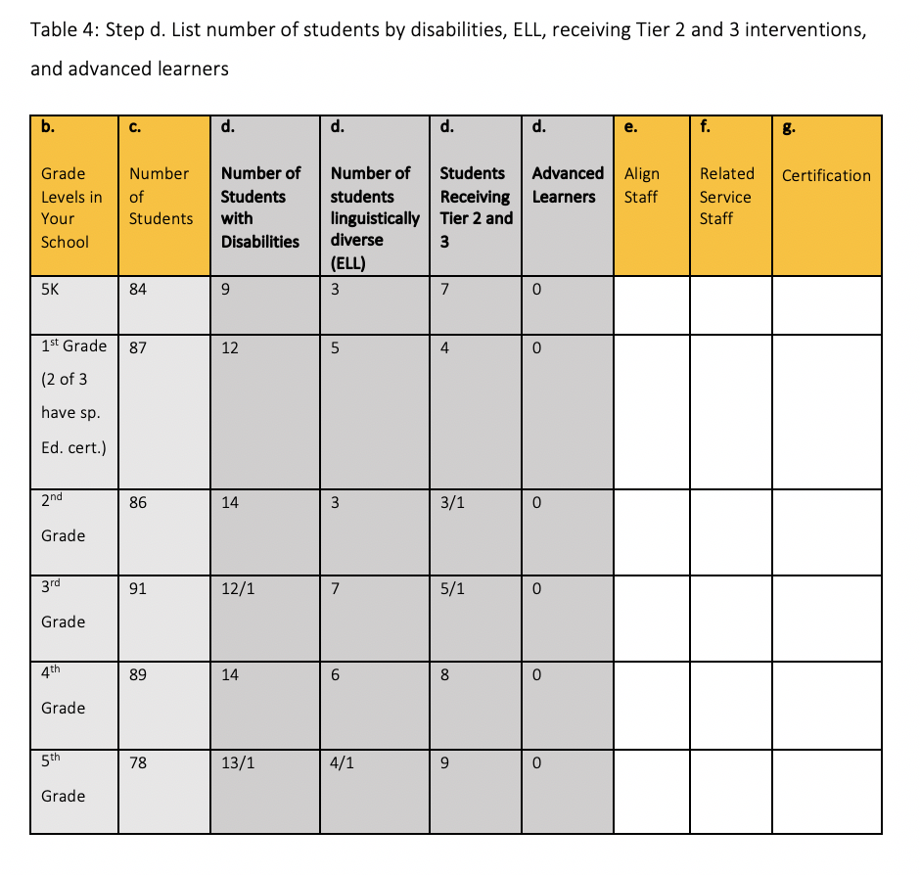
Re-Align All Staff for Elementary Example

Slide 12
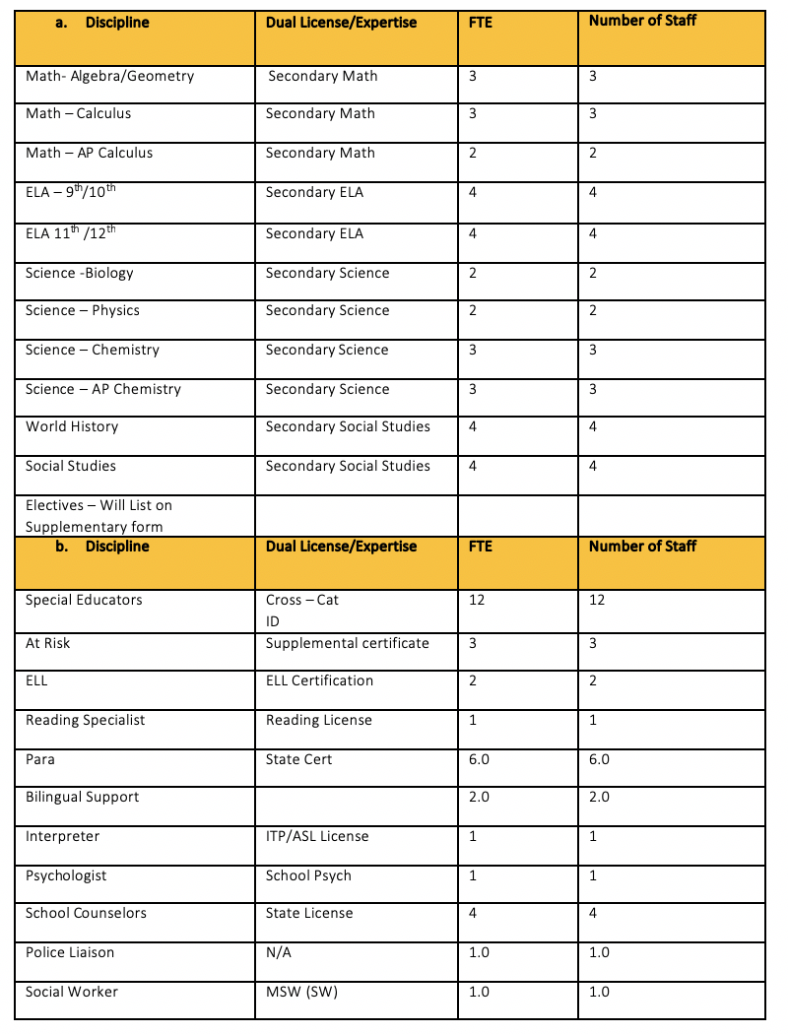

Slide 14
Stages and Steps the School Leadership Teams Work through to Re-Imagine and Intentionally Create C3 Teams for Elementary and Middle School
Stage 3: Creating of Co-Plan to Co-Serve to Co-Learn Teams (C3) by Grade Level
Step a. Identify the grade level that C3 Teams will be created
Step b. List the staff that will be aligned to each team
Step c. Summarize the creation of the Co-Plan to Co-Serve to Co-Learn (C3) Teams
Stage 4: Creating Proportional Representation in Tier 1/Every Classroom
Step a: Design a plan for proportional representation of all students in the core of teaching and learning

Slide 15
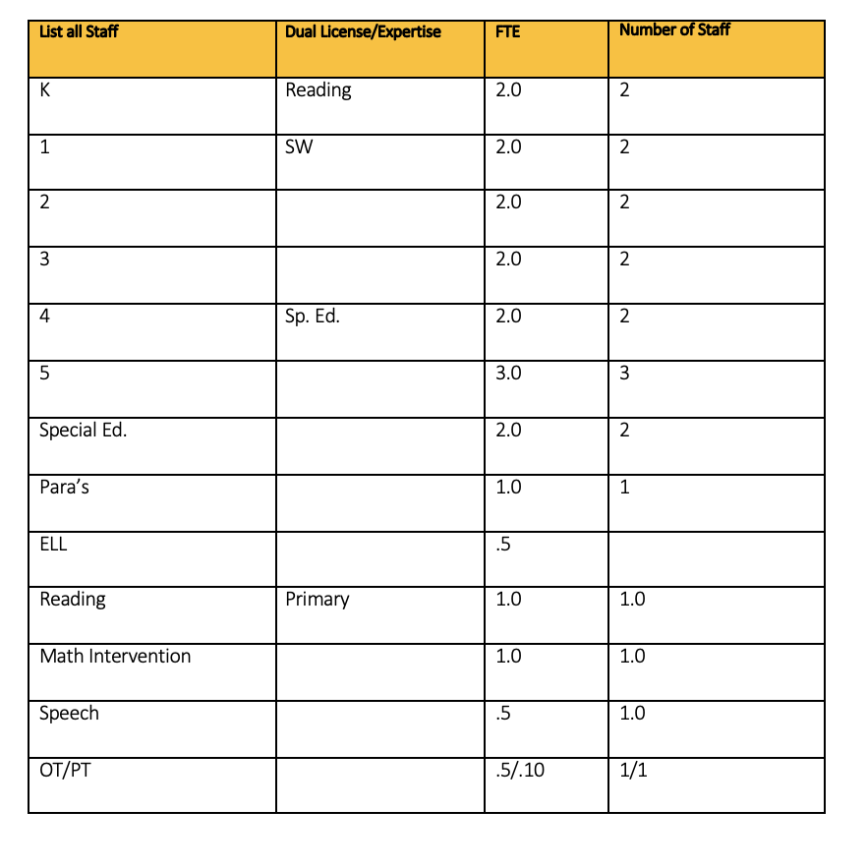

Slide 16
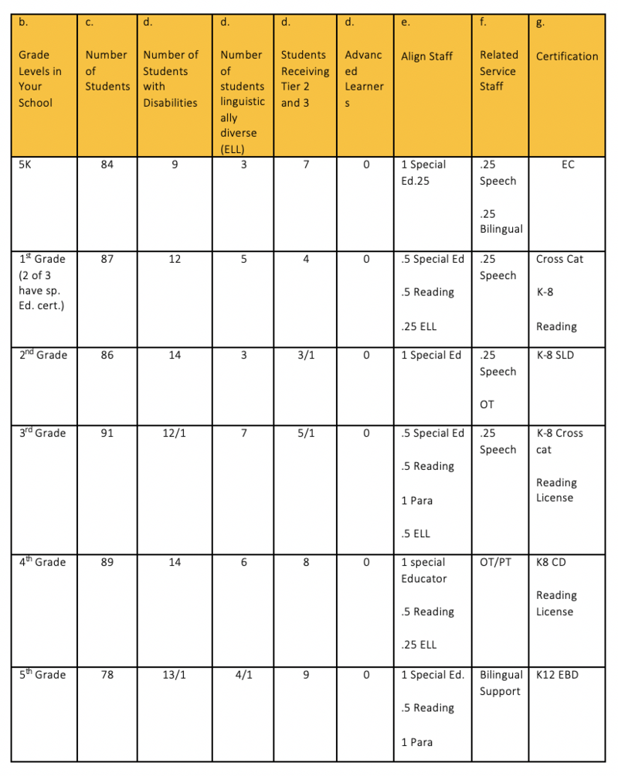

Slide 17
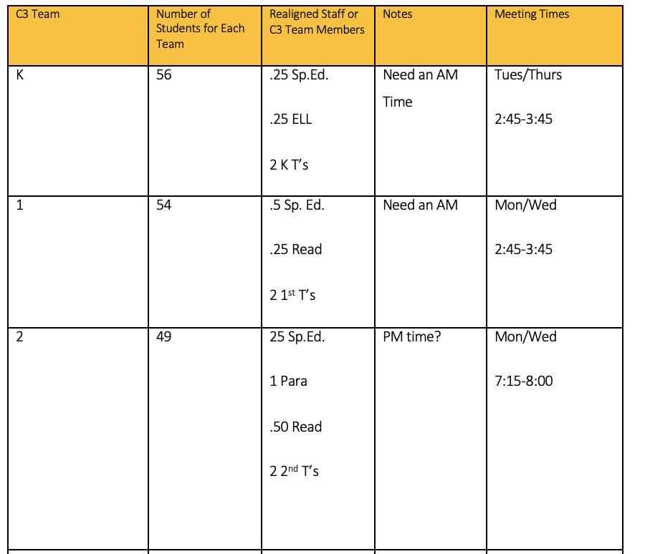

Slide 18
Re-Align All Staff for Elementary Example

Slide 19
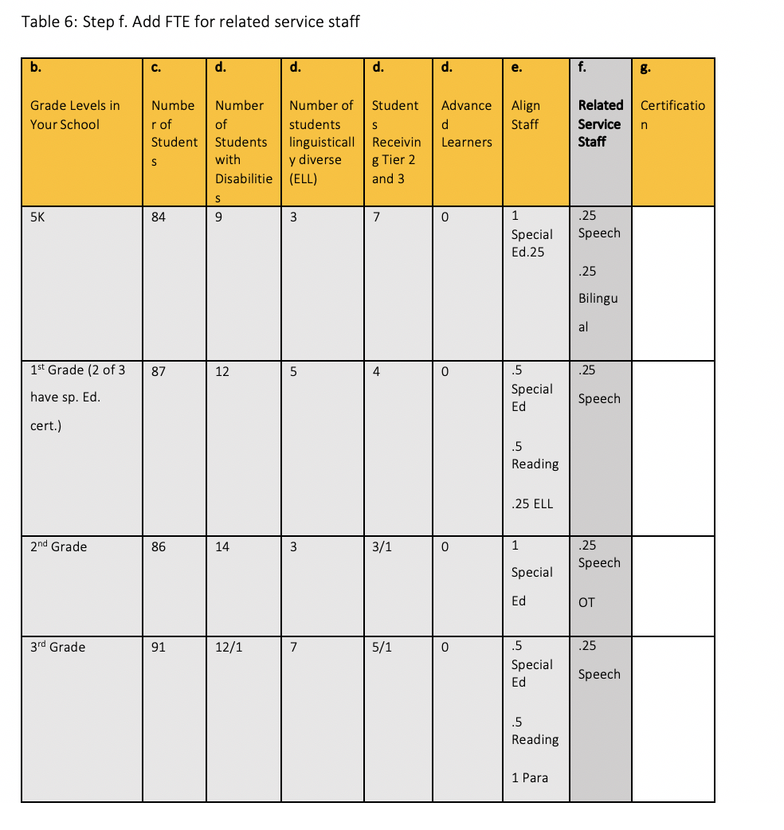
Re-Align All Staff for Elementary Example

Slide 20
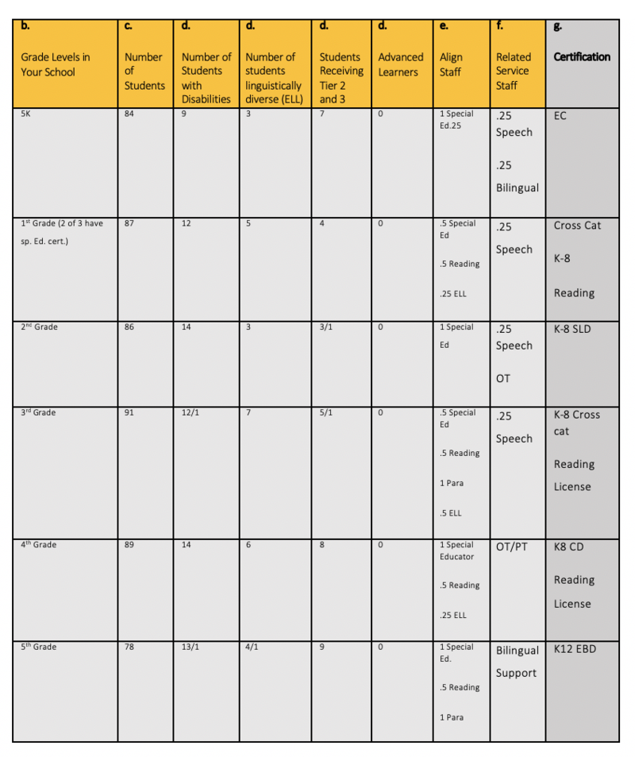

Slide 23
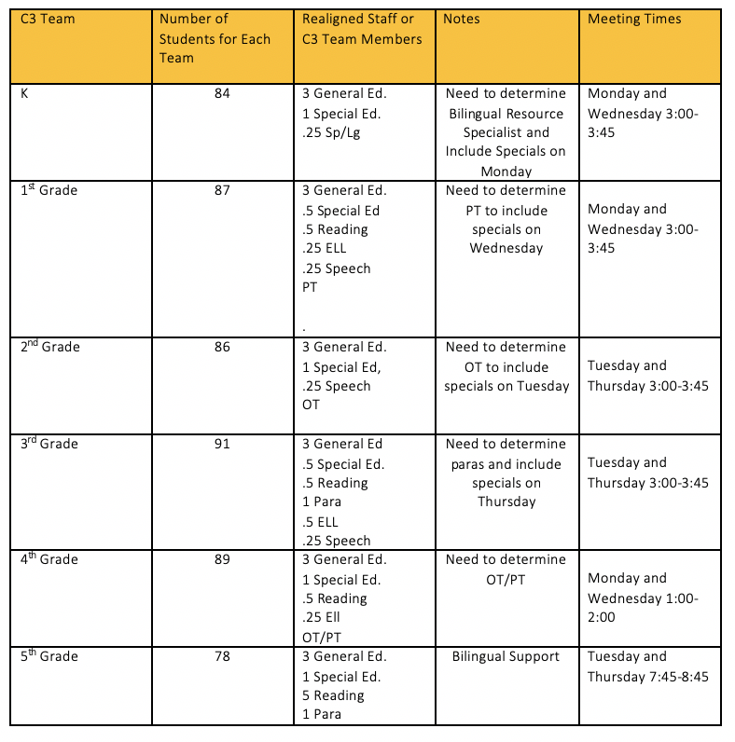

Slide 24
Stages and Steps the School Leadership Teams Work through to Re-Imagine and Intentionally Create C3 teams for High School and Junior High
Stage 4: Creating of Co-Plan to Co-Serve to Co-Learn Teams (C3) by Grade Level and Content Areas
Step a. Identify the grade level and content areas that C3 Teams will be created
Step b. List the number of sections and content teachers for each subject at the grade level
Step c. List the staff that will be aligned to each team
Step d. Summarize the creation of the Co-Plan to Co-Serve to Co-Learn (C3) Teams
Stage 5: Creating Proportional Representation in Tier 1/Every Classroom
Step a: Design a plan for proportional representation of all students in the core of teaching and learning

Slide 25
Stages and Steps the School Leadership Teams Work through to Re-Imagine and Intentionally Create C3 teams for High School and Junior High
Summary of Stages/Steps for Junior High/School C3 Teams:
Stage 1: Develop a Level-Up Plan
Stage 2: List Staff and Certification
Step a: List all staff in the school (often 3 different tables for content specialist, support specialist and elective specialist)
Stage 3: List Student Demographic Data
Step b: List the number of students in each grade level
Step c: List number of students by disabilities
Step d: List number of students who are ELL
Step e: List number of special educators per grade level, at risk teachers, ELL, reading specialist, para-professionals, bilingual support staff and interpreters.

Slide 26
Discuss: What is Leveling Up?
Leveling up is the process of de-tracking specific courses that are designed to offer less rigor and remediation for homogeneous groups of students or non proportionally represented.

Slide 27
Secondary and Leveling Up
To complete a Leveling Up analysis, follow the following steps:
Pick one grade level
Pick one content area
Write this year in the second yellow column followed by the next 4 academic years
Delineate the number of students projected for each year
List the courses that are leveled from most rigorous to least for the specific content area
List the number of sections and number of students for the current year for each level of the content area
Level up – by taking a lower level course and merging it with the sections that are more rigorous

Slide 30
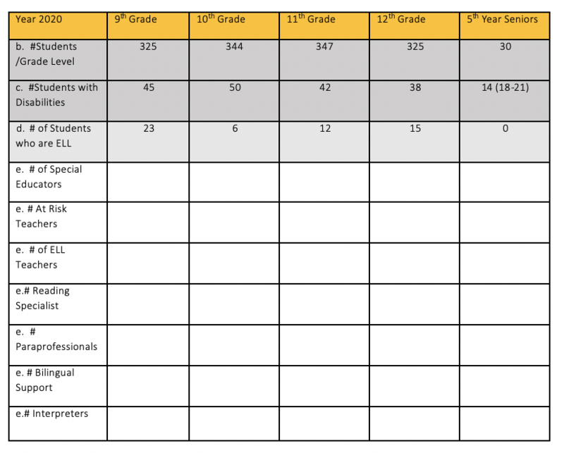

Slide 33
Team Time

Slide 34
The Alignment of C3 Teams
Created by the School Leadership Team (practice realignment as often as possible)
Year 2 of Implementation – share out Modules 7-12 –At that time the SLT is sharing out examples of C3 Teams from your practice charts. You are not teaching staff how to create C3 teams.
C3 Teams are created during the Spring of every year.
C3 Teams need to know the work in Modules 8 and 9 before they are asked to function as C3 Teams and students are proportionally represented.
At the secondary level we are creating C3 Teams for the leveled up courses.

Slide 35
