Slide 1
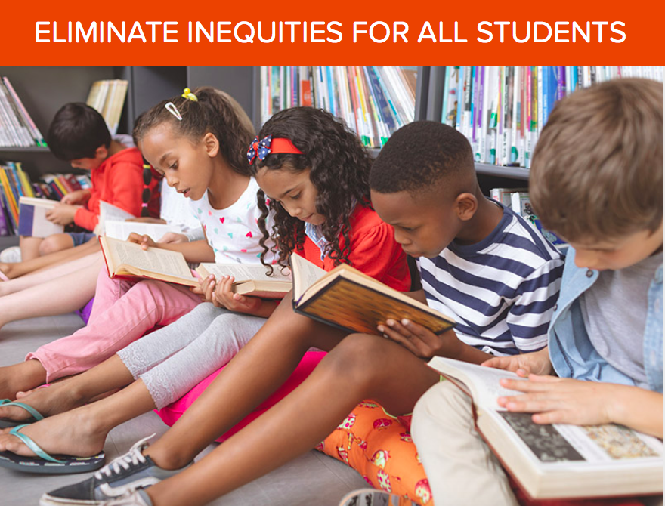
School Digital Module 1/Step 1: History of Educational Marginalization
DR. ELISE M. FRATTURA (she/her/hers)
DR. COLLEEN A. CAPPER (she/her/hers)

Slide 2
4 Agreements of Courageous Conversations (Singleton, 2022)
Experience discomfort
Stay engaged
Speak your truth
Expect and accept non- closure

Slide 3
Community Agreements (Continued)
No blame, shame, judgment.
Equity work life-long, never ending, at individual & organizational level.
“Collective Equity Capacity” we are in this with you - mutual learning, challenging, growing together.

Slide 4
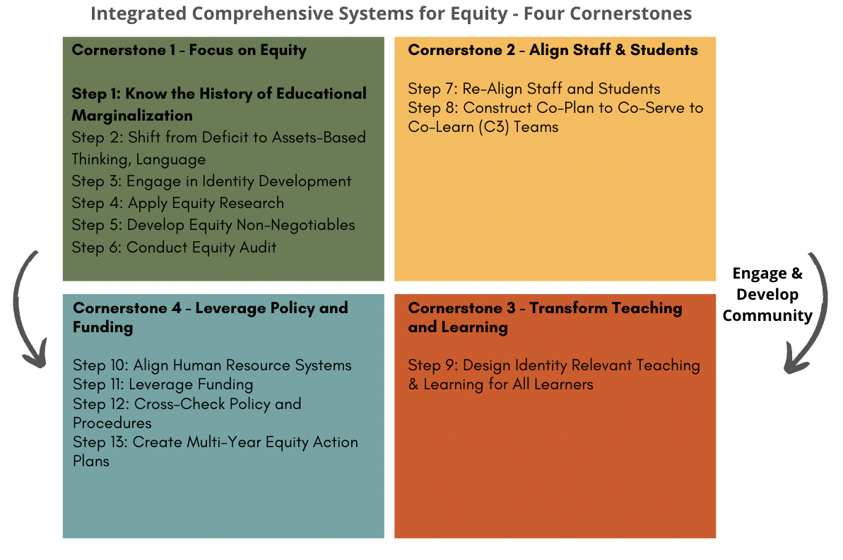

Slide 5
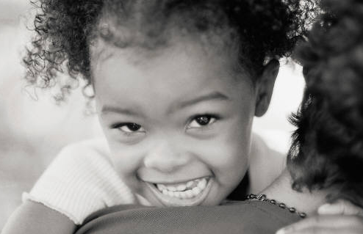
The Reality Persistent Inequities
Schools have a culture of Marginalization.
Race
Disability
Language
Social class
Religion
Gender
Sexual/Gender Identity
And their intersections

Slide 6
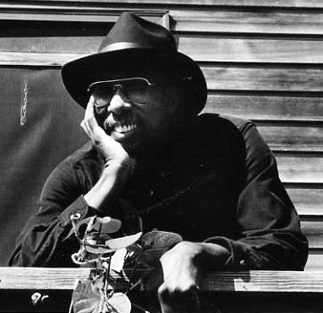
ICS Equity Step 1: History of Marginalization and Current Educational Structures Stepping Back to Move Forward
“History is not just facts and events.
History is also a pain in the heart
and we repeat history until we are able
to make another's pain in the heart our own.”
Julius Lester, Author, Poet Musician
(1939-2018)
Professor Emeritus
University of Massachusetts

Slide 7
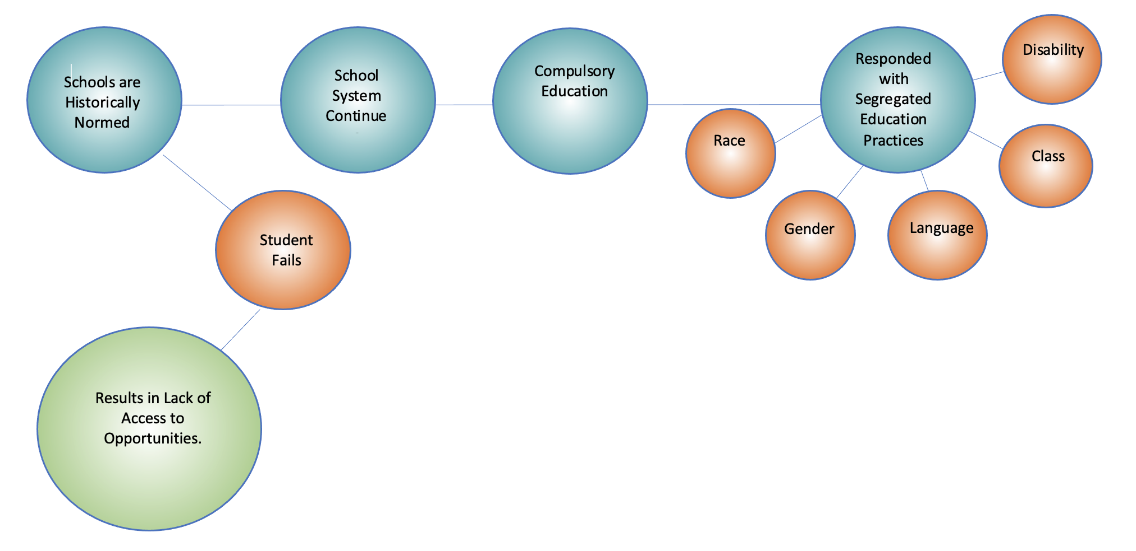
History of Educational Marginalization Mid 1600’s to Mid 1900’s

Slide 8
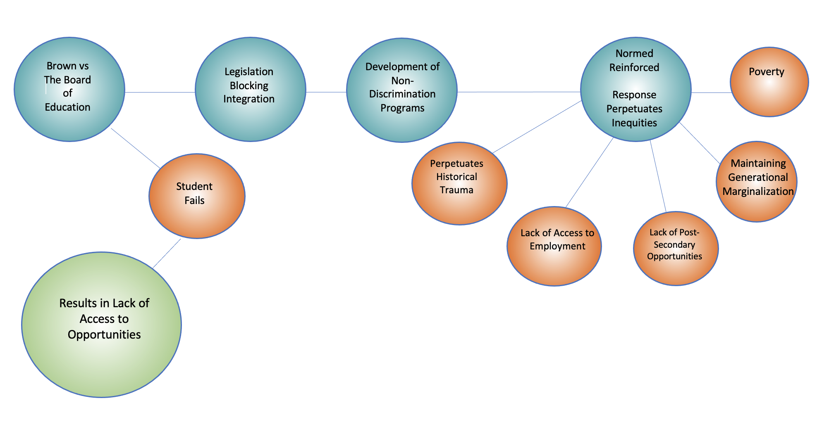
History of Educational Marginalization 1950’s to Present

Slide 9
James Baldwin
An invented past can never be used; it cracks and crumbles under the pressures of life like clay in a season of drought”
(1963)

Slide 10
Two Consistent Factors Over 400 Years, Creates and Maintains Institutional Marginalization
See the student as needing to be fixed
Respond through segregated practices
When we reinforce or develop such practices, we become complicit in institutional marginalization.

Slide 11
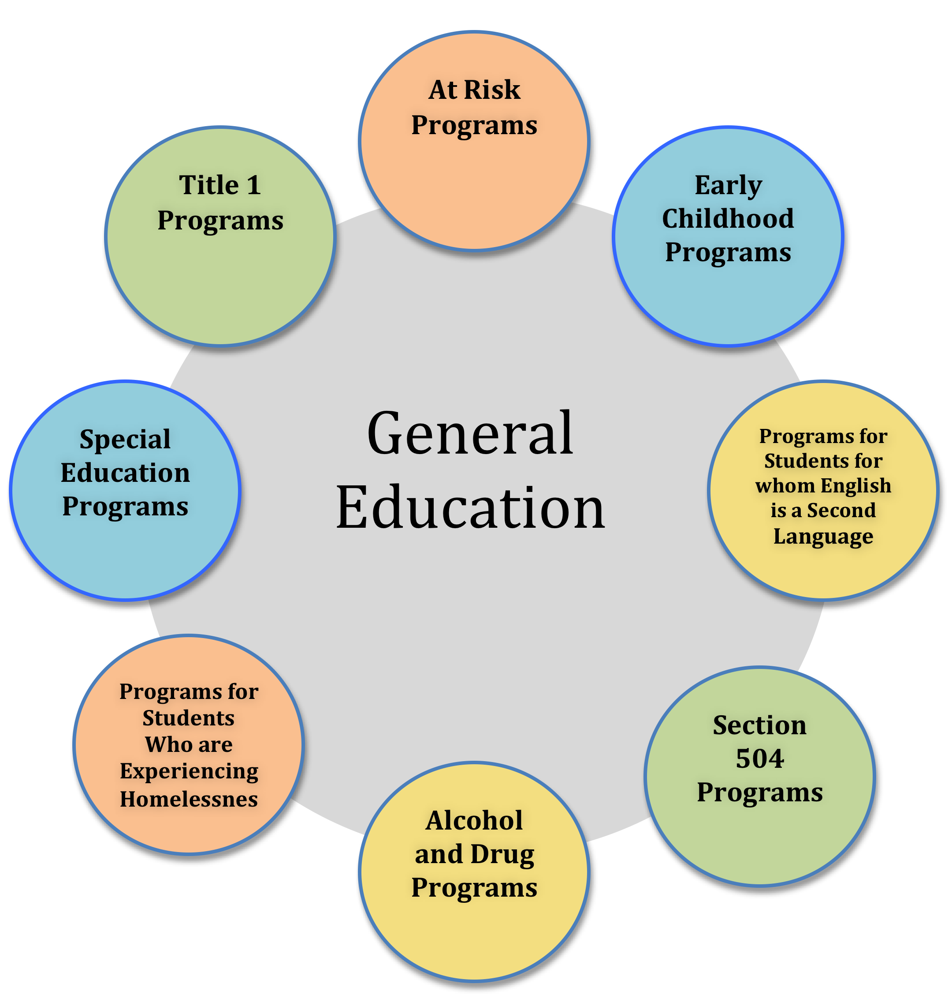
… We have created a Deficit-Based System.

Slide 12
What Our History Has Taught Us
The expectation was and remains: Assimilation to a Normative.
Setting in motion a deficit-based educational system, from higher education teacher education programs to K-12 schools, that perpetuates the gaps in achievement within the areas of:
race
poverty
(dis)ability
linguistically diverse
gender and their intersections

Slide 13
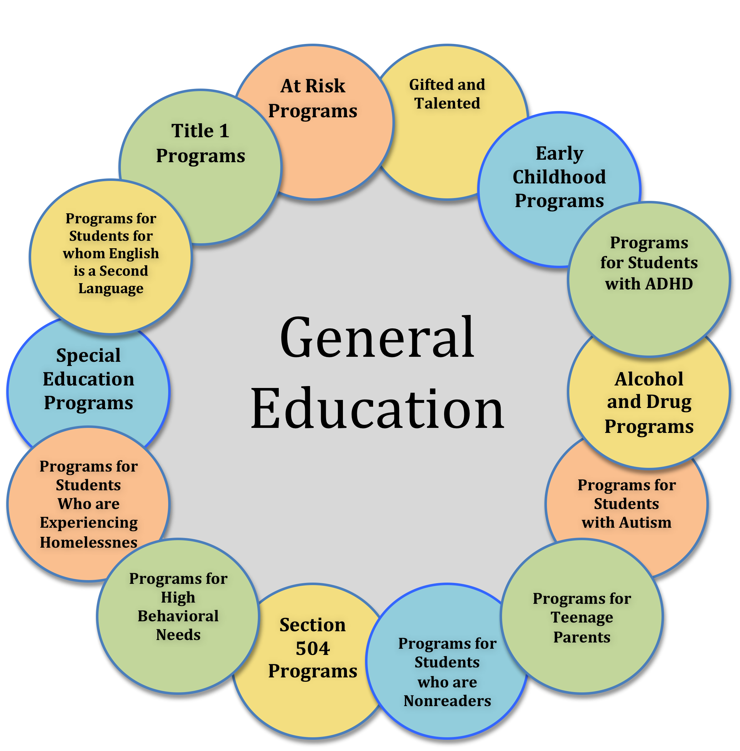
Maintaining a Normed Group of Students

Slide 14
TIERS
Special
Education
5%-10%
3
Targeted Interventions
20%
2
School-Wide Interventions
80%
1

Slide 15
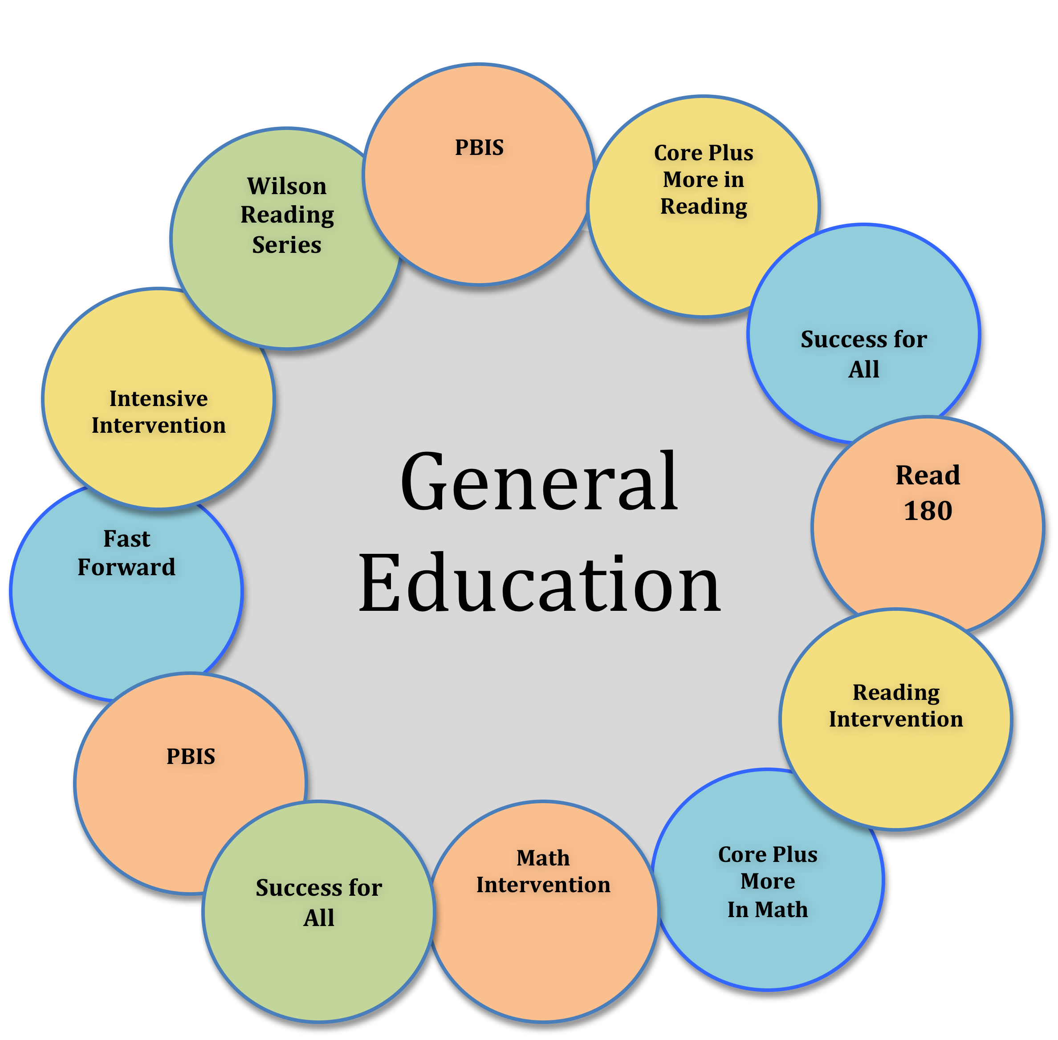
Create More Programs Under RtI

Slide 16
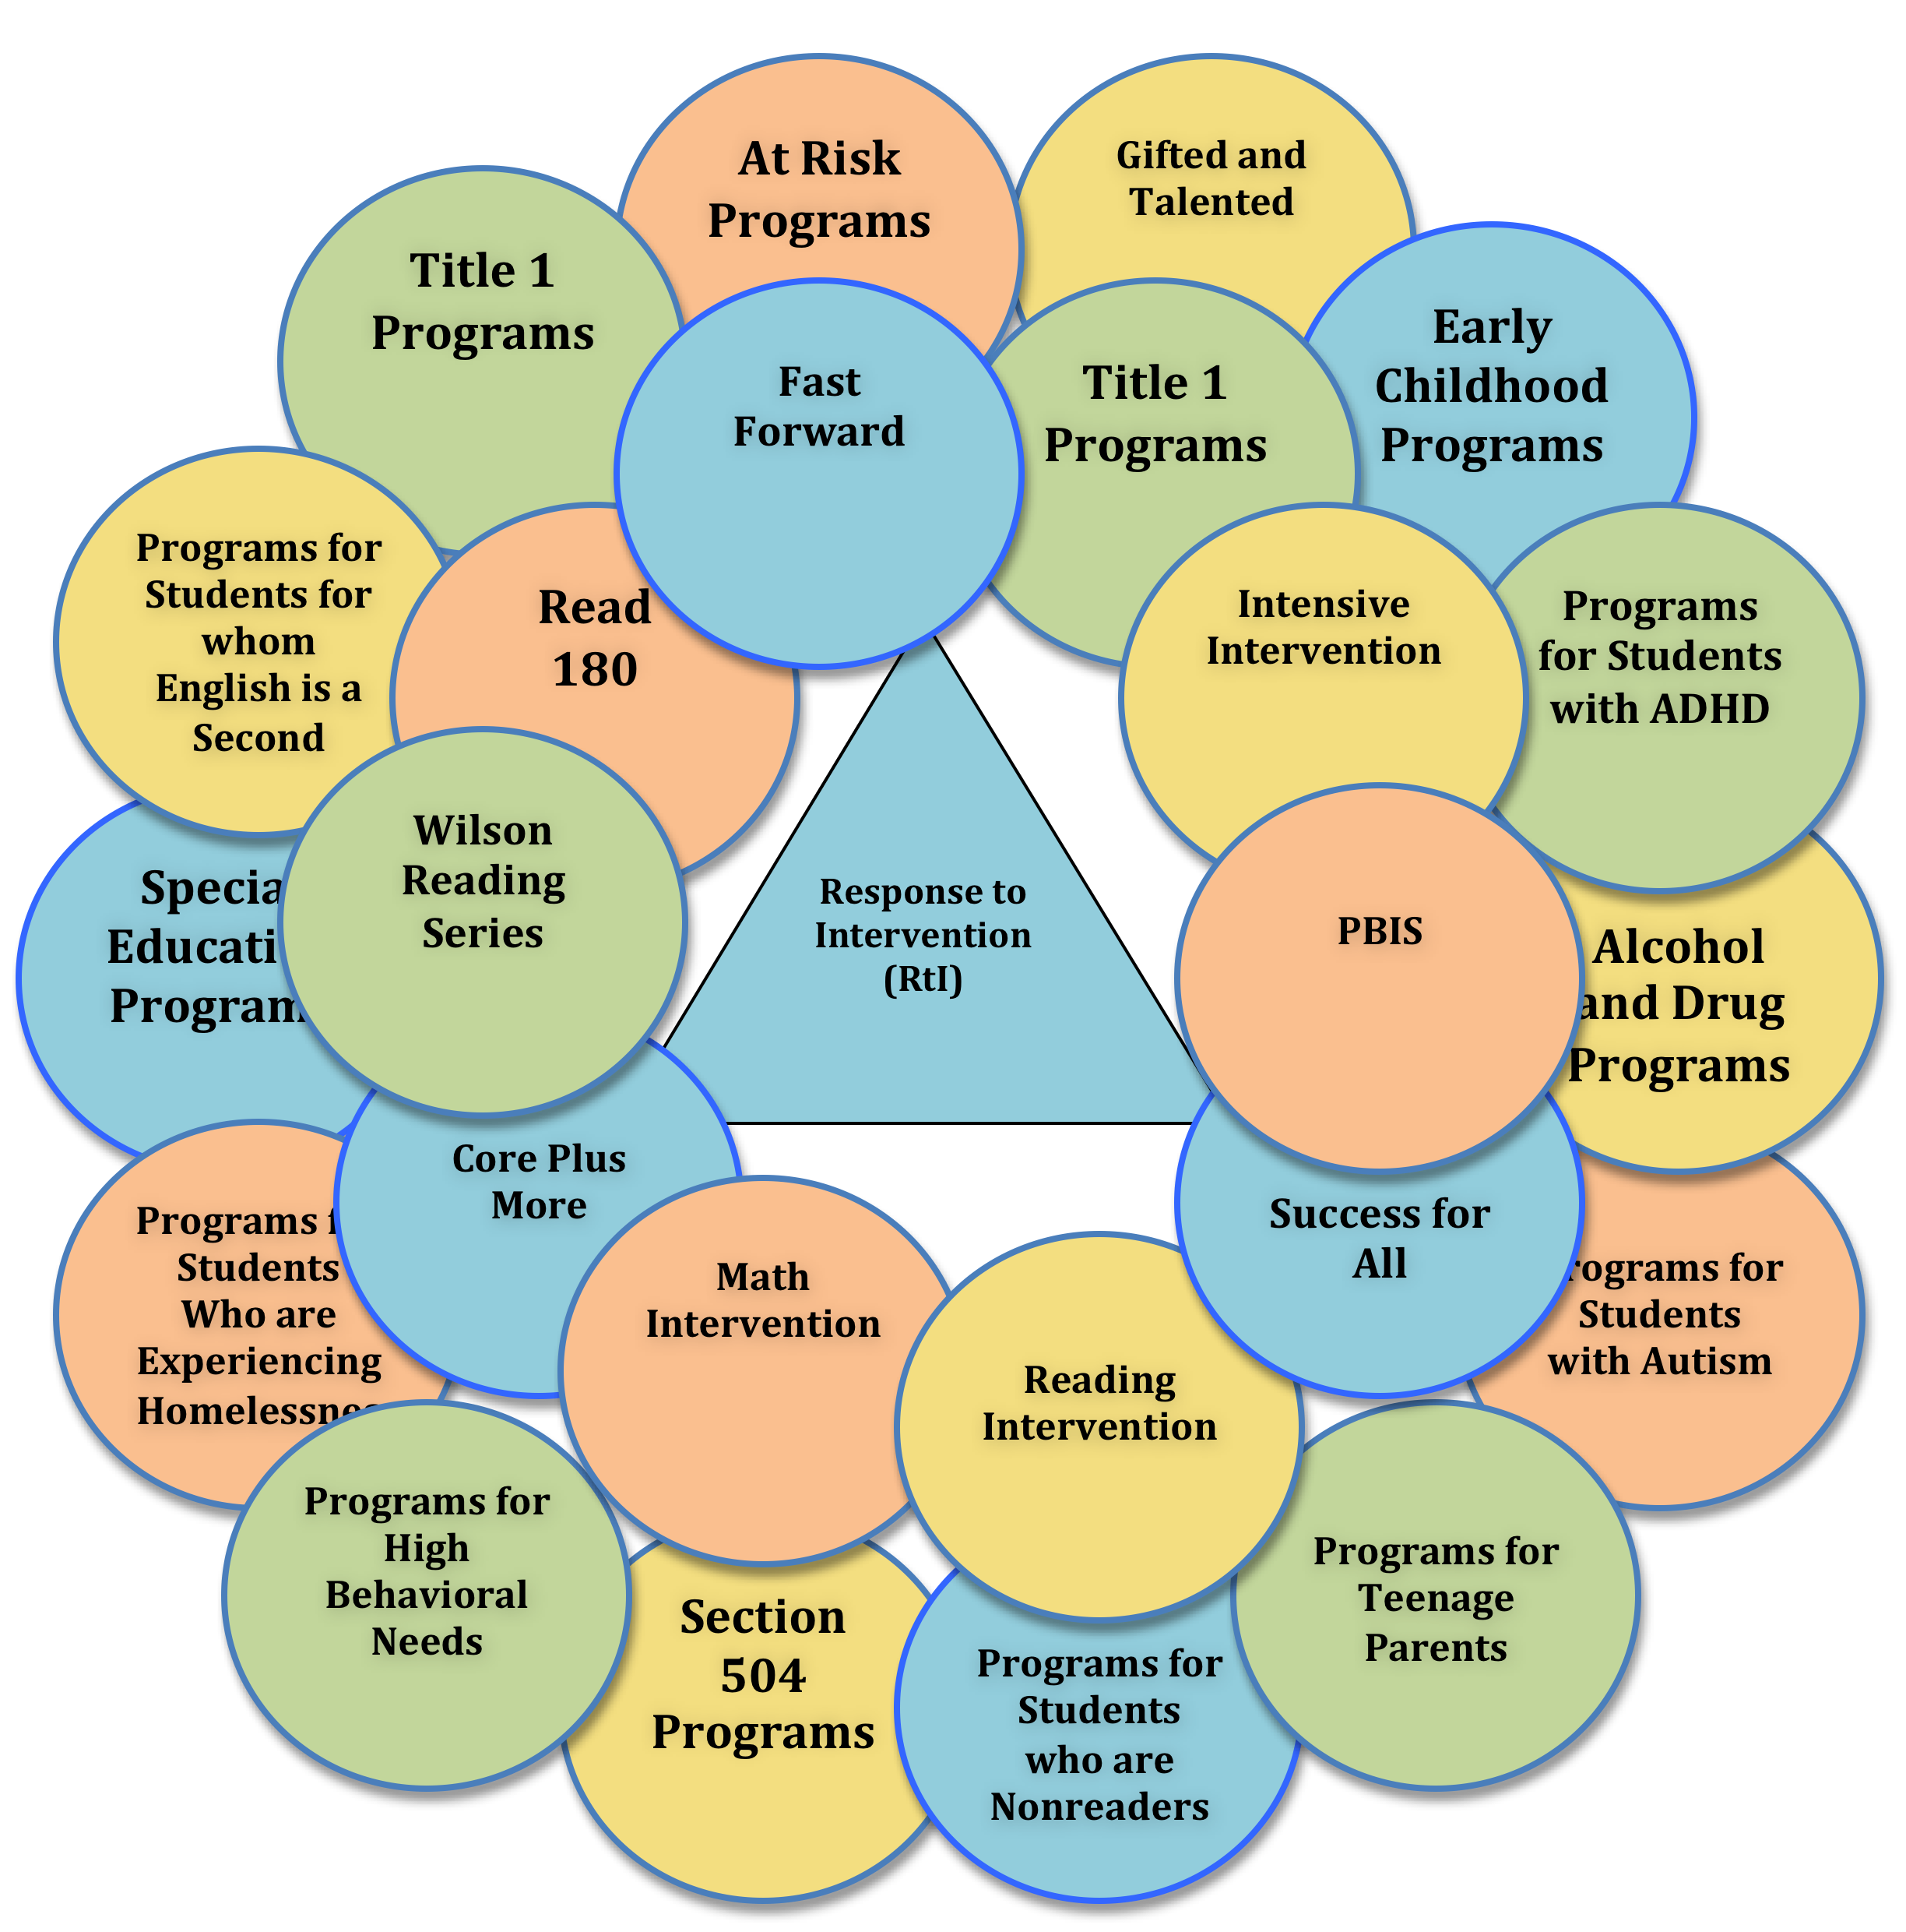

Slide 17
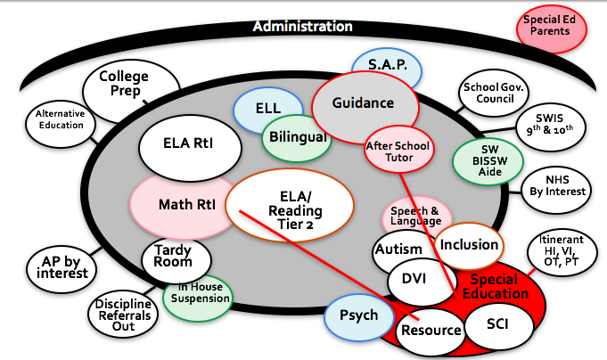
Sample High School Current
Educational Structure

Slide 18
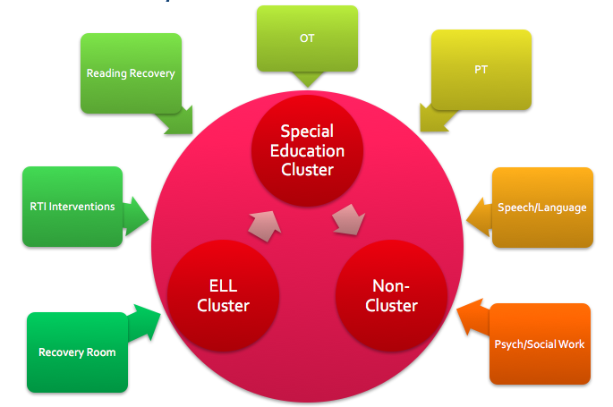
Current “Inclusive” Service Delivery - Elementary

Slide 19
School and District Leadership Teams Step 1 – Draw Educational School Structures
a.) A graphical representation of the “normed” group of students (those students who are receiving the most comprehensive education within Tier 1).
b.) Write down any programs/practices you have that represent unnatural proportions of students clustered for outside of general education (detailed special education practices, Tier 2/3, advanced learning, etc.).
c.) Add any ability grouping or other clustering within general education that is not naturally proportioned through curriculum or leveled courses.
d.) Add District Wide Supported Segregated Practices and Programs
1. Out of District Tuition Placements (Alternative, Disability, Gifted, etc.)
2. Segregated Schools (Alternative, Disability, Gifted, etc.)
3. Clustering Programs in Non-Home Schools Resource Rooms (Alternative, Disability, Gifted, etc.)

Slide 20
School and District Leadership Teams Step 1 – Draw Educational School Structures (Continued)
Second, on your structure place a “+” for what is proactive and a “-” for what is reactive about your current educational structure:
a.) Proactive “+” (anything in Tier 1 – first time skill or concept is taught)
b.) Reactive “-” (anything outside of Tier 1 – reacting to Tier 1 normative)

Slide 21
School and District Leadership Teams Step 1 – Draw Educational School Structures (Continued)
Third, on a separate Word Document – (use Google shared documents)
- List the problems or challenges with the current educational structure that you just drew on the paper through the lens of a student and then staff.

Slide 22
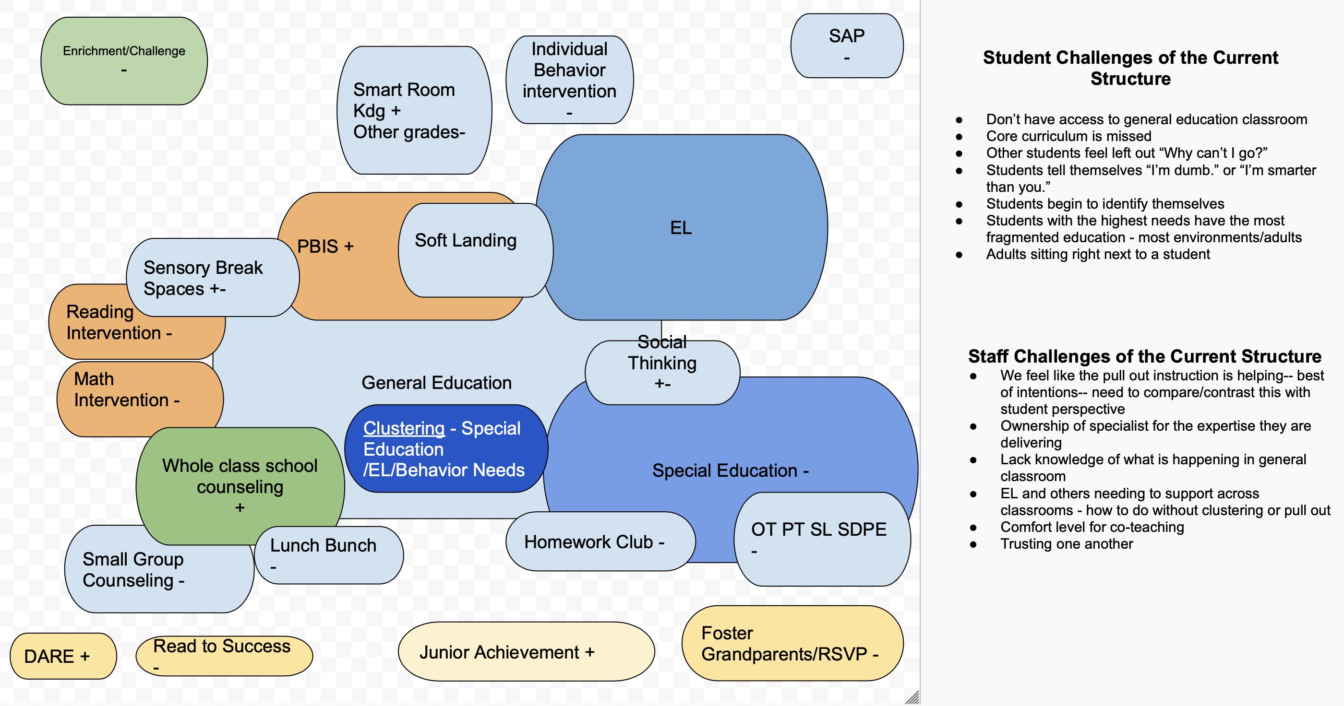

Slide 23
Summary During Group Time
1. Draw your current structure.
2. Determine what is proactive and reactive.
3. List the challenges of your structure for students and then staff.

Slide 24
Where Students Learn Matters
Students who are pulled-out, ability grouped, or segregated from other students for instruction are taught that they do not belong.
Students who remain are taught:
who belongs and who does not.
who is capable and who is not.

Slide 25
Elementary Classroom - Disrupted by Pullout (Theoharis, 2007)
S&L
OT
PT
Reading
ESL
Sp Ed
Sp Ed
Classroom Teacher
W
W
AA
W
AA
W
W
W
AA
AA
W
AA
AA
W
AS
AS
W
L
W
L
W
W

Slide 26
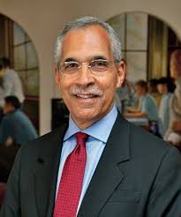
Perceptions Matter
Stereotype threat – lowers performance when their marginalized identity is reinforced, and cues can harm performance
Stereotype lift – increases performance when others are informed of a negative stereotype of another group
Stereotype lift and threat occurs every day in every school perpetuating societal marginalization…
(Steele & Aronson, 1994)

Slide 27
Claude Steele: Stereotype Threat
https://www.youtube.com/watch?v=failylROnrY

Slide 28
When have you experienced a Stereotype Threat or Lift?
In your small group, think about the question above and then if you feel comfortable share about when you experienced a Stereotype Threat or Lift.
If you experienced a Stereotype Threat or Lift:
What was the setting?
Why did it occur?
Who experienced the Stereotype threat or lift?

Slide 29
Our Educational Structures and Stereotype Threat/Lift
Review the current educational structure of your district that you drew.
Where in your current educational structure, do students experience a stereotype threat?
Where in your current education structure do students experience a stereotype lift?

Slide 30
What Our Educational History Has Taught Us
Such practices blame and label the students and provides less rigor by isolating students through the ineffective practice of grouping by ability and limiting access to high quality instruction.
Some students receive support – while others are denied.

Slide 31
What We Now Know
Students who leave the general education classroom receive the most fragmented, least cohesive education.
Students with the most needs, are expected to synthesize information across the the most adults and most environments.
Limits transfer of both educator and student knowledge back to the core of teaching and learning

Slide 32
Return to Your Team’s List of Challenges:
Add any challenges?

Slide 33
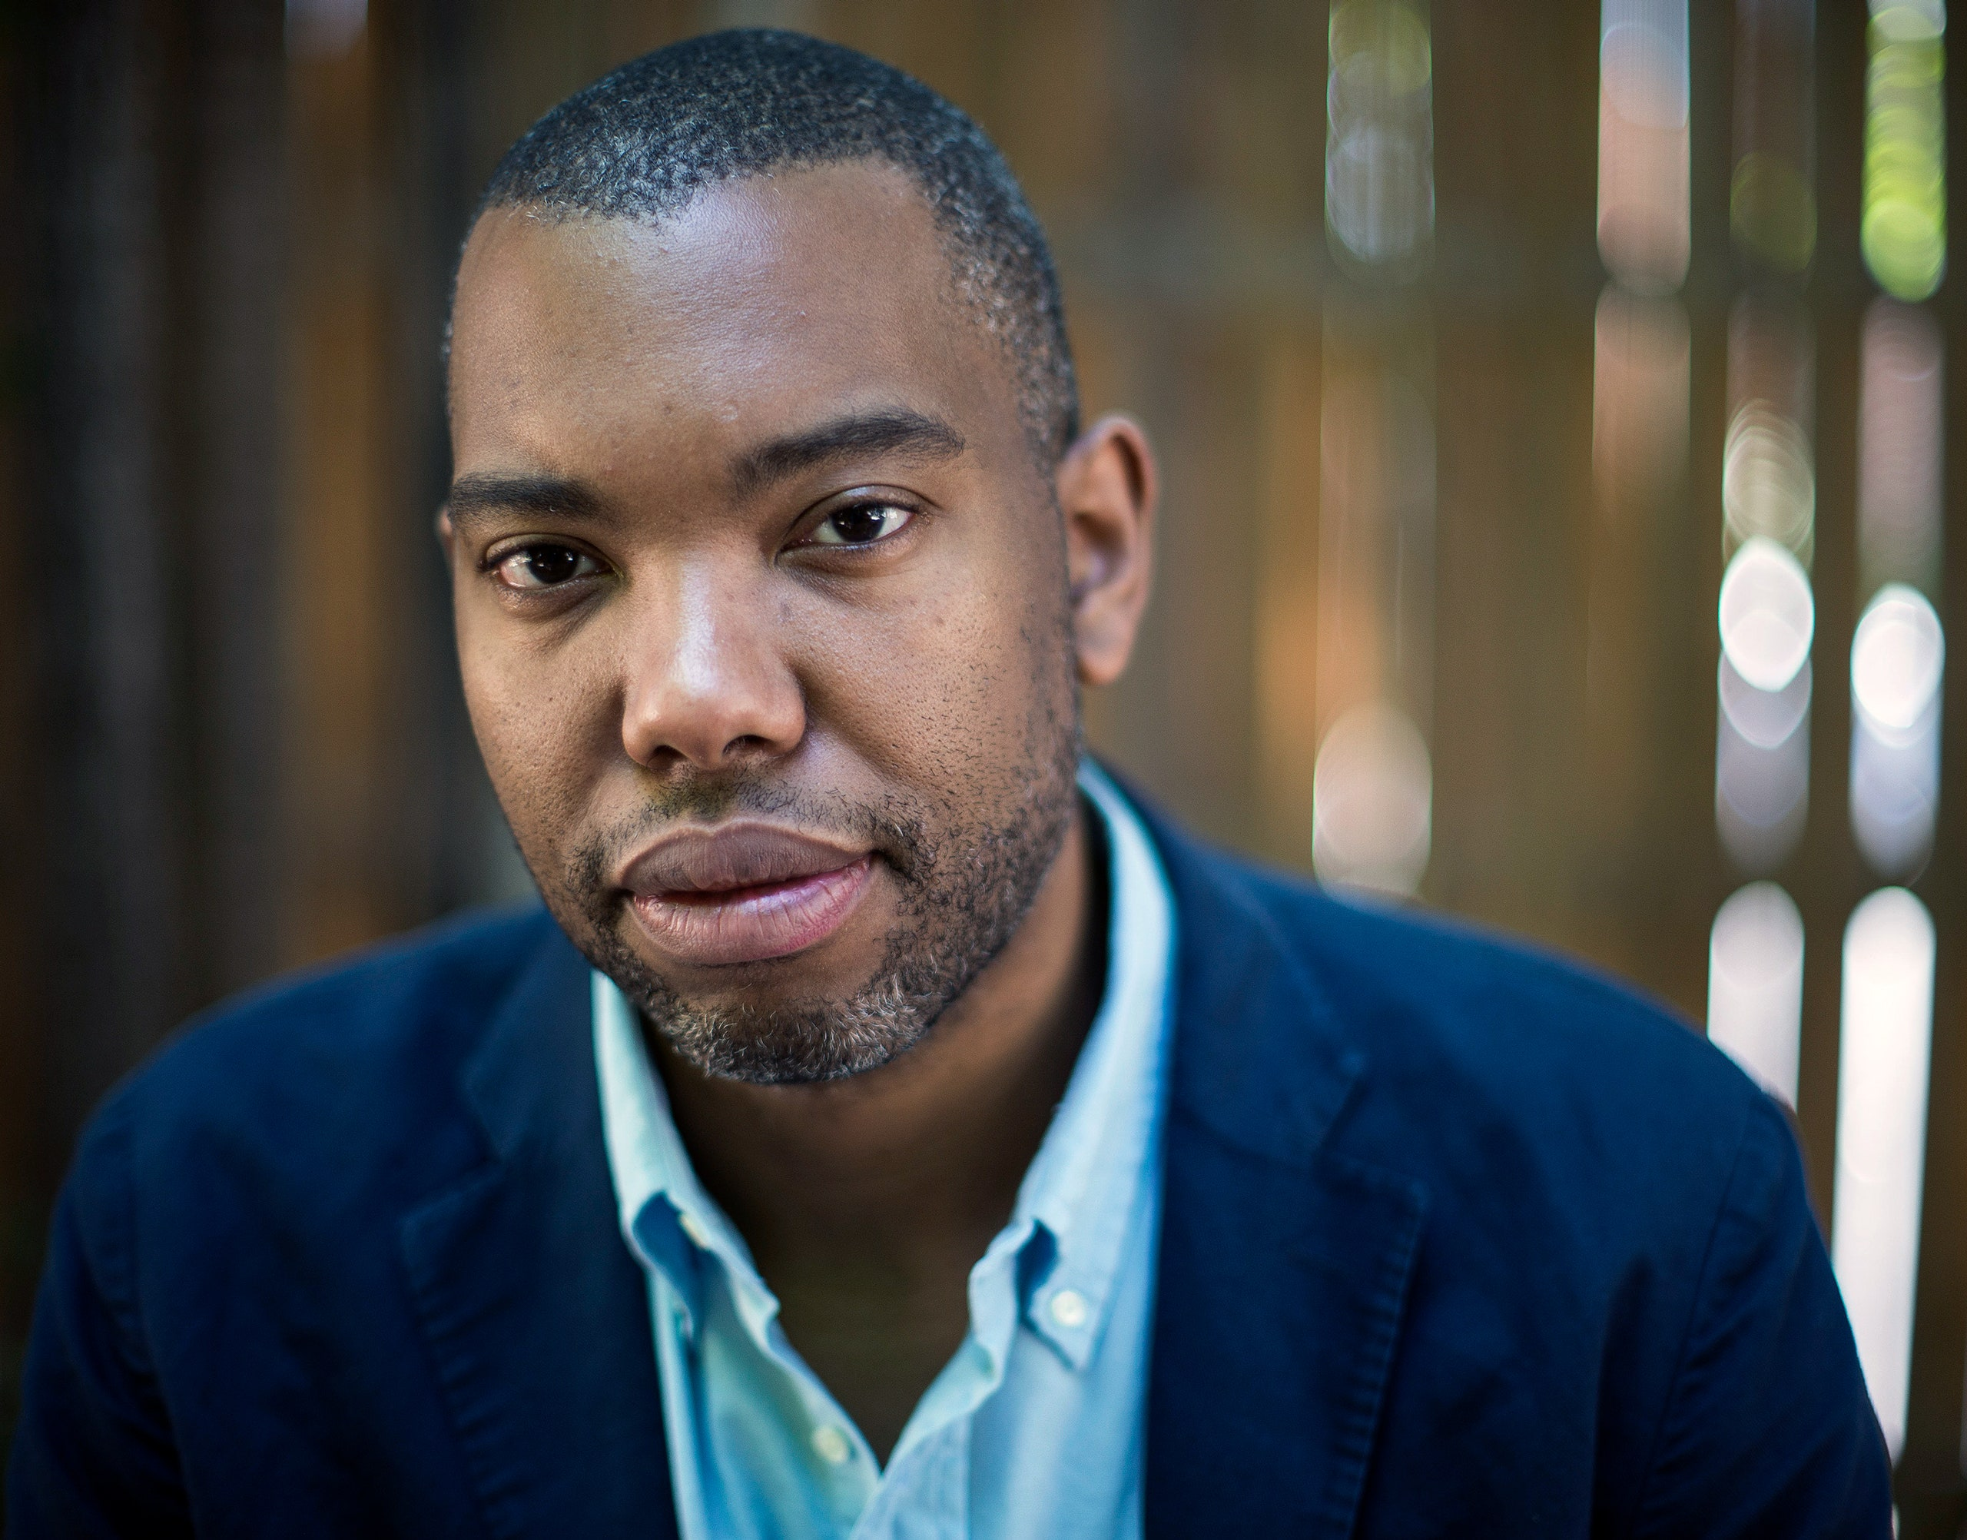
“Good intention…
… is a hall pass through history, a sleeping pill that ensures the Dream.”
Ta-Nehisi Coates, 2015
The dream… cannot be of assimilation.

Slide 34
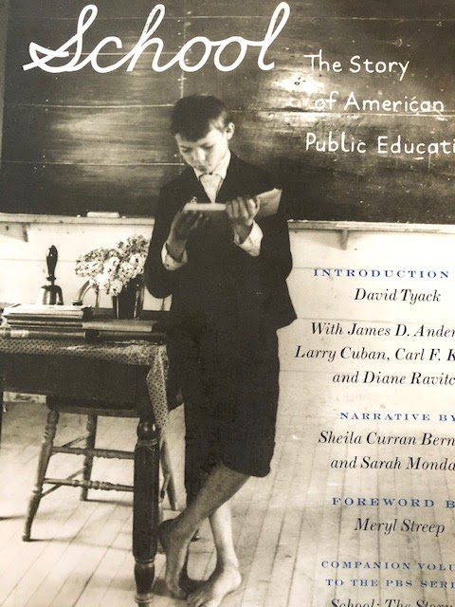
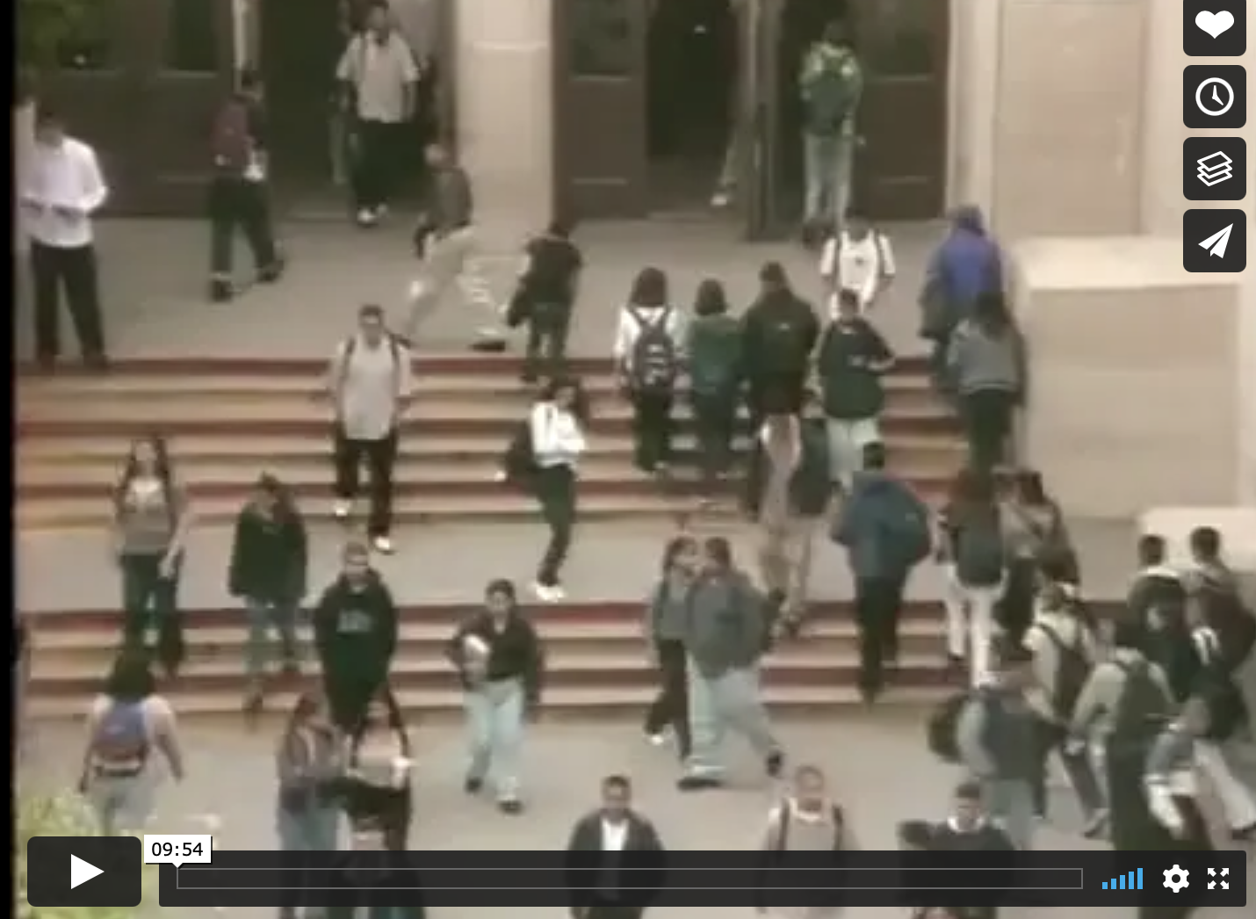
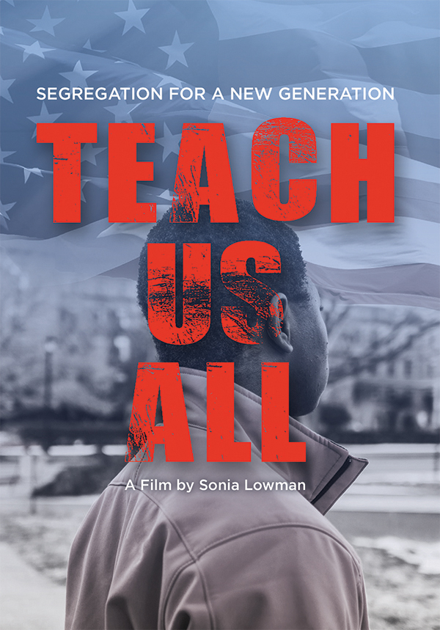
Books/Videos About the History to Read/Watch
https://vimeo.com/278549110
https://podcasts.apple.com/us/podcast/miss-buchanans-period-of-adjustment/id1119389968?i=1000389334608

Slide 35
Jeffery Robinson
Jeffery Robinson has been a criminal defense attorney for over 30 years. In addition to his work at the ACLU, Jeff is trying to teach our true history in this country. He speaks on issues of race and is working on a documentary entitled "Who We Are: A Chronicle of Racism in America." Jeff is a faculty member of the National Criminal Defense College. He is a past President of the Washington Association of Criminal Defense Lawyers and a winner of that Association’s prestigious William O. Douglas Award. In addition to being a nationally recognized trial attorney, Jeff is a respected teacher of trial advocacy and has lectured on trial skills all over the United States.
https://thewhoweareproject.org/
https://thewhoweareproject.org/

Slide 37
Thank you for your commitment to equity!
FEEDBACK CARDS
1. What resonated with you?
2. What gives you pause?

