Slide 1
School Digital Module 10/Step 10: Align Human Resource Systems
DR. ELISE M. FRATTURA (she/her/hers)
DR. COLLEEN A. CAPPER (she/her/hers)

Slide 2
4 Agreements of Courageous Conversations (Singleton, 2022)
Experience discomfort
Stay engaged
Speak your truth
Expect and accept non-closure

Slide 3
Community Agreements (Continued)
No blame, shame, judgment.
Equity work life-long, never ending, at individual & organizational level.
“Collective Equity Capacity” we are in this with you - mutual learning, challenging, growing together.

Slide 4
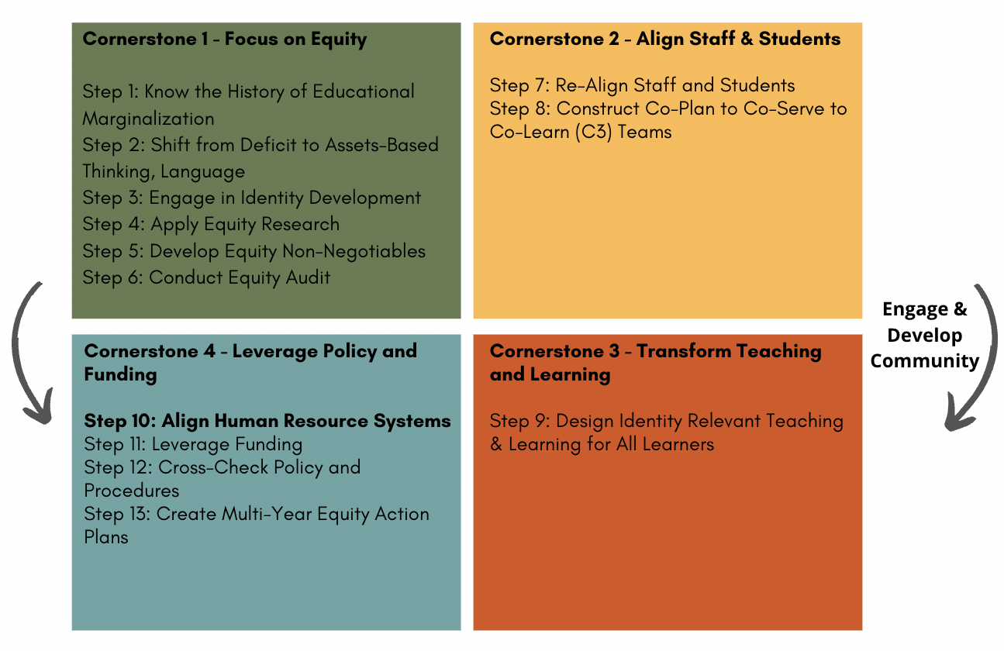

Slide 5
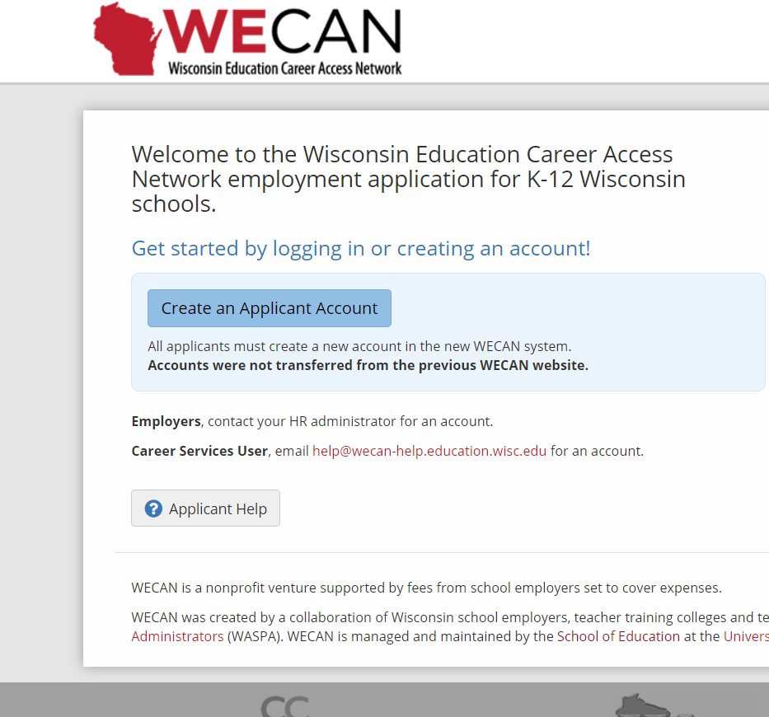
ICS Equity Digital Module 10/Step 10 –
Align Human Resource Systems
Align HR to Equity Non-Negotiables
- Position Description
- Search Team
- Interview Questions
- Evaluation System

Slide 6
ICS Equity Digital Module 10/Step 10 – Align Human Resource Systems
Professional Learning BEGINS at posting the position.

Slide 7
ICS Equity Digital Module 10/Step 10 – Align Human Resource Systems
Professional Learning BEGINS at posting the position.
Conveys -
How serious is the district about advancing equity?
Sets District Apart
Will increase diverse & equity capable applicant pool.

Slide 8
ICS Equity Digital Module 10/Step 10 – Align Human Resource Systems
Generic Statements Alone are Not Enough:
e.g., “We are committed to equity.” “We are committed to the learning of all students.”
Operationalize what you mean for “equity” in screening/interview questions based on the equity non-negotiables

Slide 9
Sample Screening/Interview Questions Aligned to Equity Non-Negotiables
1. Describe to what extent students were ability grouped pulled out, or tracked at your previous district and the challenge to that? (previous experience) or What are the challenges when students are ability grouped, pulled out, or tracked? (new to the profession) (Digital Module 1/Step 1)
2. Describe the assets of a student you have taught and their family who were experiencing poverty?(Digital Module 2/Step 2)
3. Describe the identity development work you have engaged in. (Digital Module 3/Step 3)

Slide 10
Sample Screening/Interview Questions Aligned to Equity Non-Negotiables
4. In our district, we are working to educate students in proportionally represented, heterogeneous environments. We are working to eliminate tracking, ability grouping, and programs that pull students out of the classroom. In your classroom, you will have students who are performing several grade levels above and students with significant intellectual disabilities, and across races, social classes, and language levels. How have you or how will you design lessons for this range of students? (Digital Modules/Steps 5, 6, 9, 10, 11, 12)

Slide 11
Sample Screening/Interview Questions Aligned to Equity Non-Negotiables
5. In our district, teachers work in co-plan to co-serve to co-learn teams to develop identity relevant and rigorous lessons for the heterogeneous classrooms they teach. These teams are designed to build the capacity of all staff in the school to be able to teach all students.
What teaching gifts for a range of students will you bring to this team?
What challenges will you have with teaching a range of students and that you will look to the team to help build your capacity to do so? (Digital Modules/Steps 9, 10, 11, 12)

Slide 12
What to Look for in Responses
1. A clear understanding of how the district operationalizes equity.
2. An ability to identify strengths and areas to grow to align with this mission.
3. A sincere interest in wanting to work in such a district and a willingness to grow.
Example - Speech pathologist for a high school.
Principal - “In our school, we do not pull kids out for speech. If you work here, you will be a member of co-plan to co-serve teams to help students receive speech support throughout the day within their courses.”
Speech Pathologist (recent grad) - “I was not trained to do this, but I am really interested and want to learn how.” - The Principal hired this person.

Slide 13
What to Look for in Responses (Continued)
Cautions:
1. “I believe in a continuum of services”
2. “We have to follow the IEP in how we serve students.”
3. “The law (federal/state) says we must segregate students.”

Slide 14
ICS Equity Digital Module 10/Step 10 – Align Human Resource Systems
Interview Team
Proportionally represent your district (race, social class, disability, ELL, etc.)
- Bring in community members to increase diversity
- Continue work on our own identity development

Slide 15
ICS Equity Digital Module 10/Step 10 – Align Human Resource Systems
Activity: Align Position Descriptions/Interview Questions to Equity Non-Negotiables (15 minutes)
Edit/Revise a position description to align with the suggested Equity Non-Negotiables in Digital Module 5.
Edit/revise the associated interview questions for this position based on the suggested equity non-negotiables.

Slide 16
Developing Our Collective Equity Capacity – 17 minutes
In-Person on Sticky Notes:
List each of your teaching/leadership gifts across a range of students one each on separate sticky notes and place on large paper by team
List each of your teaching/leadership challenges across a range of students one each on separate stick notes and place on large paper by team.
When everyone in each team has placed all their sticky notes on large paper – each team line up those gifts to counter those challenging areas
Those challenges where the team believes they are without solution – discuss other options?
Virtually:
Independently, list your teaching/leadership gifts across a diverse normative.
List your teaching/leadership challenges across a diverse normative.
Can you identify places where your challenge can be supported by another’s gift and vice versa?

Slide 17
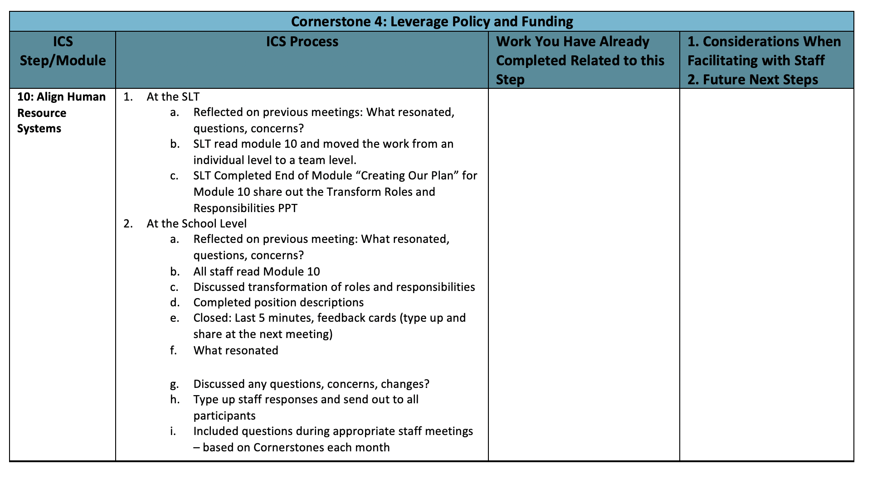
8 minutes

Slide 18
Thank you for your commitment to equity!
FEEDBACK CARDS
1. What resonated?

Slide 19
Thank you for your commitment to equity!
FEEDBACK CARDS
2. What gives you pause?

