Slide 1
School Digital Module 12/Step 12: Cross-Check Policy and Procedures
DR. ELISE M. FRATTURA (she/her/hers)
DR. COLLEEN A. CAPPER (she/her/hers)

Slide 2
4 Agreements of Courageous Conversations (Singleton, 2022)
Experience discomfort
Stay engaged
Speak your truth
Expect and accept non-closure

Slide 3
Community Agreements (Continued)
No blame, shame, judgment.
Equity work life-long, never ending, at individual & organizational level.
“Collective Equity Capacity” we are in this with you - mutual learning, challenging, growing together.

Slide 4
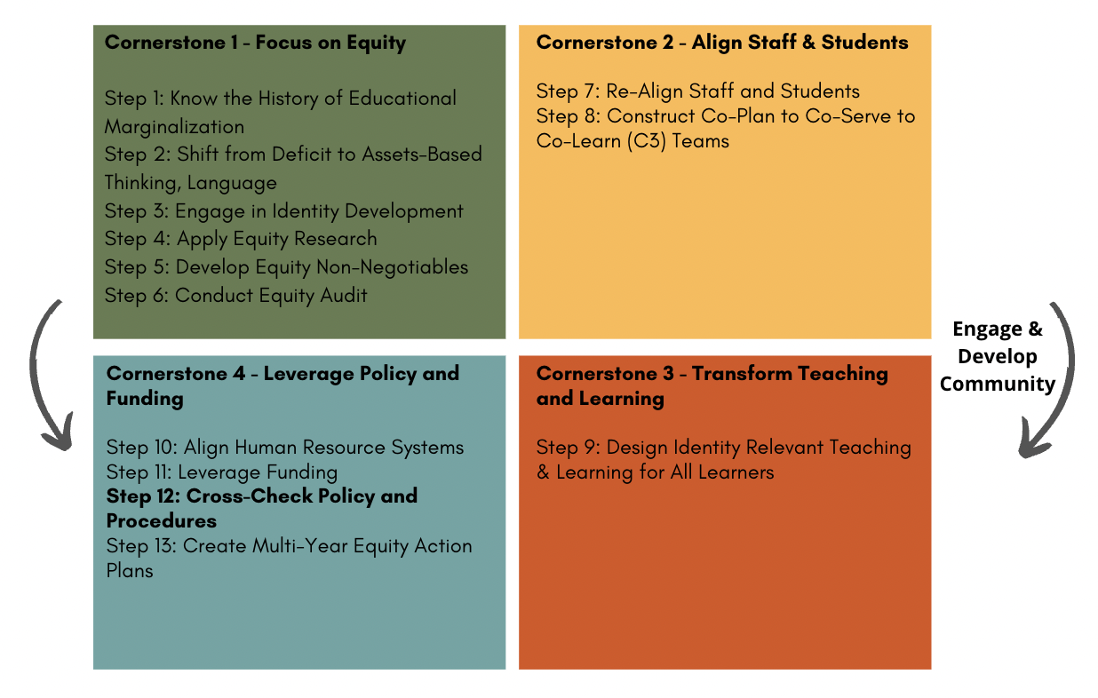

Slide 5
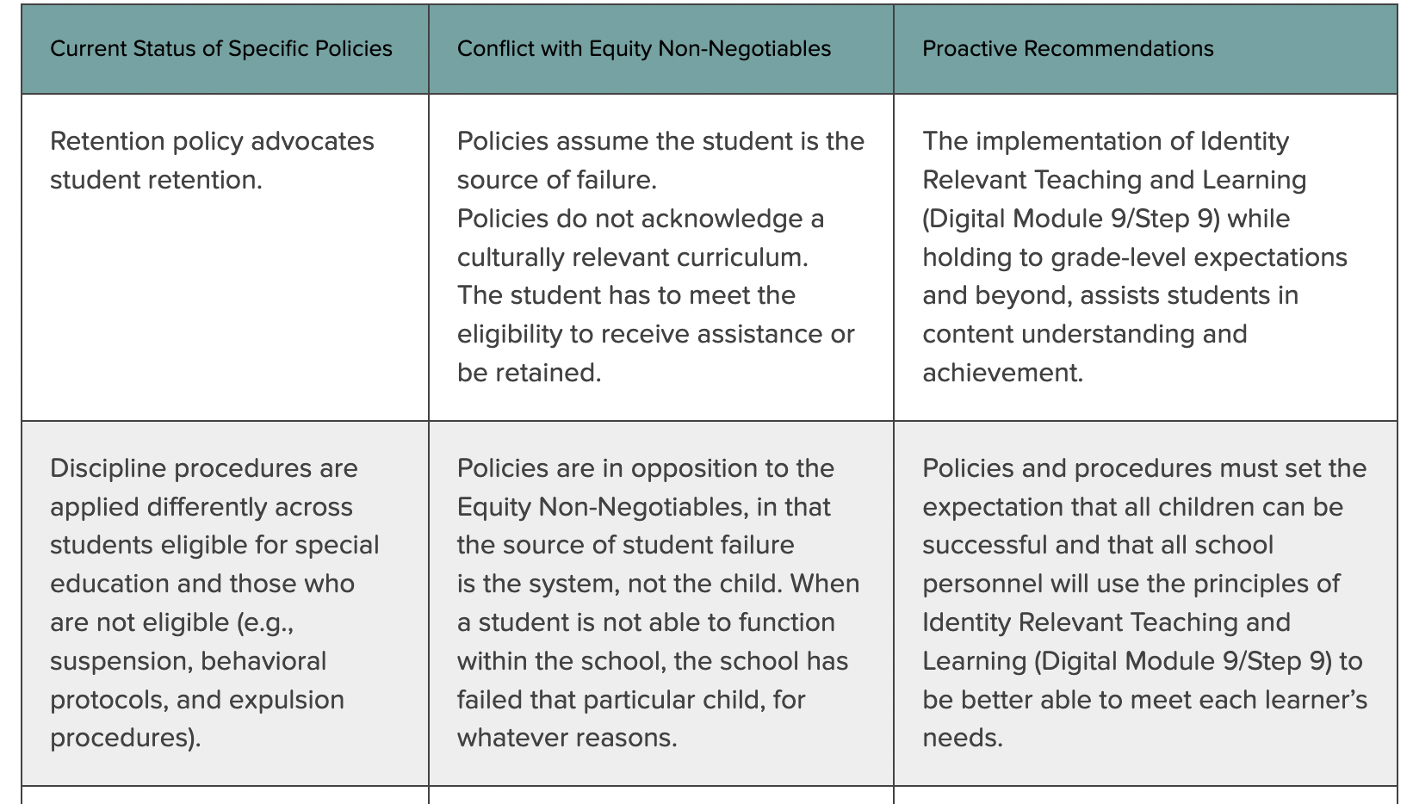
ICS Equity Digital Module 12/Step 12: Cross-Check Policy and Procedures

Slide 6
ICS Equity Digital Module 12/Step 12: Cross-Check Policy and Procedures
Retention policies – all research shows students fall more behind, less likely to graduate if retained.
Discipline policies – e.g., High School students consistently not getting to class are suspended (greater impact on students of color as more students of color are not getting to class).
Any policy that as a result has a differential impact on students based on race, class, gender, ability, language, gender/sexual identity and their intersections – must be examined and changed or eliminated.

Slide 7
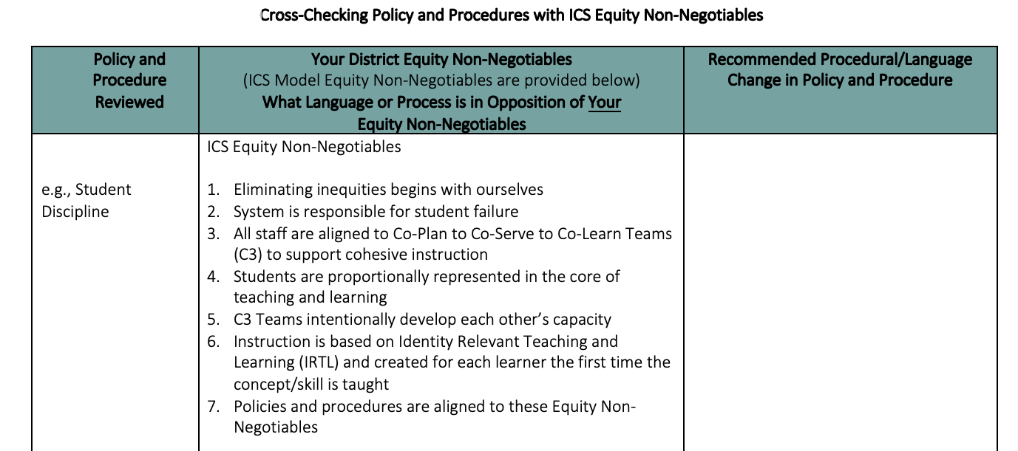

Slide 8
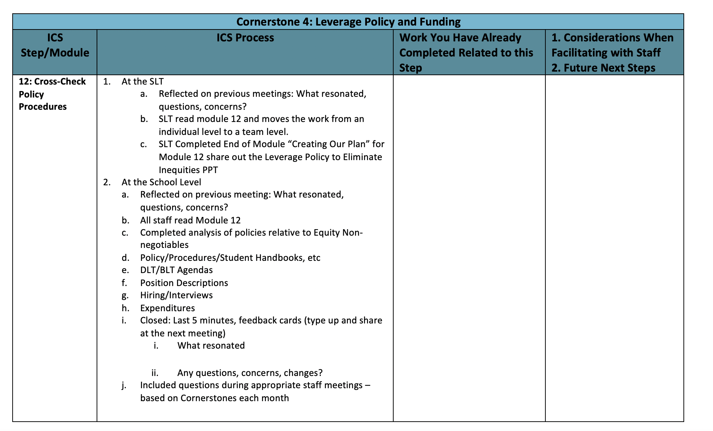

Slide 9
Thank you for your commitment to equity!
FEEDBACK CARDS
1. What resonated?

Slide 10
Thank you for your commitment to equity!
FEEDBACK CARDS
2. What gives you pause?

