Slide 1
School Digital Module 8/Step 8: Construct Co-Plan to Co-Serve to Co-Learn (C3) Teams (North Carolina)
DR. ELISE M. FRATTURA (she/her/hers)
DR. COLLEEN A. CAPPER (she/her/hers)

Slide 2
4 Agreements of Courageous Conversations (Singleton, 2022)
Experience discomfort
Stay engaged
Speak your truth
Expect and accept non-closure

Slide 3
Community Agreements (Continued)
No blame, shame, judgment.
Equity work life-long, never ending, at individual & organizational level.
“Collective Equity Capacity” we are in this with you - mutual learning, challenging, growing together.

Slide 4
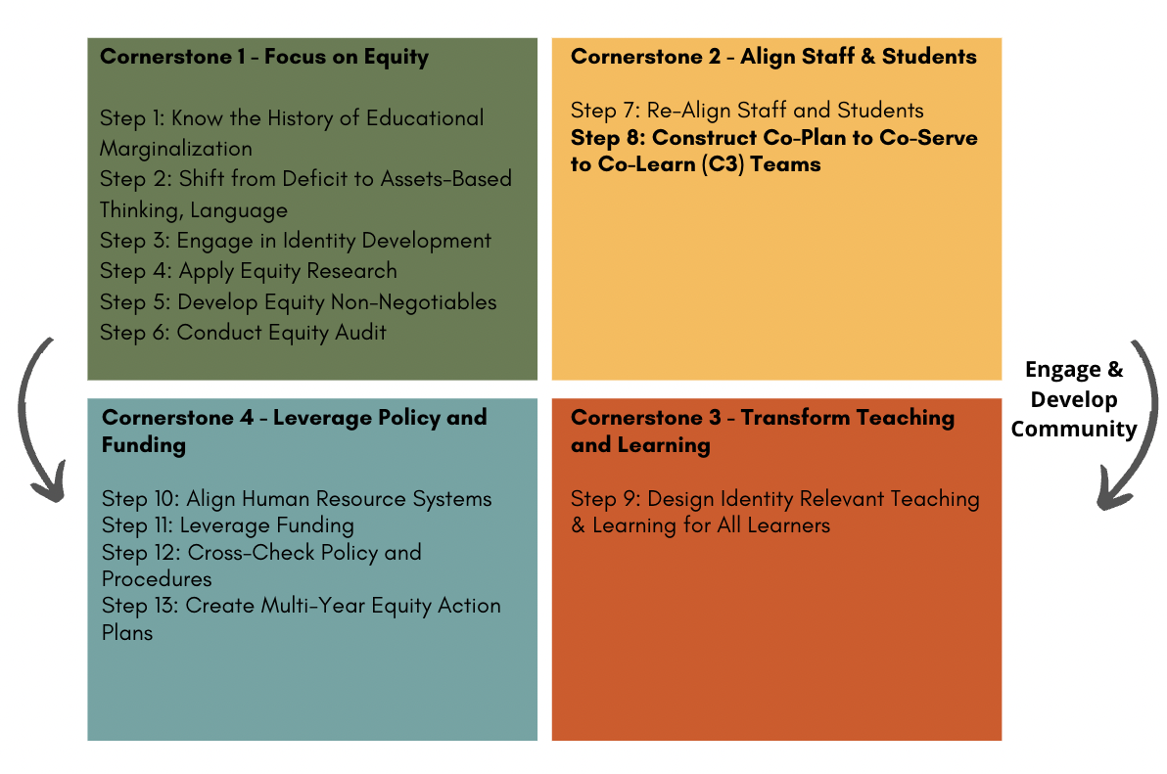

Slide 5
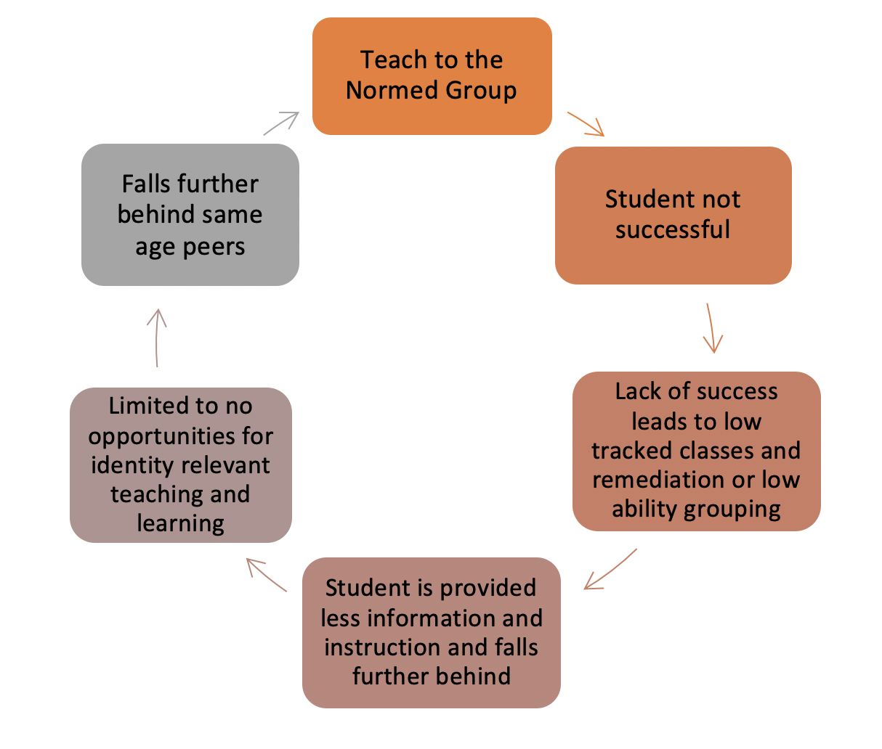
To Move Beyond the Deficit Based Cycle within the Classroom

Slide 6
Carter and Welner (2013)
"the achievement gap has not arisen by coincidence; children learn when they have opportunities to learn, and gaps in opportunities have led to gaps in achievement."

Slide 7
C3 Proactive Structure

Slide 8
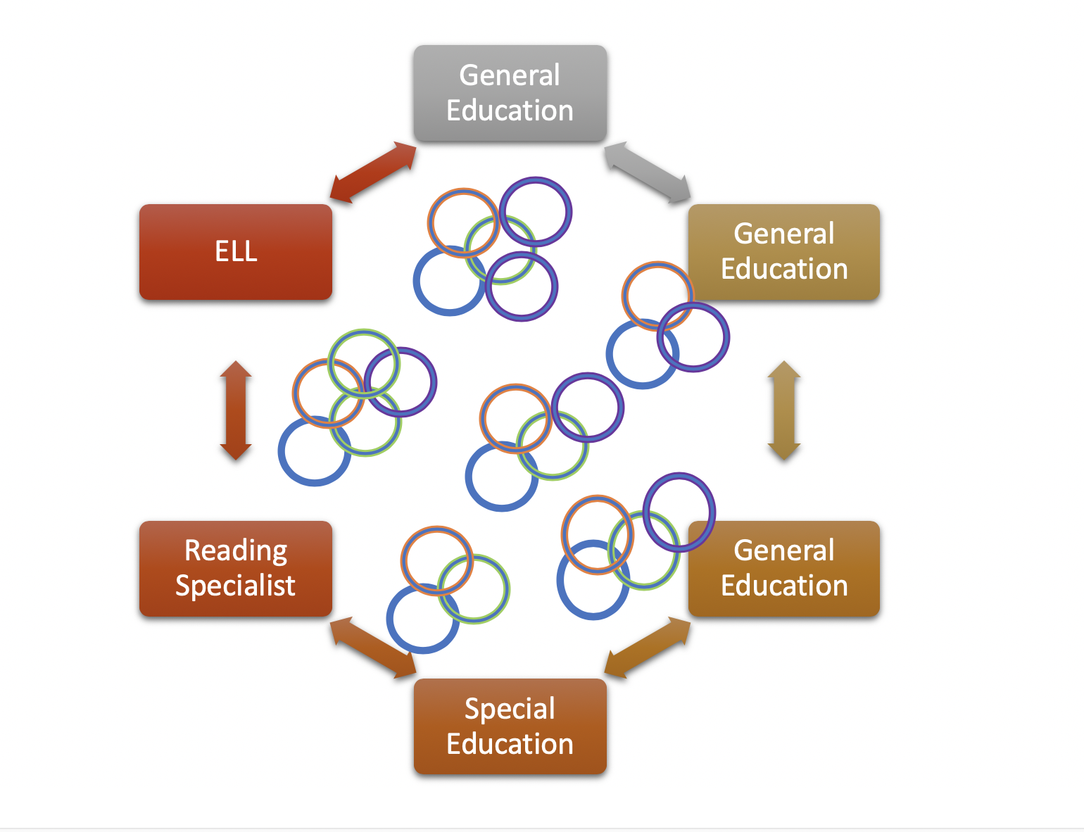
By Year
By Grade Level
By Content
By Educator Expertise
By Student Proportional Make Up
Yet…
Consistent for Comprehensive IRTL
Most important Teams in the School
Necessary for Equity

Slide 9
Digital Module 8/Step 8: C3 Roles and Lesson Plans
Confirm meeting times and the C3 Team's agenda
Develop an ICS Skills at a Glance Template
Revisiting the difference between the role of Co-teaching and Co-Plan to Co-Serve to Co-Learn Teams (C3 Teams).
The PLC and how it can create inequities and equities.
The role of C3 Teams in Multi-Level Systems of Support (MLSS) through Response to Intervention (RtI).
The role of special education teachers and specially designed instruction (SDI).
The Evolution of Roles of Itinerant Staff (ELL, Speech and Language, etc.).
Our C3 Lesson Plan Template

Slide 10
Digital Module 8/Step 8: C3 Roles and Lesson Plans
Confirm meeting times and the C3 Team's agenda
Develop an ICS Skills at a Glance Template
Revisiting the difference between the role of Co-teaching and Co-Plan to Co-Serve to Co-Learn Teams (C3 Teams).
The PLC and how it can create inequities and equities.
The role of C3 Teams in Multi-Level Systems of Support (MLSS) through Response to Intervention (RtI).
The role of special education teachers and specially designed instruction (SDI).
The Evolution of Roles of Itinerant Staff (ELL, Speech and Language, etc.).
Our C3 Lesson Plan Template

Slide 11
a. Confirm Meeting Times
Scheduling C3 Meeting Times is the Highest Priority
Determine at least 2 times per week
Lesson plans are written for at least:
one week at the elementary level
1.5 weeks at the middle level and
two weeks at the secondary level

Slide 12
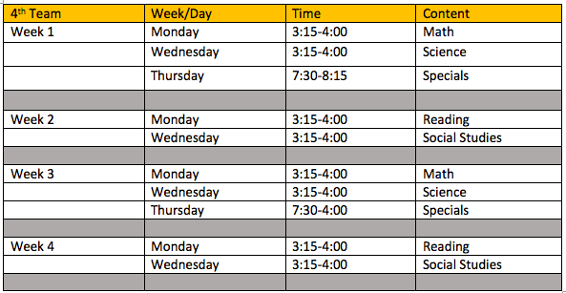
Clarifying Consistent Meeting Times

Slide 13
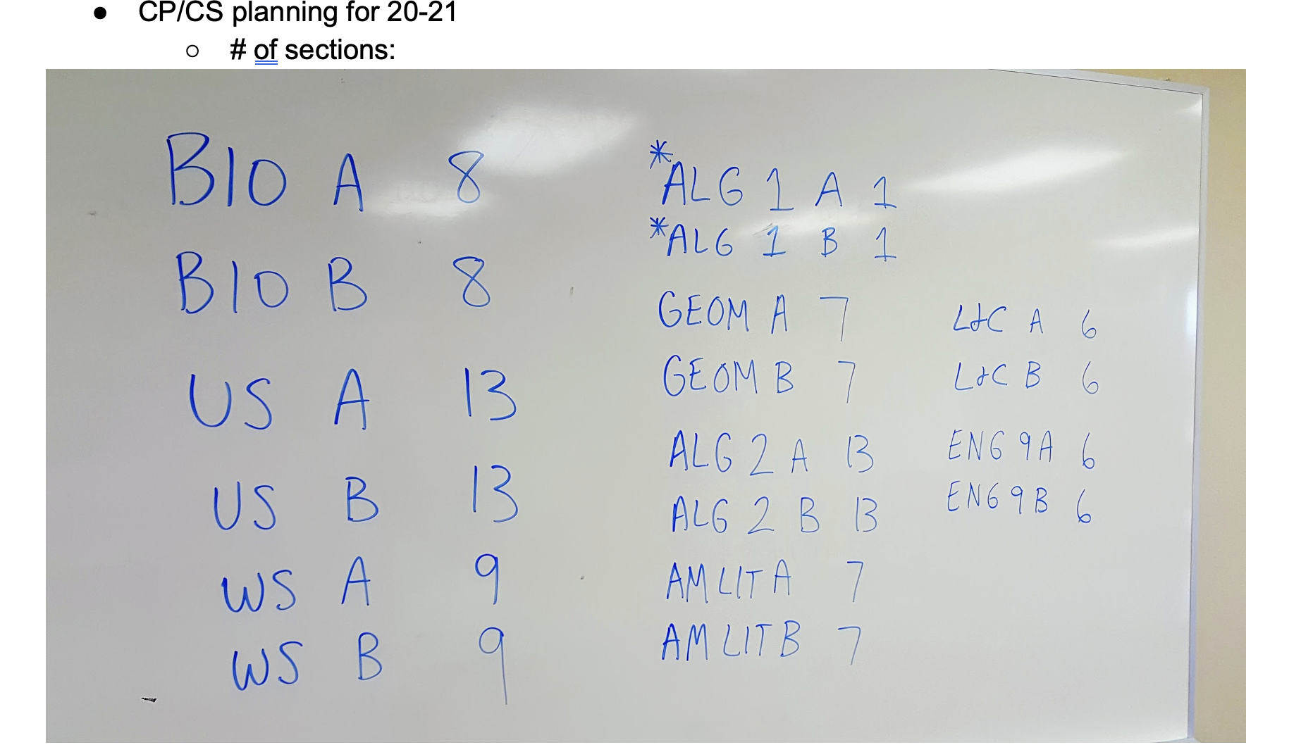

Slide 14
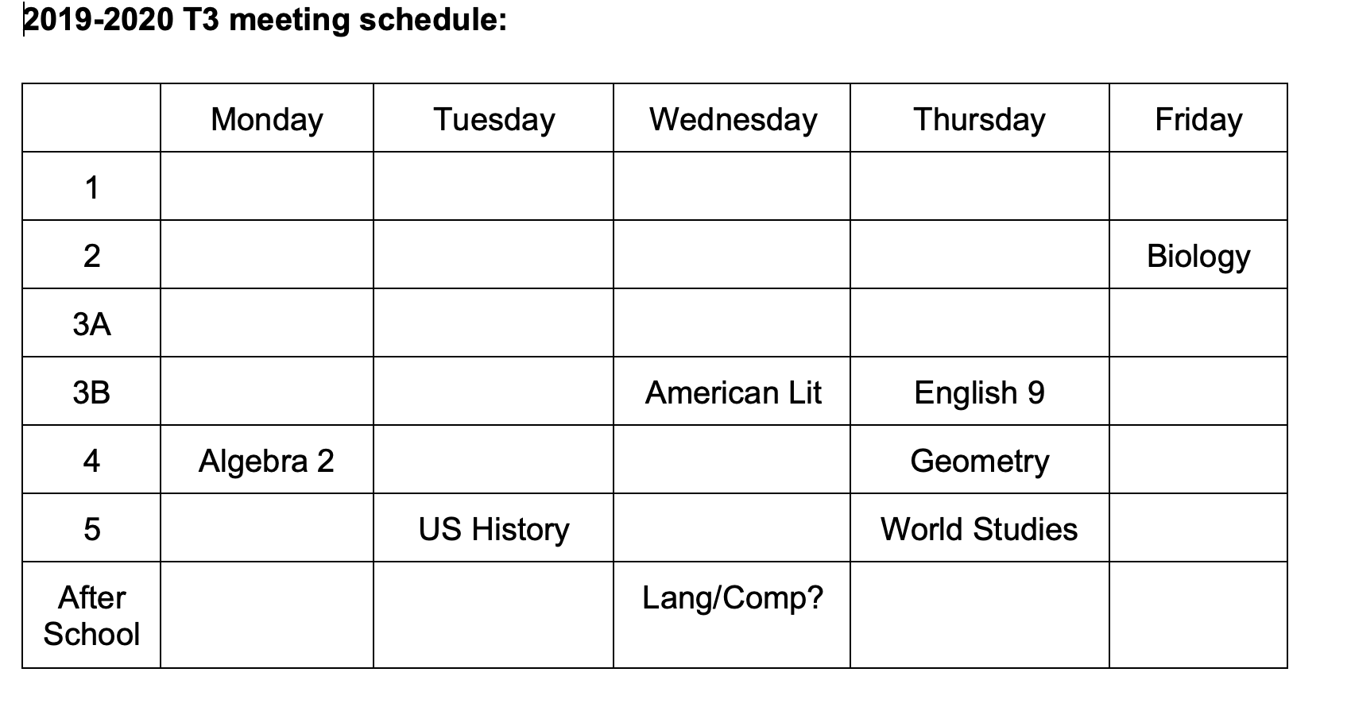

Slide 15
Meeting Time Agenda
3 lessons ahead
10 minutes review implementation of previous lesson (s) – apply any
changes on saved document
10 minutes review current lesson to be implemented
25 minutes complete next co-developed lesson plan
Signatures of team members are essential
2 minutes save all lesson plans in folder
Then… other conversation

Slide 16
Digital Module 8/Step 8: C3 Roles and Lesson Plans
Confirm meeting times and the C3 Team's agenda
Develop an ICS Skills at a Glance Template
Revisiting the difference between the role of Co-teaching and Co-Plan to Co-Serve to Co-Learn Teams (C3 Teams).
The PLC and how it can create inequities and equities.
The role of C3 Teams in Multi-Level Systems of Support (MLSS) through Response to Intervention (RtI).
The role of special education teachers and specially designed instruction (SDI).
The Evolution of Roles of Itinerant Staff (ELL, Speech and Language, etc.).
Our C3 Lesson Plan Template

Slide 17
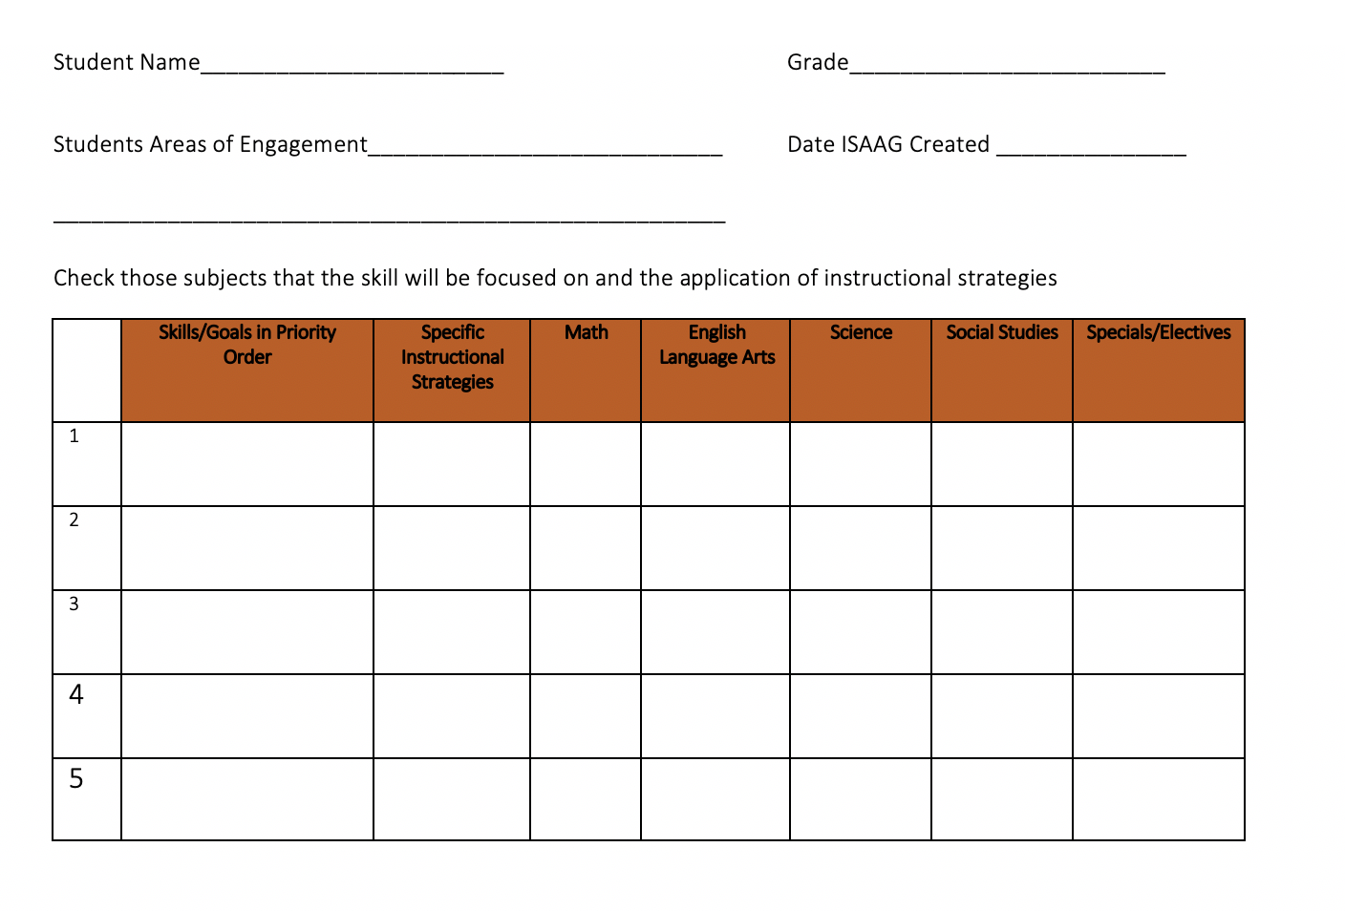

Slide 18
Why Use ICS Skills @ A Glance
Frequency of opportunity to practice skills
Consistency of instruction
Across co-plan to co-serve to co-learn teams
Increases Learning!

Slide 19
Create Your ISAAG
Your team may adopt the ISAAG form
Your team may create your own form or adapt a comparable form
You should have brought 2 – 3 completed ISAAG’s – what worked or what did not for you? What questions do you have?
Will it be electronic?
How will all staff have access?
How will the initial SAAG be completed?

Slide 20
Digital Module 8/Step 8: C3 Roles and Lesson Plans
Confirm meeting times and the C3 Team's agenda
Develop an ICS Skills at a Glance Template
Revisiting the difference between the role of Co-teaching and Co-Plan to Co-Serve to Co-Learn Teams (C3 Teams).
The PLC and how it can create inequities and equities.
The role of C3 Teams in Multi-Level Systems of Support (MLSS) through Response to Intervention (RtI).
The role of special education teachers and specially designed instruction (SDI).
The Evolution of Roles of Itinerant Staff (ELL, Speech and Language, etc.).
Our C3 Lesson Plan Template

Slide 21
Co-Plan to Co-Serve vs. Co-Teaching
CO-TEACHING (REACTIVE)
CO-PLAN TO CO-SERVE (PRO-ACTIVE)
1. Typically about special education, not all students
2. “Pairing” a special education teacher with another teacher, course, or classroom
3. Goal – support students, mostly with IEP’s, not build general education teacher capacity.
4. Results in over-representation of students with IEP’s in particular classrooms/courses
5. General education teacher, dependent on special education teacher
6. Accommodations after planning vs planning together
1. About all students
2. About all staff- All staff can teach all students. Match staff expertise with student need.
3. Goal – meet learning needs of all students, share staff expertise to develop all staff capacity
4. Supports proportional representation of students across settings.
5. All staff share and further develop each other’s expertise.
6. Co-plan and co-serve together

Slide 22
Team Time 10 Minutes
Discuss how your school could schedule meeting times and the C3 Team's agenda.
Discuss how an ICS Skills at a Glance Template could be developed.
Discuss the difference between the Co-Plan to Co-Serve to Co-Learn Lesson Plan Template and what your school typically uses.

Slide 23
Digital Module 8/Step 8: C3 Roles and Lesson Plans
Confirm meeting times and the C3 Team's agenda
Develop an ICS Skills at a Glance Template
Revisiting the difference between the role of Co-teaching and Co-Plan to Co-Serve to Co-Learn Teams (C3 Teams).
The PLC and how it can create inequities and equities.
The role of C3 Teams in Multi-Level Systems of Support (MLSS) through Response to Intervention (RtI).
The role of special education teachers and specially designed instruction (SDI).
The Evolution of Roles of Itinerant Staff (ELL, Speech and Language, etc.).
Our C3 Lesson Plan Template

Slide 24
Aligning to PLC’s
How Can PLC’s Create Inequities?
How Can PLC’s Create Equity?

Slide 25
Aligning to PLC’s
How Can PLC’s Create inequities?
How Can PLC’s Create Equity?
Not have Equity at their Core
See the student as deficit
Review data and determine the child requires and out of class removal
Not align to co-plan and co-serve teams (special educators have their own PLC)
Have Equity at their Core
See the system as the deficit
Review data and determine the co-plan team needs to provide instruction differently based on the child and how they bring in information
Align PLC’s as co-plan and co-serve teams (special educators do NOT have their own PLC)

Slide 26
Digital Module 8/Step 8: C3 Roles and Lesson Plans
Confirm meeting times and the C3 Team's agenda
Develop an ICS Skills at a Glance Template
Revisiting the difference between the role of Co-teaching and Co-Plan to Co-Serve to Co-Learn Teams (C3 Teams).
The PLC and how it can create inequities and equities.
The role of C3 Teams in Multi-Level Systems of Support (MLSS) through Response to Intervention (RtI).
The role of special education teachers and specially designed instruction (SDI).
The Evolution of Roles of Itinerant Staff (ELL, Speech and Language, etc.).
Our C3 Lesson Plan Template

Slide 27
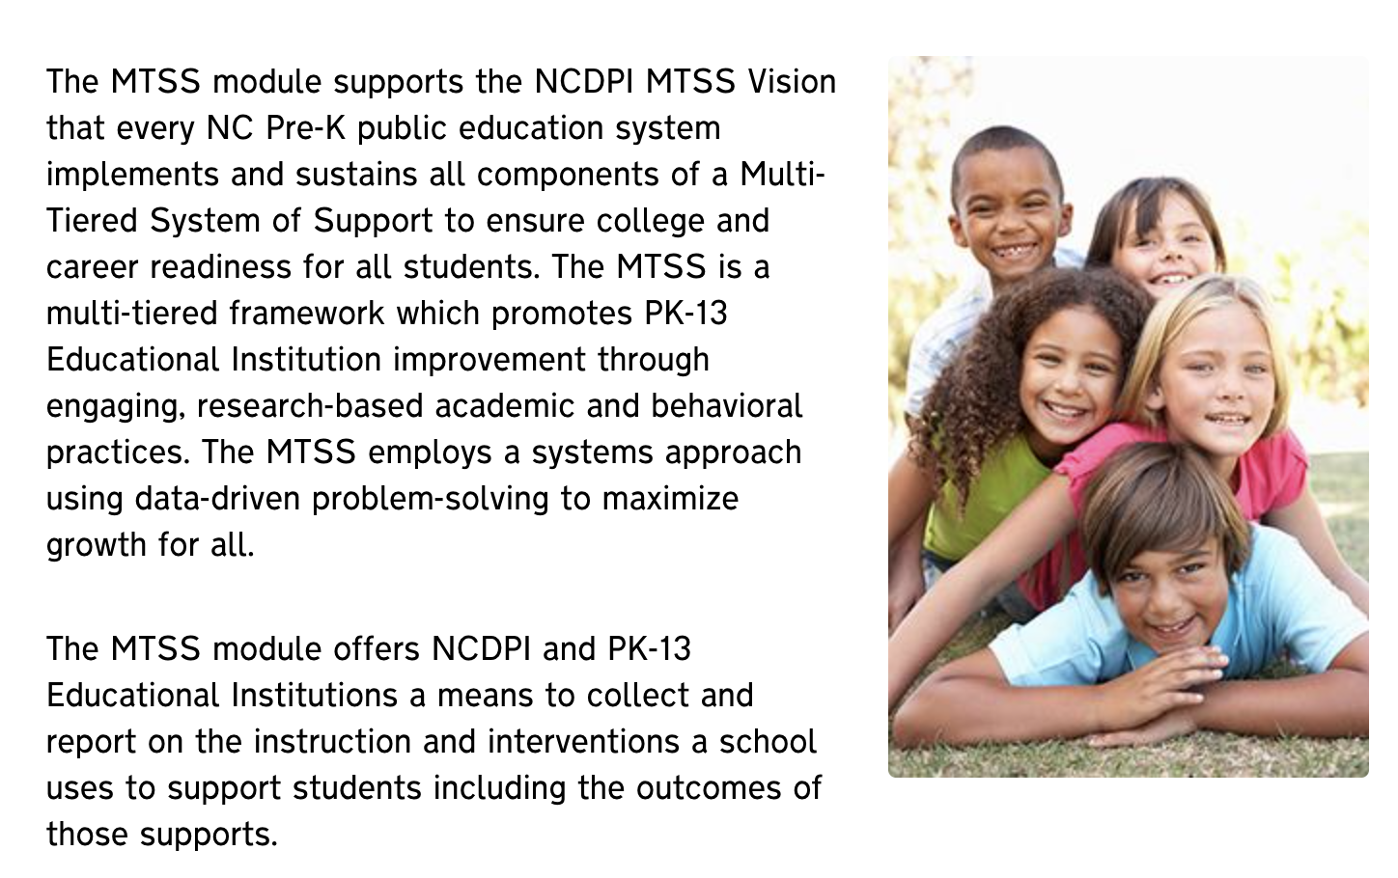
North Carolina’s critical components were adapted from collaboration with Florida’s MTSS work, July 2019

Slide 28
North Carolina MTSS Critical Components
Leadership
Leadership is key to successful implementation of any large-scale innovation. The building principal, assistant principal(s), and school leadership team are critical to implementing MTSS at the school level. They engage staff in ongoing professional development for implementing MTSS, plan strategically for MTSS implementation, and model a problem-solving process for school improvement. The school principal also supports the implementation of MTSS by communicating a vision and mission to school staff, providing resources for planning and implementing instruction and intervention, and ensuring that staff have the data needed for data-based problem-solving.

Slide 29
North Carolina MTSS Critical Components
Building the Capacity/Infrastructure for Implementation
School-wide capacity and infrastructure are required in order to implement and sustain MTSS. This capacity and infrastructure usually include ongoing professional development and coaching with an emphasis on data-based problem-solving and multi-tiered instruction and intervention, scheduling that allows staff to plan and implement instruction and intervention, and processes and procedures for engaging in data-based problem-solving.

Slide 30
North Carolina MTSS Critical Components
Communication and Collaboration
Ongoing communication and collaboration are essential for successful implementation of MTSS. Many innovations fail due to a lack of consensus, lack of feedback to implementers to support continuous improvement, and not involving stakeholders in planning. In addition to including stakeholders in planning and providing continuous feedback, it is also important to build the infrastructure to communicate and work with families and other community partners. These practices increase the likelihood that innovative practices will be implemented and sustained.

Slide 31
North Carolina MTSS Critical Components
Data-Based Problem Solving
The use of data-based problem-solving to make education decisions is a critical element of MTSS implementation. This includes the use of data-based problem-solving for student outcomes across content areas, grade levels, and tiers, as well as the use of problem-solving to address barriers to school wide implementation of MTSS. While several models for data-based problem-solving exist, the four step problem-solving approach includes: 1) defining the goals and objectives to be attained, 2) identify possible reasons why the desired goals are not being attained, 3) developing a plan for implementing evidence-based strategies to attain goals, 4) evaluating the effectiveness of the plan.

Slide 32
North Carolina MTSS Critical Components
Three Tiered Instructional/Intervention Model
The three-tiered instructional/intervention model is another critical element of MTSS implementation. In a typical system, Core (Tier 1) includes the instruction all students receive; Supplemental (Tier 2) includes additional instruction or intervention provided to students not meeting benchmarks; and Intensive (Tier 3) includes intense, small group or individual interventions for students showing significant barriers to learning the skills required for school success. It is important to consider both academic and social-emotional/behavioral instruction and interventions when examining this domain.

Slide 33
North Carolina MTSS Critical Components
Data-Evaluation
Given the importance of data-based problem-solving within an MTSS model, the need for data and evaluation system is clear. In order to do data-based problem-solving, school staff need to understand and have access to data sources that address the purposes of assessment. Procedures and protocols for administering assessments and data use allow school staff to use student data to make educational decisions. In addition to student data, data on the fidelity of MTSS implementation allow school leadership to examine the current practices and make changes for improving MTSS implementation.
North Carolina’s critical components were adapted from collaboration with Florida’s MTSS work, July 2019

Slide 34
Multi-Level Systems of Support or (RtI) in Tier 1:
Use current data/research (Module 4) that disputes success of pullout instruction.
Increase learning when we move from 2x a week for 30 minutes to across the curriculum in Tier 1:
C3 Team synthesizes across content rather than the student
C3 Team provides repetition in trials across content areas
C3 Team provide consistent instruction based on a shared lesson plan
The use of the ICS Skills at a Glance (ISAAG) to provide consistent, synthesized and repetitive research based instructional strategies.
Document instructional strategies and student progress through progress monitoring tools.

Slide 35
Digital Module 8/Step 8: C3 Roles and Lesson Plans
Confirm meeting times and the C3 Team's agenda
Develop an ICS Skills at a Glance Template
Revisiting the difference between the role of Co-teaching and Co-Plan to Co-Serve to Co-Learn Teams (C3 Teams).
The PLC and how it can create inequities and equities.
The role of C3 Teams in Multi-Level Systems of Support (MLSS) through Response to Intervention (RtI).
The role of special education teachers and specially designed instruction (SDI).
The Evolution of Roles of Itinerant Staff (ELL, Speech and Language, etc.).
Our C3 Lesson Plan Template

Slide 36
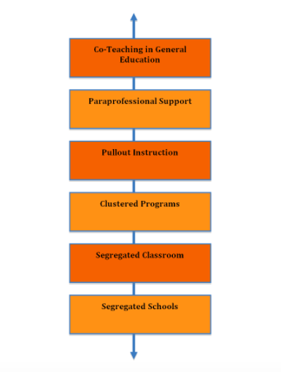
The Continuum

Slide 37
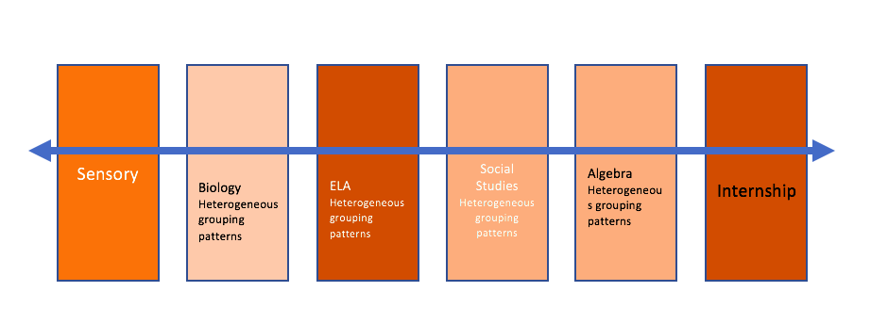
Heterogeneous Flexible Learning Groups Based on How Each Student Learns…

Slide 38
Specially Designed Instruction through C3 Teams
The ICS Skills at a Glance (ISAAG) provides the map to consistently attend to skills and concepts (academic, behavioral, social-emotional) using specified instructional strategies consistently
The C3 Team synthesizes specially designed instruction across content rather than the student
The C3 Team provides consistent instructional practices based on a shared lesson plan
The C3 Team provides repetition in trials across content areas
The C3 Team documents instructional strategies and student progress through progress monitoring tools

Slide 39
Federal IEP Language
…placement in the general education classroom at the child’s home school… (iii)
Special education is a service, not a place
Other language… if this doesn’t work…

Slide 40
IEP Objectives
Agreement:
April’s special education teacher will co-plan and co-serve in all content areas. The special educator will present at least 60 minutes per week of instruction in Tier 1 to provide direct support in the areas of comprehension and fluency.
IEP Objective:
1. Given fourth grade material, April will read 70-100 wpm with 1-3 errors.
2. April will identify the main idea and summarize, visualize, retell and use story maps to reflect her level of grade level reading material 8 out of 10 times.

Slide 41
IEP Objectives
April will receive Reading support through her C3 team for an additional 240 minutes/week in the content area of Reading and another 180 in reading across the curriculum in SS and Science.
Objectives:
1. April will identify the main idea and use prediction, questioning and prior knowledge to summarize and retell information at the 4th grade level 8 out of 10 times.
2. Given fourth grade material and high interest books, April will read 120 wpm with only random error.

Slide 42
IEP Goals and Objectives
April will receive sensory integration on a planned schedule to proactively support her throughout the day.
Objectives:
1. April will have scheduled breaks throughout her day beginning with every 45 minutes being decreased to every 2 hours.
2. April will choose from weighted vest or blanket, during reading time, sitting in the tent, or playing with weighted balls.

Slide 43
Team Time 10 Minutes
Discuss how PLC’s can create inequities and equities.
Discuss the role of C3 Teams in Multi-Level Systems of Support (MLSS) through Response to Intervention (RtI) in Tier 1.
Discuss the role of special education teachers and specially designed instruction (SDI).

Slide 44
Digital Module 8/Step 8: C3 Roles
Confirm meeting times and the C3 Team's agenda
Develop an ICS Skills at a Glance Template
Revisit the difference between the role of Co-teaching and Co-Plan to Co-Serve to Co-Learn Teams (C3 Teams).
The PLC and how it can create inequities and equities.
The role of C3 Teams in Multi-Level Systems of Support (MLSS) through Response to Intervention (RtI).
The role of special education teachers and specially designed instruction (SDI).
The Evolution of Roles of Itinerant Staff (ELL, Speech and Language, etc.).
Our C3 Lesson Plan Template

Slide 45
Evolution of Roles
Teachers who have predominately removed students for instruction in a resource room or someplace else will move from providing reactionary instruction (discussed in Module 1) to providing proactive identity relevant teaching and learning through the Co-Plan to Co-Serve to Co-Learn Teams.
Special educators, English language learner teachers, speech and language, interventionist, advanced learning teachers', reading/math specialist will find their role moves from one of spending time remediating to one of advancing or reinforcing core instruction and sharing expertise to intentionally developing the capacity of their C3 Team.
Individuals within such roles will move to an active member on multiple C3 Teams and modeling high-quality teaching and learning in the core, in place of removing students for intervention or remedial practices.

Slide 46
ICS Lesson Plan Template Must Include:
Defining the cluster of standards or essential learning targets (both foundational and content standards)
Providing clarity of what will be introduced in large group instruction that is only 10% of the instructional time
Sharing appropriate information from the ICS Skills at a Glance for each student
Defining what will be achieved in heterogeneous small groups by interest 90% of the instructional period
Defining what engagement, instruction and assessment will look for each heterogeneous small group
Clarifying what staff will facilitate learning and where – staff schedules
Signing off on the lesson for all C3 Team members

Slide 47
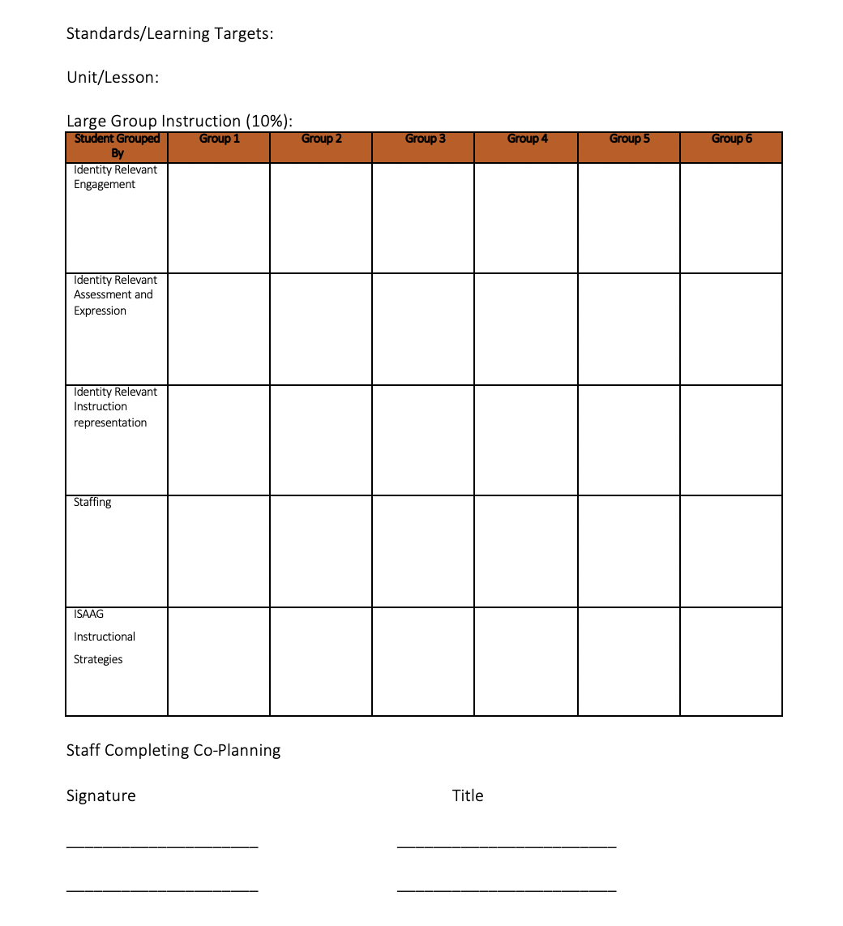

Slide 48
Provide Step-by-Step Process to Co-Create Lesson Plans
Define the cluster of standards or essential learning targets (both foundational and content standards)
Provide clarity of what will be introduced in large group that is only 10% of the instructional time
Share appropriate information from the ICS Skills at a Glance for specific students
Define what will be achieved in heterogeneous small groups by interest 90% of the instructional period
Define what engagement, instruction and assessment will look for each heterogeneous small group
Clarify what staff will facilitate learning and where – staff schedules
Sign off on the lesson for all C3 Team members

Slide 49
f. Determine How the Lesson Will be Staffed and Facilitated
After the completion of a C3 Lesson Plan, each Co-Plan to Co-Serve to Co-Learn Team decides where specific team members should provide support. The following questions assist in determining who should be in what classroom to model for staff or facilitate learning for specific children:
What staff members need to view the facilitation of instruction to increase their own capacity?
What students require specific facilitation of instruction to become more capable learners and by whom?
How will the C3 Team grow best in facilitating heterogeneous small group instructional practices where both students and staff learns more?

Slide 50
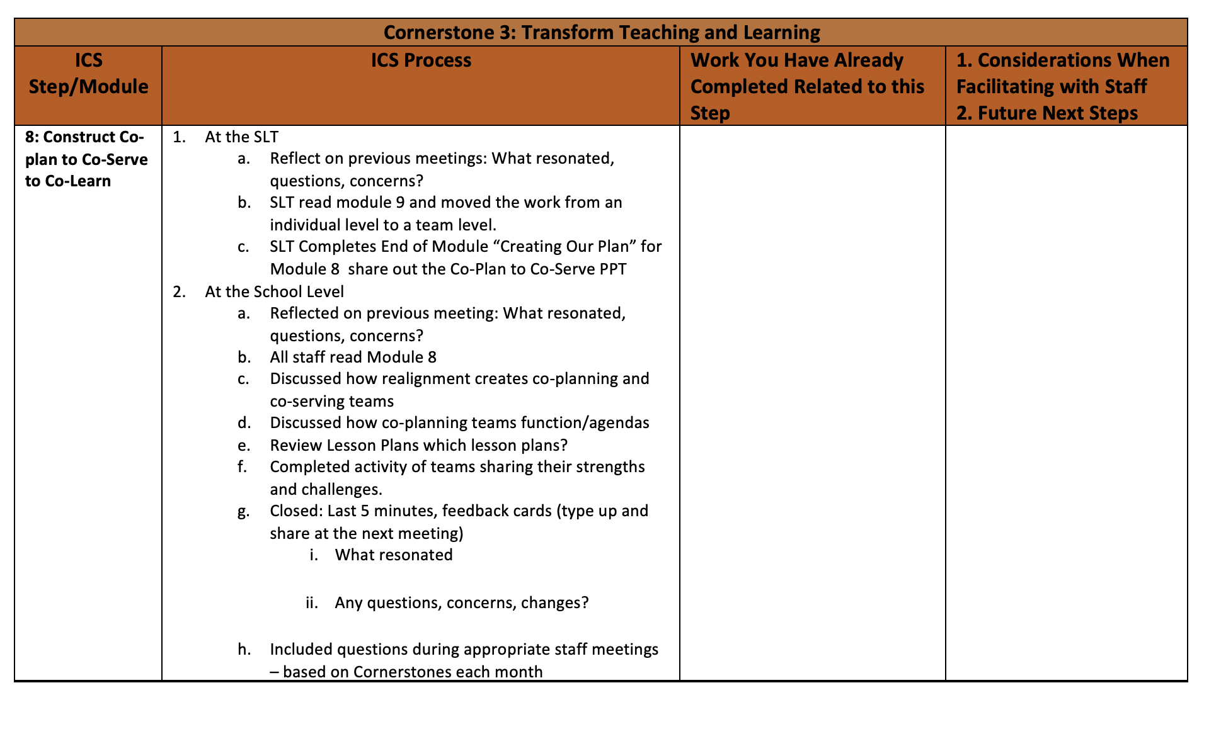

Slide 51
Thank you for your commitment to equity!
FEEDBACK CARDS
1. What resonated?

Slide 52
Thank you for your commitment to equity!
FEEDBACK CARDS
2. What gives you pause?

