Slide 1
IEP’s and C3 Teams
DR. ELISE M. FRATTURA (she/her/hers)
DR. COLLEEN A. CAPPER (she/her/hers)

Slide 2
4 Agreements of Courageous Conversations (Singleton, 2022)
Experience discomfort
Stay engaged
Speak your truth
Expect and accept non-closure

Slide 3
Community Agreements (Continued)
No blame, shame, judgment.
Equity work life-long, never ending, at individual & organizational level.
“Collective Equity Capacity” we are in this with you - mutual learning, challenging, growing together.

Slide 4
Inequities are Historical, Structural, Cultural, and Systemic
Requires Equity Systems Change

Slide 5
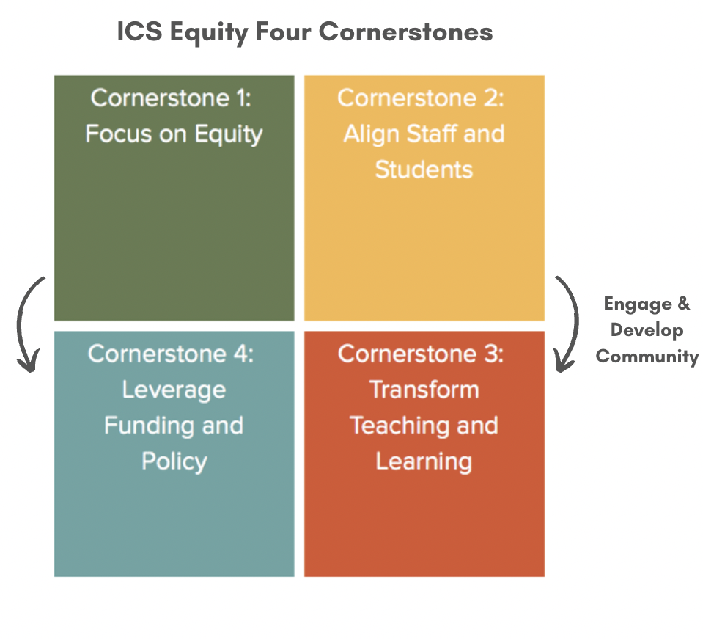
Integrated Comprehensive Systems for Equity – Four Cornerstones (A Framework and Process for Eliminating Inequities)

Slide 6
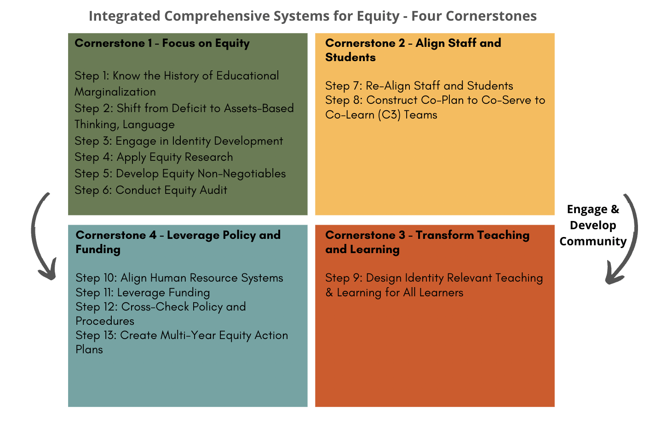
Integrated Comprehensive Systems for Equity – Four Cornerstones
Year 1
Year 2
Year 2 and 3
Year 2 and 3

Slide 7
What You Need for Today:
An IEP
A ISAAG associated with the student’s IEP

Slide 8
So – How Different is the IEP for C3 Teams, Really?
All students are proportionally placed in the building and C3 Teams are in place.
IEP Team membership is often the C3 Team
Special Educator is responsible for the completion of the IEP and ISAAG (Individualized Skills at a Glance Form) and any revisions and updates.
C3 Team members are responsible for reinforcing all IEP goals in the core of teaching and learning (often defined as SDI) in order to increase opportunities of skill development within the general education environments that the skills take place.
We are working with DPI and following all the DPI guidelines
© 2022 ELISE M. FRATTURA AND COLLEEN A. CAPPER. ALL RIGHTS RESERVED. YOU MAY NOT REPRODUCE, MODIFY, OR DISTRIBUTE THIS WORK WITHOUT WRITTEN CONSENT FROM THE AUTHORS. PLEASE EMAIL INFO@ICSEQUITY.ORG TO OBTAIN SUCH PERMISSION.

Slide 9
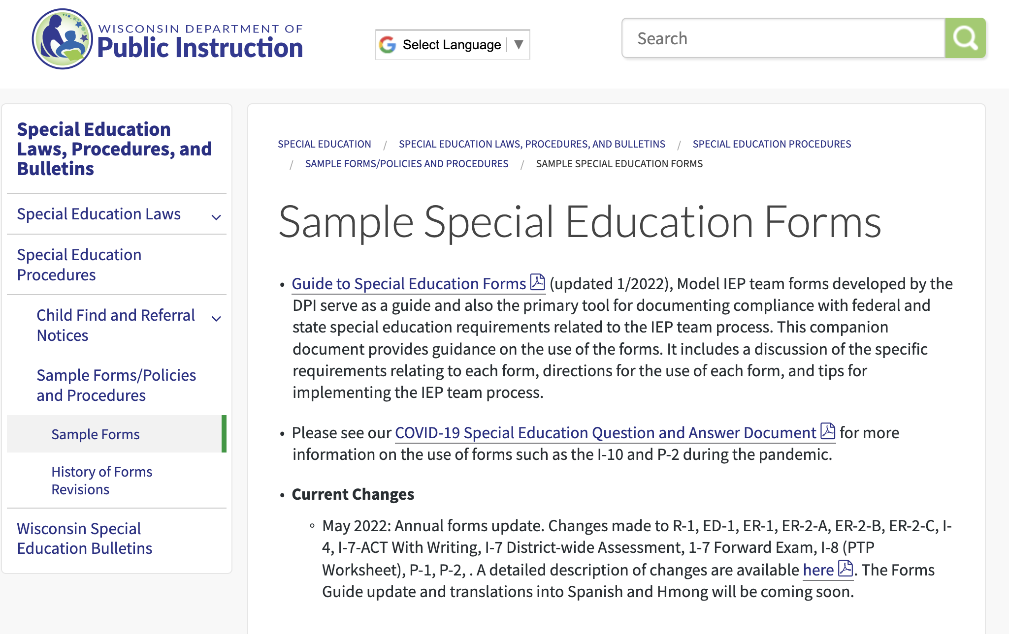

Slide 10
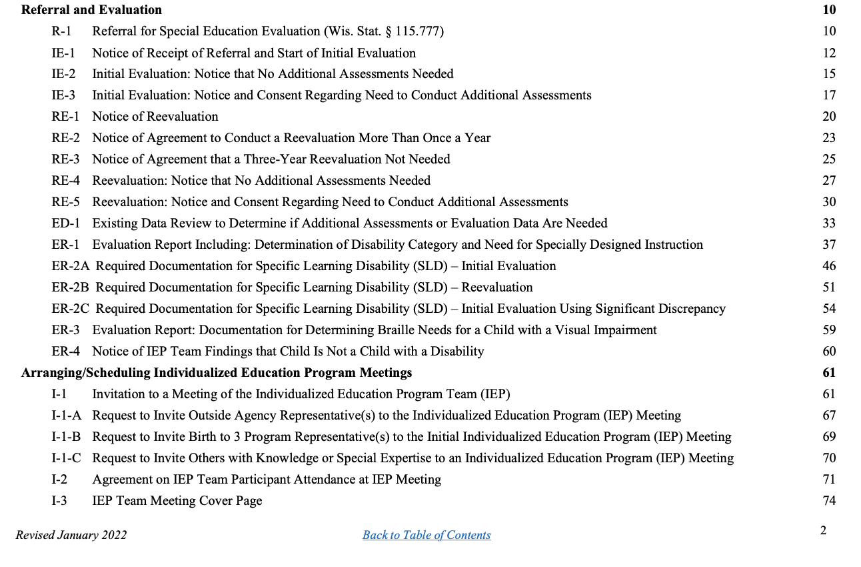

Slide 12
I-4: Linking Present Levels, Needs, Goals, and Services Form
What you may notice in April’s example:
General Education
Assets-Based Language
SDI by Special Education Teacher, C3 Team and OT
Supports for School Personnel includes C3 Planning Time
© 2022 ELISE M. FRATTURA AND COLLEEN A. CAPPER. ALL RIGHTS RESERVED. YOU MAY NOT REPRODUCE, MODIFY, OR DISTRIBUTE THIS WORK WITHOUT WRITTEN CONSENT FROM THE AUTHORS. PLEASE EMAIL INFO@ICSEQUITY.ORG TO OBTAIN SUCH PERMISSION.

Slide 13
I-4: Linking Present Levels, Needs, Goals, and Services Form
Two Agreements of the IEP Team
April’s special education teacher will co-plan and co-serve in all content areas. The special educator will present at least 60 minutes per week of instruction in Tier 1 to provide direct support in the areas of comprehension and fluency.
April will receive Reading support through her C3 team for an additional 240 minutes per week in the content area of Reading and another 180 in reading across the curriculum in Social Studies and Science.
© 2022 ELISE M. FRATTURA AND COLLEEN A. CAPPER. ALL RIGHTS RESERVED. YOU MAY NOT REPRODUCE, MODIFY, OR DISTRIBUTE THIS WORK WITHOUT WRITTEN CONSENT FROM THE AUTHORS. PLEASE EMAIL INFO@ICSEQUITY.ORG TO OBTAIN SUCH PERMISSION.

Slide 14
I-4: Linking Present Levels, Needs, Goals, and Services Form
Sample IEP I-4 Form for April
© 2022 ELISE M. FRATTURA AND COLLEEN A. CAPPER. ALL RIGHTS RESERVED. YOU MAY NOT REPRODUCE, MODIFY, OR DISTRIBUTE THIS WORK WITHOUT WRITTEN CONSENT FROM THE AUTHORS. PLEASE EMAIL INFO@ICSEQUITY.ORG TO OBTAIN SUCH PERMISSION.

Slide 15
Supplementary Aids and Services

Slide 16
Specially Designed Instruction (SDI)

Slide 17
Related Services

Slide 18
Program Modifications

Slide 19
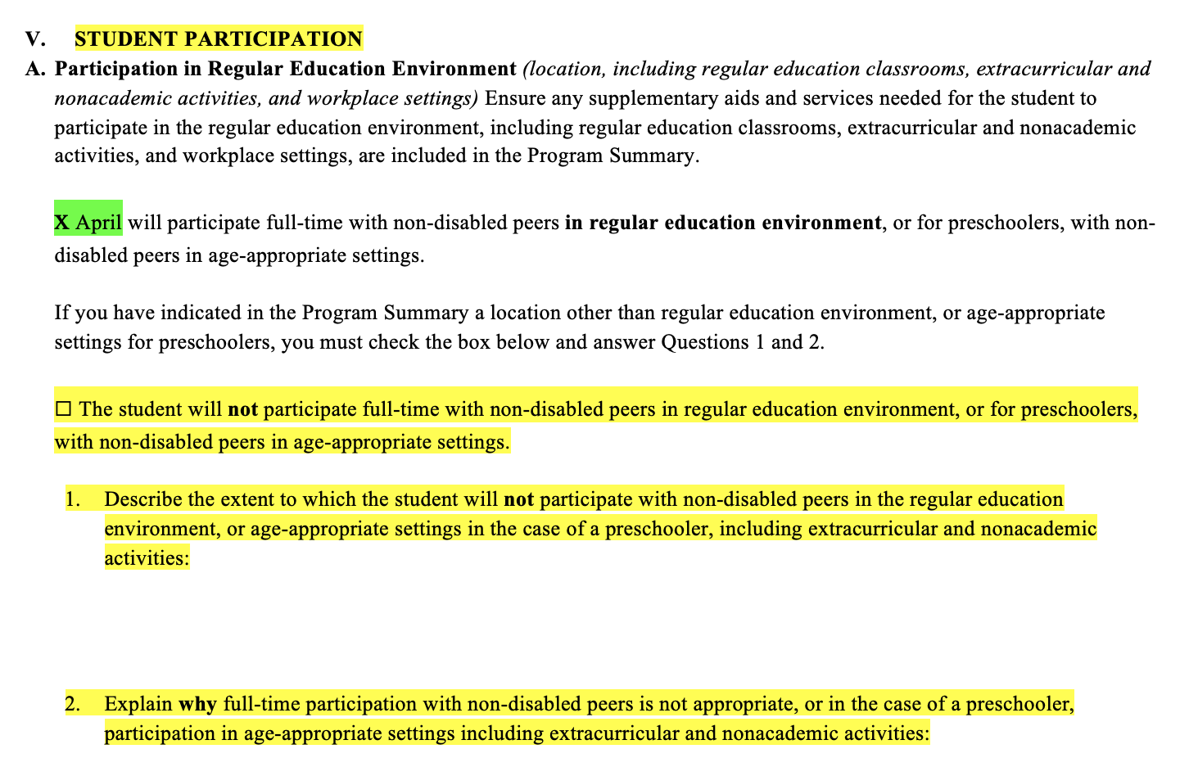
A Word About General Education Placement

Slide 20
I-4: Linking Present Levels, Needs, Goals, and Services Form
What is different about your IEP forms?
What changes can you make to align to your C3 Teams?
© 2022 ELISE M. FRATTURA AND COLLEEN A. CAPPER. ALL RIGHTS RESERVED. YOU MAY NOT REPRODUCE, MODIFY, OR DISTRIBUTE THIS WORK WITHOUT WRITTEN CONSENT FROM THE AUTHORS. PLEASE EMAIL INFO@ICSEQUITY.ORG TO OBTAIN SUCH PERMISSION.

Slide 21
P-2: Determination and Notice of Placement
P2 Determination Notice of Placement
© 2022 ELISE M. FRATTURA AND COLLEEN A. CAPPER. ALL RIGHTS RESERVED. YOU MAY NOT REPRODUCE, MODIFY, OR DISTRIBUTE THIS WORK WITHOUT WRITTEN CONSENT FROM THE AUTHORS. PLEASE EMAIL INFO@ICSEQUITY.ORG TO OBTAIN SUCH PERMISSION.

Slide 22
P-2: Determination and Notice of Placement
What is different about your IEP forms?
What changes can you make to align to your C3 Teams?
© 2022 ELISE M. FRATTURA AND COLLEEN A. CAPPER. ALL RIGHTS RESERVED. YOU MAY NOT REPRODUCE, MODIFY, OR DISTRIBUTE THIS WORK WITHOUT WRITTEN CONSENT FROM THE AUTHORS. PLEASE EMAIL INFO@ICSEQUITY.ORG TO OBTAIN SUCH PERMISSION.

Slide 23
Let’s Write a Proactive IEP and a Follow-Up ISAAG for our C3 Teams
© 2022 ELISE M. FRATTURA AND COLLEEN A. CAPPER. ALL RIGHTS RESERVED. YOU MAY NOT REPRODUCE, MODIFY, OR DISTRIBUTE THIS WORK WITHOUT WRITTEN CONSENT FROM THE AUTHORS. PLEASE EMAIL INFO@ICSEQUITY.ORG TO OBTAIN SUCH PERMISSION.

Slide 24
Thank you for your commitment to equity!
FEEDBACK CARDS
1. What resonated with you and the learning today?
2. What gave you pause?

