Slide 1

Integrated Comprehensive Systems for Equity Institute Part 1
DR. ELISE M. FRATTURA (she/her/hers)
DR. COLLEEN A. CAPPER (she/her/hers)
MR. NASIF K. ROGERS, PhD Candidate (he/him/his)

Slide 2
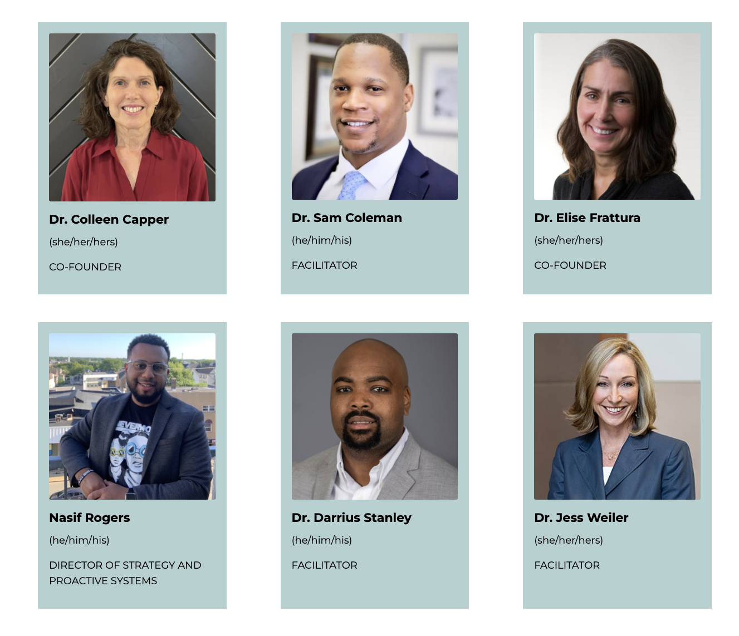

Slide 3

4 Agreements of Courageous Conversations (Singleton, 2022)
Experience discomfort
Stay engaged
Speak your truth
Expect and accept non-closure

Slide 4
Community Agreements (Continued)
No blame, shame, judgment.
Equity work life-long, never ending, at individual & organizational level.
“Collective Equity Capacity” we are in this with you - mutual learning, challenging, growing together.

Slide 5

School Part 1 Module 0:
Learning Targets
Access the ICS Digital Modules.
Define Equity through the ICS framework.
Describe the ICS Framework and Implementation process.
Identify School Leadership and District Leadership Team membership and roles.

Slide 6
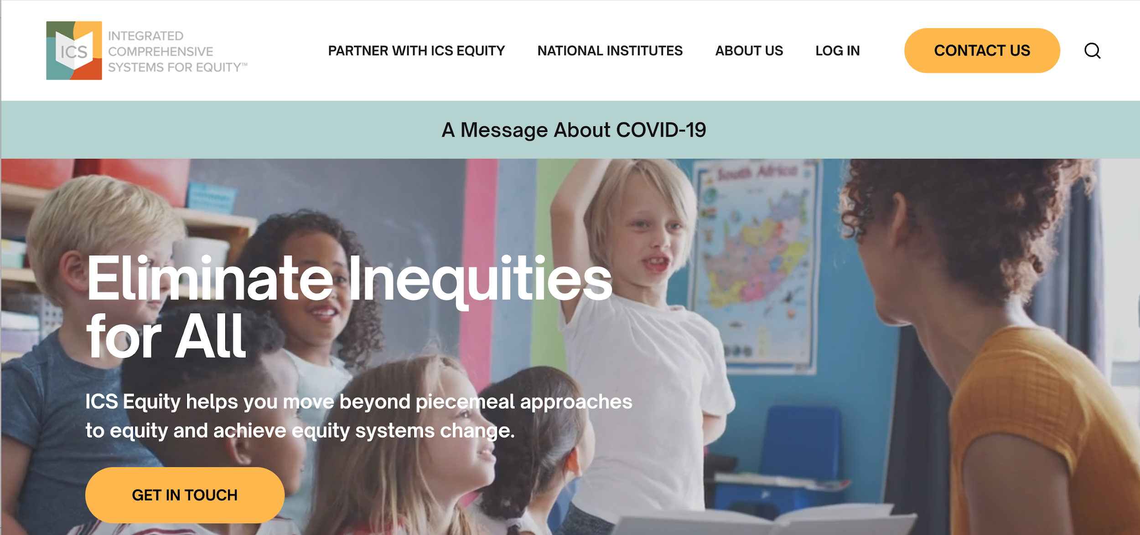
ICS Equity.org

Slide 7
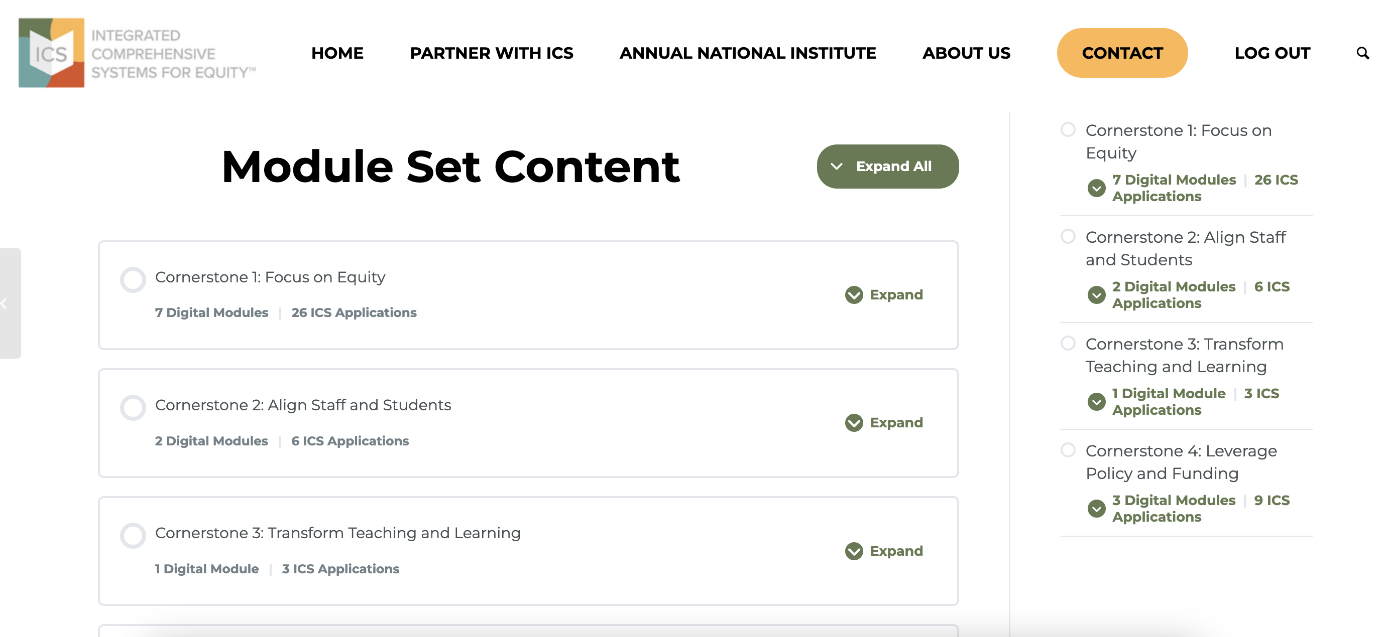

Slide 8
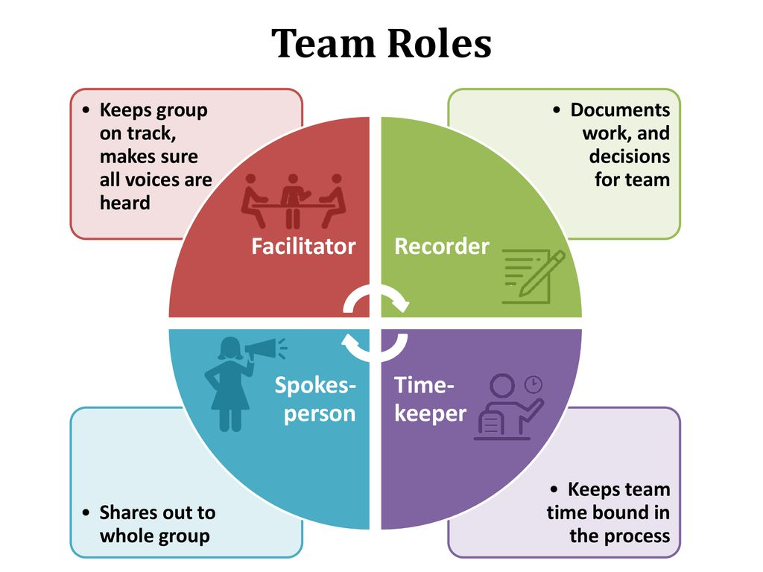
Assign Team Roles

Slide 9
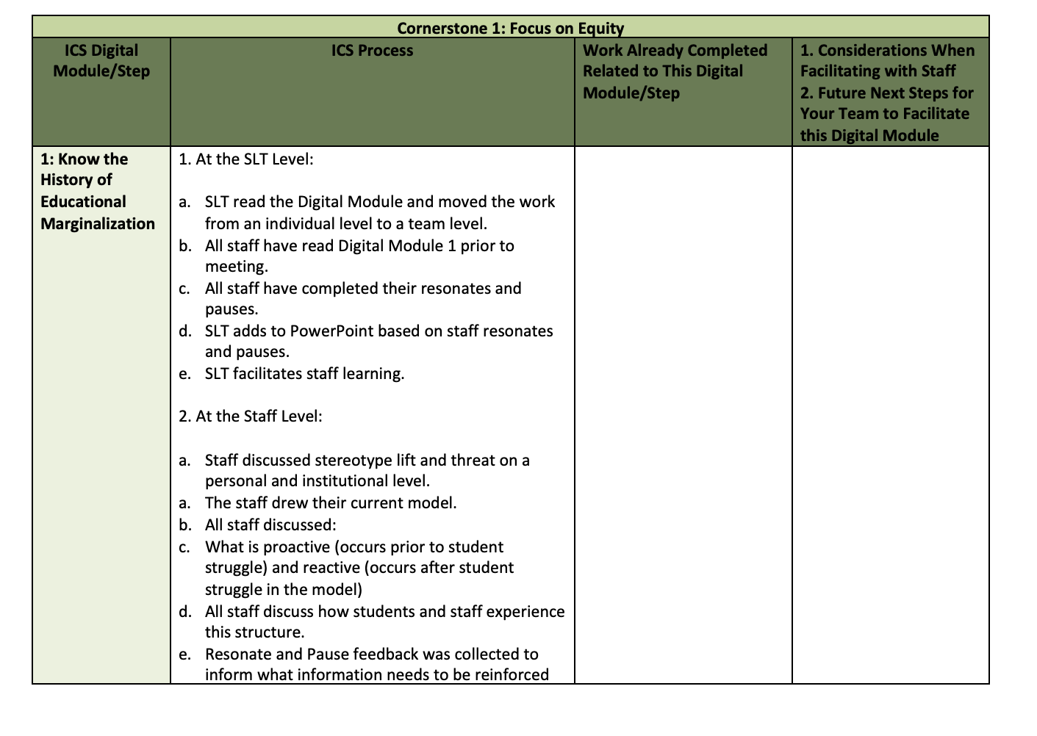

Slide 10

List the efforts your district/school has engaged in to address inequities across beliefs, policies, systems, structures, and/or practices?
What impact has this work had on students and the community?
We will take 8 minutes to discuss in team breakouts
Identify a recorder, timekeeper, communicator, and facilitator and be prepared to share 1 or 2 in chat or from your tables

Slide 11
ICS Equity Mitigates & Avoids
Equity Traps, Tropes, & Pitfalls
Defining Equity Traps, Tropes, and Pitfalls
Adapted from Jamila Dugan, ”Equity Traps and Tropes” (2021)
Doing Equity: Treating equity as a series of tools, strategies, and compliance versus a whole person, a whole system change process linked to culture, identity, & healing
Siloing Equity: Locating equity work in a separate and siloed policy, team, or body
Equity Warrior(s): Nestling equity with a single champion and holder of the vision
Spray and Pray Equity: Engaging “equity experts” to drop in for a training with no ongoing plan for learning or capacity building
Navel-Gazing Equity: Keeping equity work at the level of self-reflection and failing to penetrate the instructional core and/or school systems and structures (segregation, tracking)

Slide 12
ICS Equity Mitigates & Avoids
Equity Traps, Tropes, & Pitfalls
Defining Equity Traps, Tropes, and Pitfalls
Adapted from Jamila Dugan, ”Equity Traps and Tropes” (2021)
Structural Equity: Redesigning systems & structures without investing in the deeper personal, interpersonal, and cultural shifts
Blanket Equity: Investing in a program or curriculum rather than building the capacity of your people to address equity challenges as complex and ongoing places of inquiry
Tokenizing Equity: Asking leaders of color to hold, drive, and symbolically represent equity without providing support & resources to thrive nor engaging the entire staff in the work
Superficial Equity: Failing to take time to build equity-centered knowledge and fluency, leading to behavioral shifts without understanding deeper meaning or historical context
Boomerang Equity: Investing time and resources to understand your equity challenges but reverting back to recycled, status quo solutions.

Slide 13
Traps, Tropes and Pitfalls
Doing Equity
Siloing Equity
Equity Warrior(s)
Spray and Pray Equity
Navel-Gazing Equity
Structural Equity
Blanket Equity
Tokenizing Equity
Superficial Equity
Boomerang Equity
Which of the 10 Traps, Tropes and Pitfalls –
Have you Experienced Thus Far with Your Equity Efforts

Slide 14

No surprise then, that Inequities Persist in Our Districts…
  ICS Advances the Learning for All Students Across Identities
  Race
  Disability
  Language
  Social class
  Religion
  Gender
  Sexual/Gender Identity
  And their intersections

Slide 15

ICS provides a Framework to Bring Together District/School Work

Slide 16





We Define Equity As…
HIGH-QUALITY TEACHING AND LEARNING ABSENT ANY EXPERIENCE OF MARGINALIZATION OR OPPRESSION
perceptual
curricular
structural
procedural
financial
instructional

Slide 17
Inequities are:
Historical, Structural, Cultural, and Systemic
Require Systems Change

Slide 18
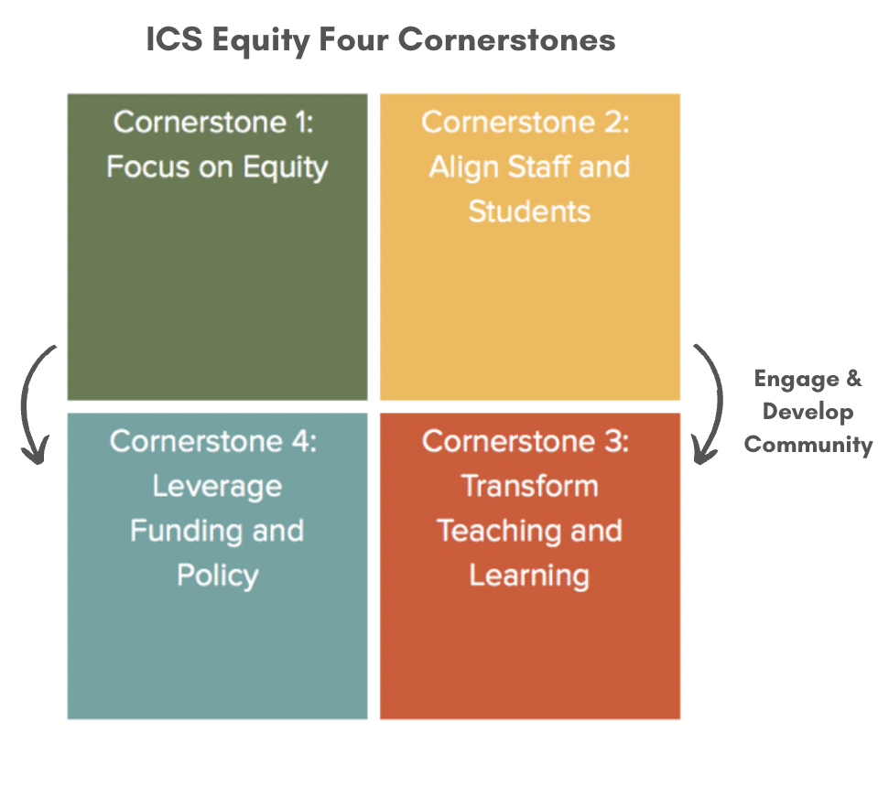
Integrated Comprehensive Systems –
Four Cornerstones

Slide 19
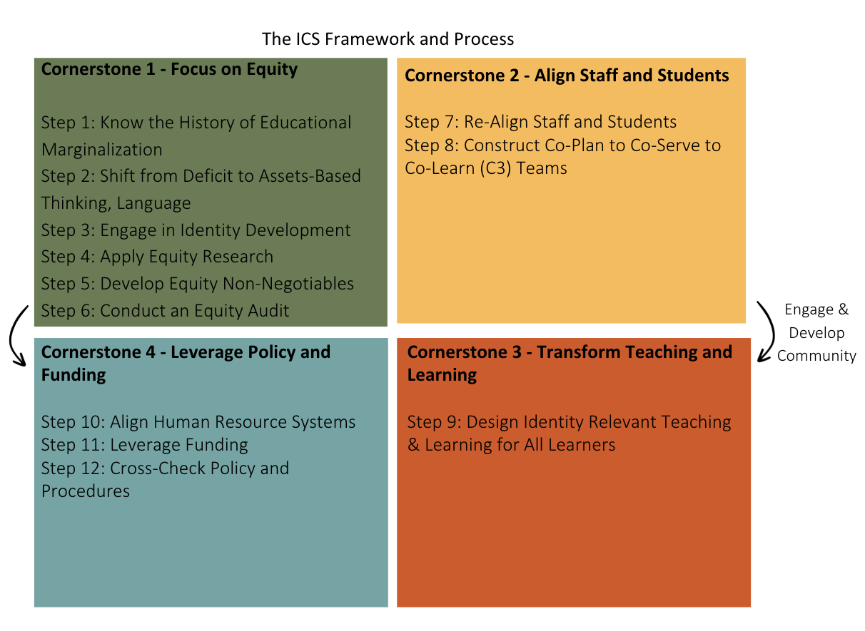
Integrated Comprehensive Systems –
Four Cornerstones
Year 1
Year 2
Year 2 and 3
Year 2 and 3

Slide 20
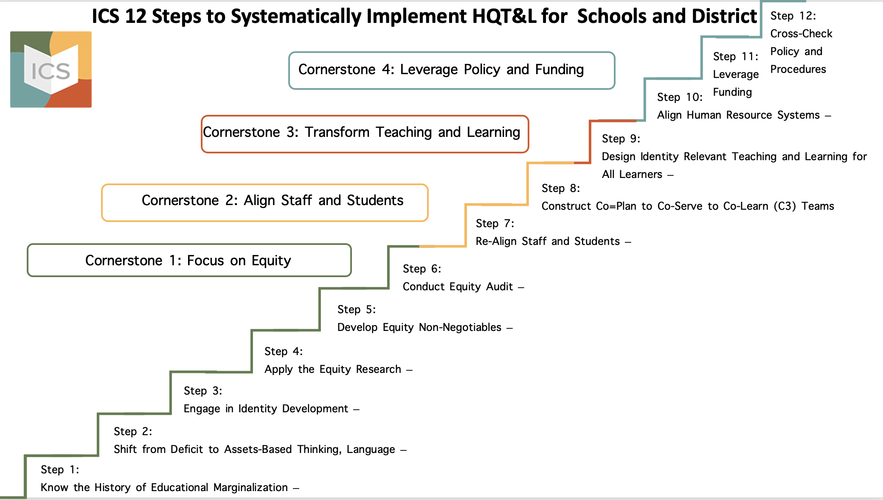

Slide 21

ICS Equity
5
KEY FEATURES
Historically (and presently), efforts to engage in and operationalize equity work falls short of producing any sustainable, measurable change.
Too often, piecemeal equity work ends up perpetuating the traps, tropes, and pitfalls of your typical Diversity, Equity, and Inclusion training.
ICS, instead, works to avoid those traps, tropes, and pitfalls through implementing, with fidelity, the key features of ICS Four Cornerstones and Systems change framework.

Slide 22
ICS for Equity
5 KEY FEATURES
  Advances Learning for All Students Across Identities
  Race
  Disability
  Language
  Social class
  Religion
  Gender
  Sexual/Gender Identity
  And their intersections

Slide 23
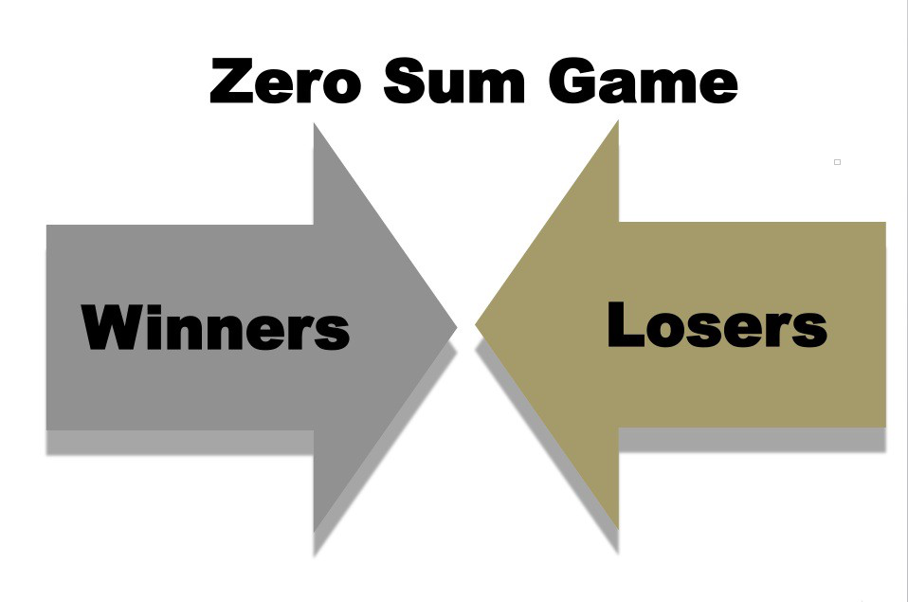
Not a Zero-Sum Game–
Advances Learning for All

Slide 24
ICS Equity Mitigates & Avoids
Equity Traps, Tropes, & Pitfalls
Equity Traps, Tropes, and Pitfalls
Adapted from Jamila Dugan, ”Equity Traps and Tropes” (2021)
ICS Equity 5 Key Features
Doing Equity
Siloing Equity
Equity Warrior(s)
Spray and Pray Equity
Navel-Gazing Equity
Structural Equity
Blanket Equity
Tokenizing Equity
Superficial Equity
Boomerang Equity
Framework and Process
Advances Learning for All
Research and Evidence
Build Collective Equity Capacity
Accountability

Slide 25
ICS Equity Mitigates & Avoids
Equity Traps, Tropes, & Pitfalls
Equity Traps, Tropes, and Pitfalls
Adapted from Jamila Dugan, ”Equity Traps and Tropes” (2021)
ICS Equity 5 Key Features
Doing Equity
Siloing Equity
Equity Warrior(s)
Spray and Pray Equity
Navel-Gazing Equity
Structural Equity
Blanket Equity
Tokenizing Equity
Superficial Equity
Boomerang Equity
Framework and Process
Advances Learning for All
Research and Evidence
Build Collective Equity Capacity
Accountability

Slide 26
ICS Equity Mitigates & Avoids
Equity Traps, Tropes, & Pitfalls
Equity Traps, Tropes, and Pitfalls
Adapted from Jamila Dugan, ”Equity Traps and Tropes” (2021)
ICS Equity 5 Key Features
Doing Equity
Siloing Equity
Equity Warrior(s)
Spray and Pray Equity
Navel-Gazing Equity
Structural Equity
Blanket Equity
Tokenizing Equity
Superficial Equity
Boomerang Equity
Framework and Process
Advances Learning for All
Research and Evidence
Build Collective Equity Capacity
Accountability

Slide 27
ICS Equity Mitigates & Avoids
Equity Traps, Tropes, & Pitfalls
Equity Traps, Tropes, and Pitfalls
Adapted from Jamila Dugan, ”Equity Traps and Tropes” (2021)
ICS Equity 5 Key Features
Doing Equity
Siloing Equity
Equity Warrior(s)
Spray and Pray Equity
Navel-Gazing Equity
Structural Equity
Blanket Equity
Tokenizing Equity
Superficial Equity
Boomerang Equity
Framework and Process
Advances Learning for All
Research and Evidence
Build Collective Equity Capacity
Accountability

Slide 28
ICS Equity Mitigates & Avoids
Equity Traps, Tropes, & Pitfalls
Equity Traps, Tropes, and Pitfalls
Adapted from Jamila Dugan, ”Equity Traps and Tropes” (2021)
ICS Equity 5 Key Features
Doing Equity
Siloing Equity
Equity Warrior(s)
Spray and Pray Equity
Navel-Gazing Equity
Structural Equity
Blanket Equity
Tokenizing Equity
Superficial Equity
Boomerang Equity
Framework and Process
Advances Learning for All
Research and Evidence
Build Collective Equity Capacity
Accountability

Slide 29
ICS Equity Mitigates & Avoids
Equity Traps, Tropes, & Pitfalls
Equity Traps, Tropes, and Pitfalls
Adapted from Jamila Dugan, ”Equity Traps and Tropes” (2021)
ICS Equity 5 Key Features
Doing Equity
Siloing Equity
Equity Warrior(s)
Spray and Pray Equity
Navel-Gazing Equity
Structural Equity
Blanket Equity
Tokenizing Equity
Superficial Equity
Boomerang Equity
Framework and Process
Advances Learning for All
Research and Evidence
Build Collective Equity Capacity
Accountability

Slide 30
PAUSE AND REFLECT
As we think about the various Equity Traps, Tropes, and Pitfalls, Your Previous Equity Efforts, and how ICS can disrupt these Traps, Tropes, and Pitfalls
What Resonates with You?
What Gives You Pause?
We will take 7 minutes to discuss in team breakouts.

Slide 31
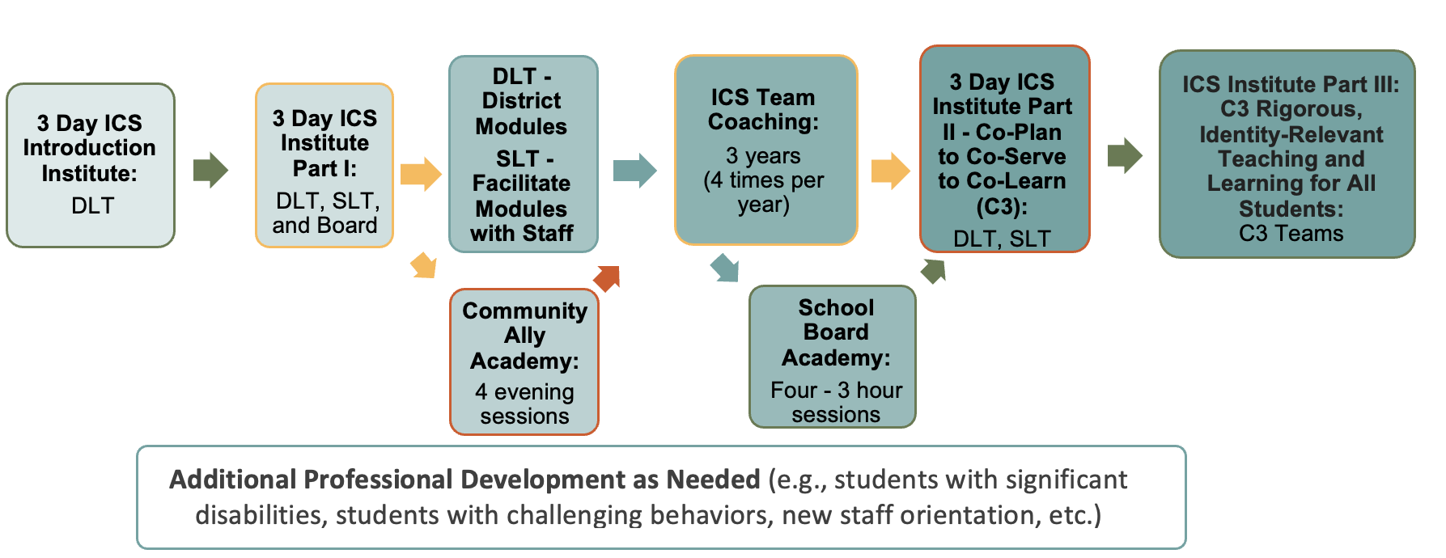
ICS Implementation Process –
Implementation Science – Trainer of Trainers

Slide 32
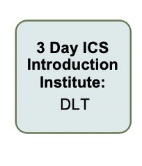
ICS Equity Overview for District Leadership Team or District Office Introduction to the Work
Often completed a semester prior to the School Leadership Teams

Slide 33
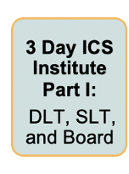
The ICS Equity Part 1 Institute Work with School Teams (DLT and Board are welcome to attend)
The current professional development
Primary focus is a deep dive into Cornerstone 1 – Focus on Equity. Modules 0-6
Overview of Cornerstones 2 -4 – Modules 7-12

Slide 34
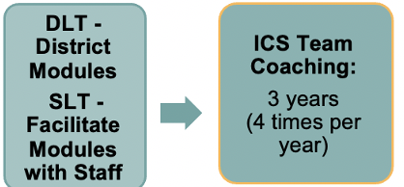
ICS Equity Virtual Coaching Coaching First Semester/Year After the Part 1 Institute
Coaching happens 4 times a year or 2x/semester virtually following the Part 1 and 2 and 3 Institutes for all school and district office teams.
After Part 1 - School Teams are beginning to share out the Modules 0- 6 over two semesters.

Slide 35
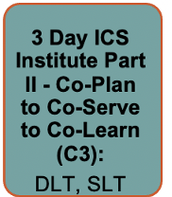
The ICS Equity Part II Institute Work for School School Teams
Part 2 occurs two semesters after Part 1 with the same SLT’s.
Focus is on taking a deeper dive into Modules 7-12 with an overview on Modules 0-6.

Slide 36
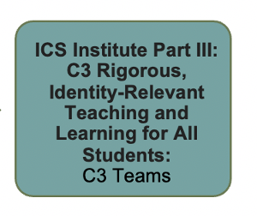
The ICS Equity Part III Institute Work for C3 Teams
Part 3 is for C3 Teams to continue to practice the work of the C3 Team and lesson design.

Slide 37
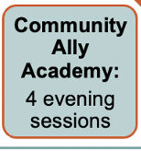
Community Ally Academy
Can happen as often as the District is interested – often District’s complete 2 cohorts.
Assist in community members understanding and supporting the work of the schools and district.

Slide 38
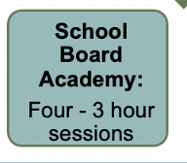
School Board Academy
Workshop for Board members to understand the work of the District and Schools to better support in policy and funding decisions.
To better understand the role of the Board in leading the work.

Slide 39
Expectations of District Administrative Team (DLT) and School Leadership Teams (SLTs)
1. Meets at least once a month for at least one hour, to work through the School or District Digital Modules.
2. “Work through the school or district modules” means:
- All members read the module.
- Two members volunteer to facilitate the module slides and activities
3. Each District Administrative Team member assigned to a school to serve as ICS District/School Liaison – Co-Coaching:
- Attend each SLT ICS planning meeting
- Attend each SLT facilitation with the staff
-Attend each SLT coaching session
4. Meets an additional hour a month to check in on how the SLT/School work is going, support each other, share resources/ideas.
5. Meets with ICS Coach, 75 minutes, 4 times a year for 3 years.

Slide 40
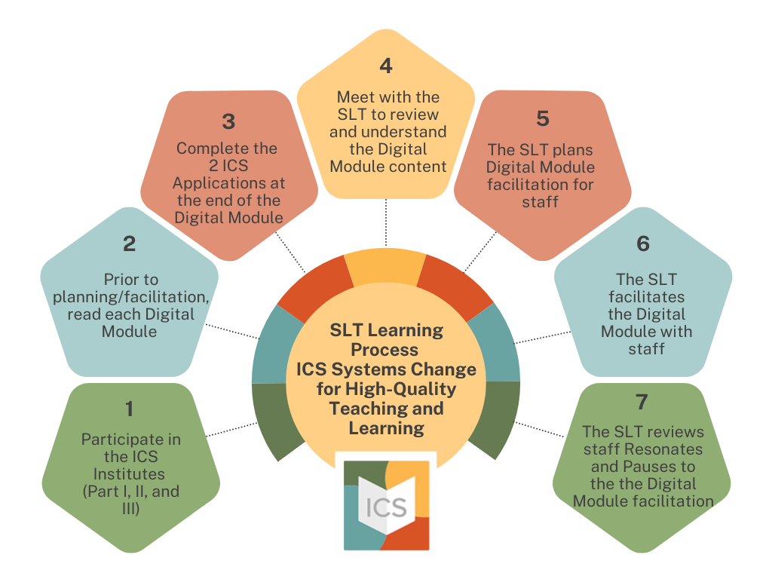

Slide 41
