Slide 1

Part I School Digital Module 9/Step 9: Design Identity Relevant Teaching and Learning for All Learners
DR. ELISE M. FRATTURA (she/her/hers)
DR. COLLEEN A. CAPPER (she/her/hers)
MR. NASIF K. ROGERS, PhD Candidate (he/him/his)

Slide 2

4 Agreements of Courageous Conversations (Singleton, 2022)
Experience discomfort
Stay engaged
Speak your truth
Expect and accept non-closure

Slide 3
Community Agreements (Continued)
No blame, shame, judgment.
Equity work life-long, never ending, at individual & organizational level.
“Collective Equity Capacity” we are in this with you - mutual learning, challenging, growing together.

Slide 4
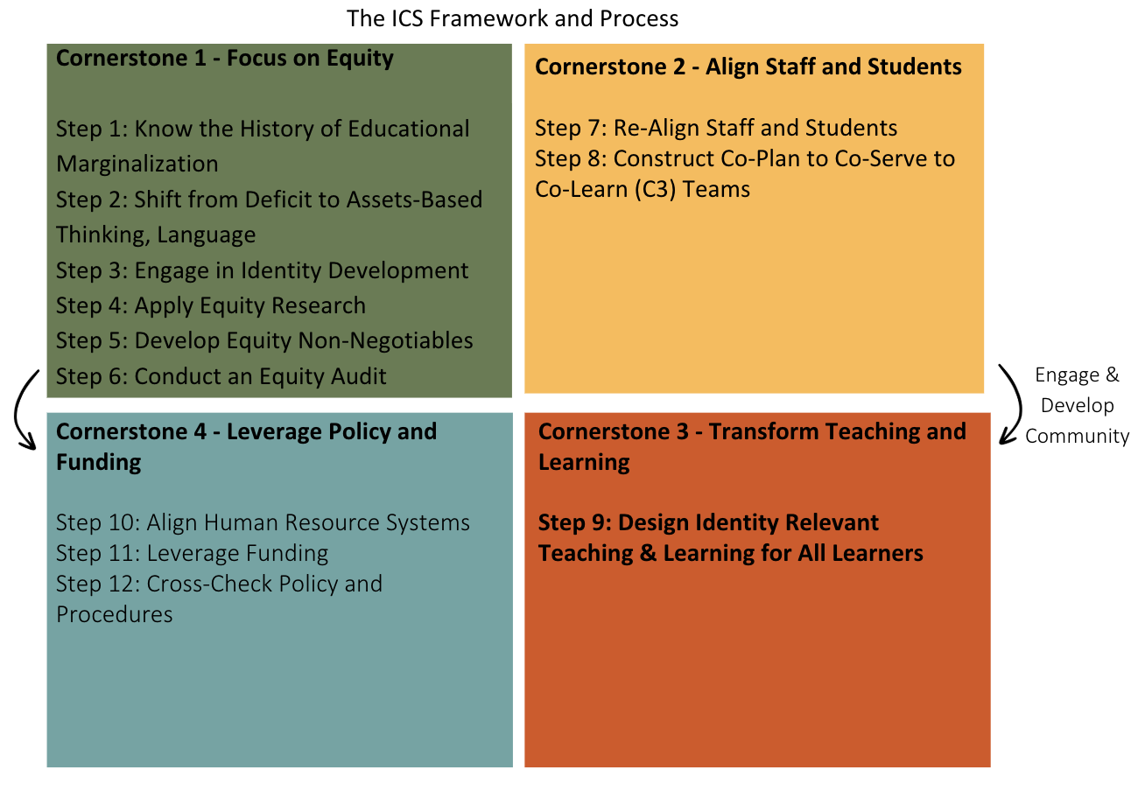
Part 1- Focuses on Cornerstone 1- First Year of application.
In Part 1 – we introduce Cornerstones 2, 3 and 4.
During Part 2 – We bring Cornerstones 2 – 3 and 4 to practice to prepare School Leadership Teams to share out in Year 2 of application of the ICS Framework and Process.

Slide 5
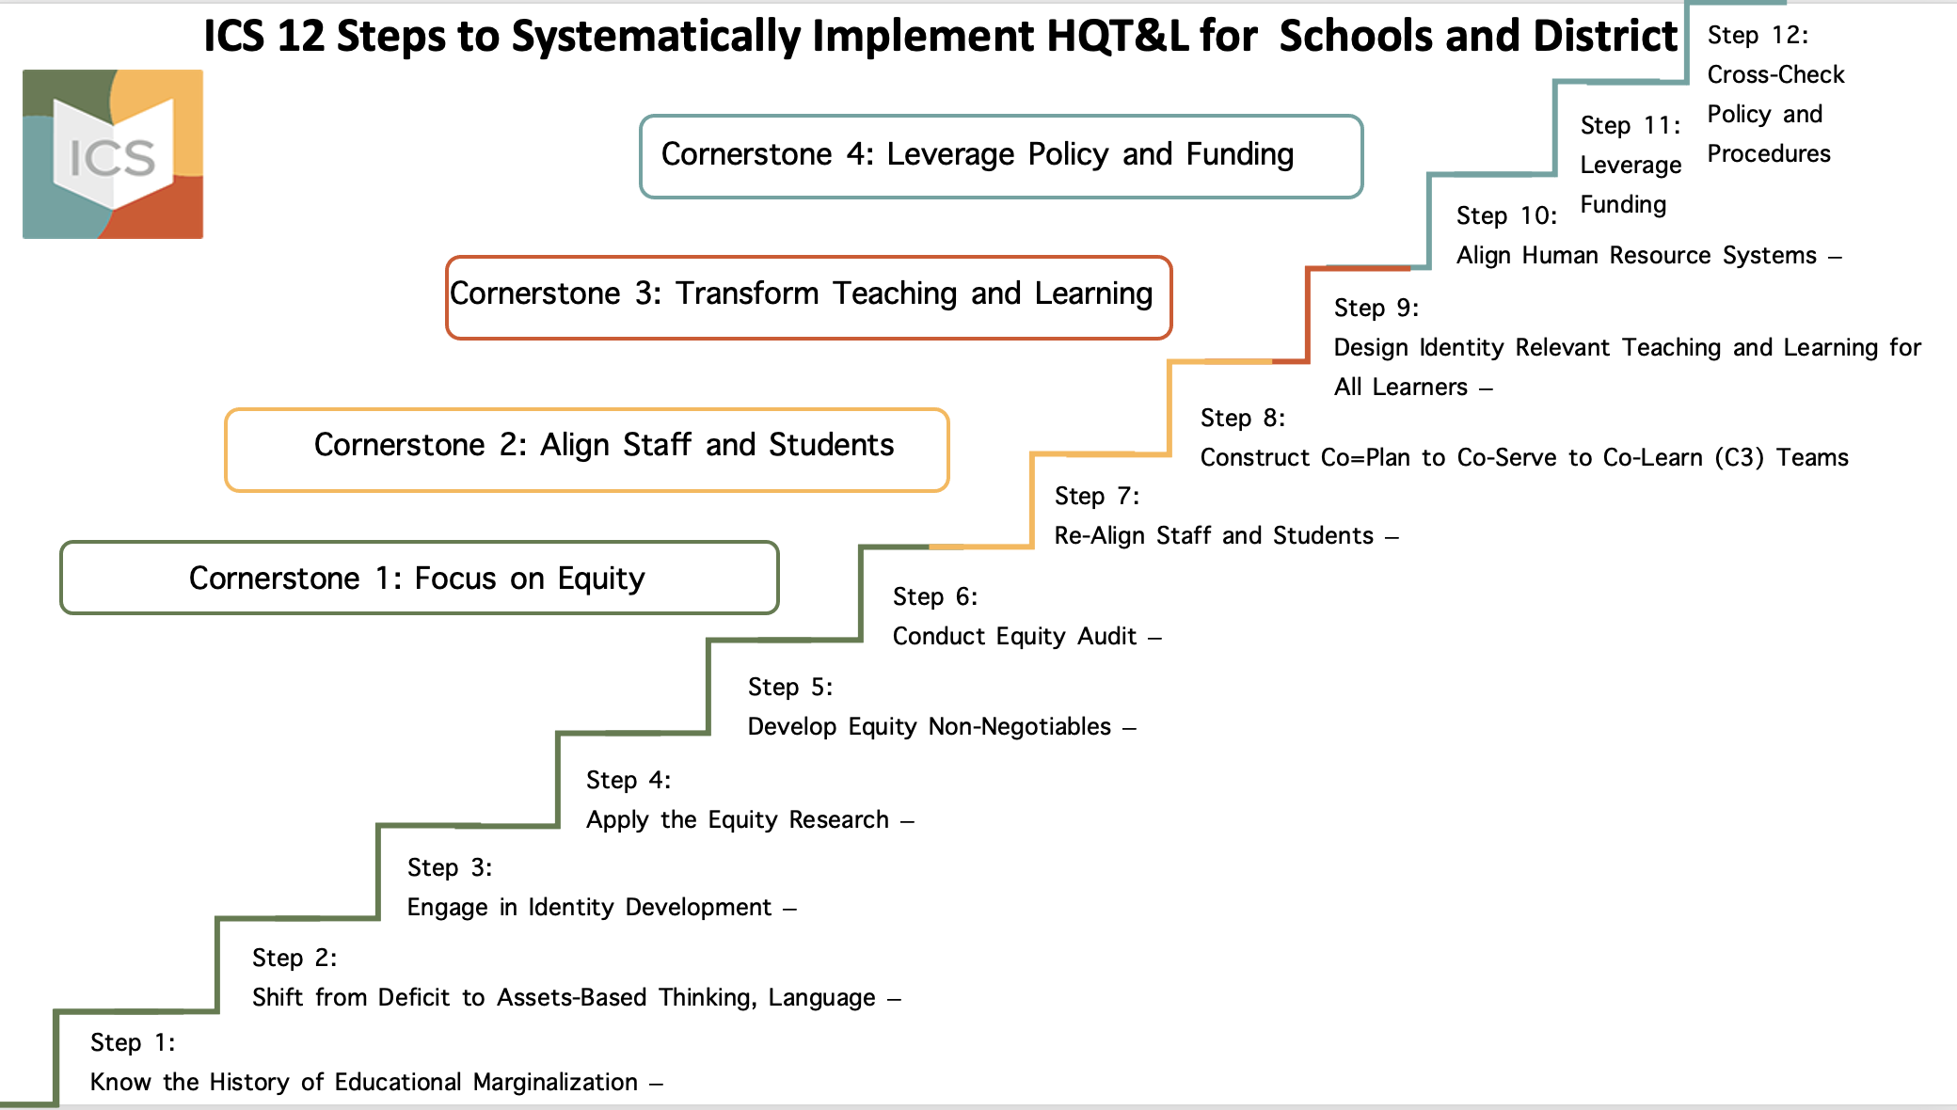

Slide 6

Module 9: Learning Targets
Strategies and practices that have the least and greatest impact on student achievement.
Practices reinforce grouping students by ability
Heterogeneous small group instruction and the benefits on student achievement.
Universal Design for Learning and how it is or is not individualized for each learner based on how they bring in information and show what they know the most often.
Identity relevant instructional practices
Overview in co-designing Co-Plan to Co-Serve to Co-Learn lesson plans for heterogeneous groups of students.

Slide 7
Digital Module 9/Step 9: IRTL Review of the Following
Research Based Instructional Practices
Heterogeneous Small Group Instruction
A Word on Universal Design for Learning and Backward Mapping
Identity Relevant Instructional Practices
Creating Lessons that Lift the Learning of All Learners

Slide 8
Digital Module 9/Step 9: IRTL Agenda
Research Based Instructional Practices
Heterogeneous Small Group Instruction
A Word on Universal Design for Learning and Backward Mapping
Identity Relevant Instructional Practices
Creating Lessons that Lift the Learning of All Learners

Slide 9
As Discussed in Module 4 and 8
John Hattie (2023) has been clear that the RtI research has “focused on efficacy of each component” rather than the value of the RtI process as “an integrated whole.” The research represents “higher effects for Tier 1 interventions than Tier 2 and insufficient studies for Tier 3.”
Hattie adds, “many have identified problems with the [RtI] model and is quickly being replaced with multitiered support system or MTSS.”
MTSS should not hold to separate tiered practices.

Slide 10

John Hattie (2023)
In 2023, John Hattie returns to his ground-breaking Visible Learning Study, which was first published in 2008 and was based on a synthesis of over 800 meta-analyses relating to achievement. In the last 15 years the research base underlying the Visible Learning project has grown to more than 2,100 meta-analyses, drawn from more than 130,000 studies, and involved more than 400 million students from all around the world.

Slide 11
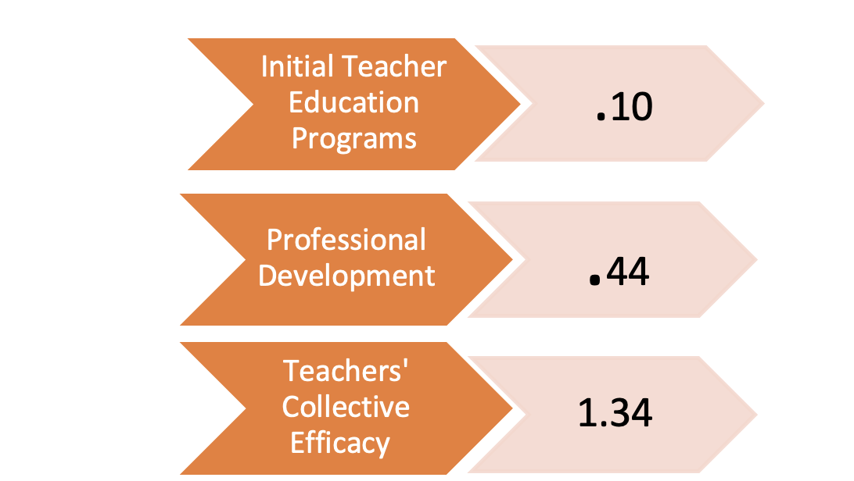
Hattie’s Work Reflects the Least and Greatest Impact on Student Learning

Slide 12

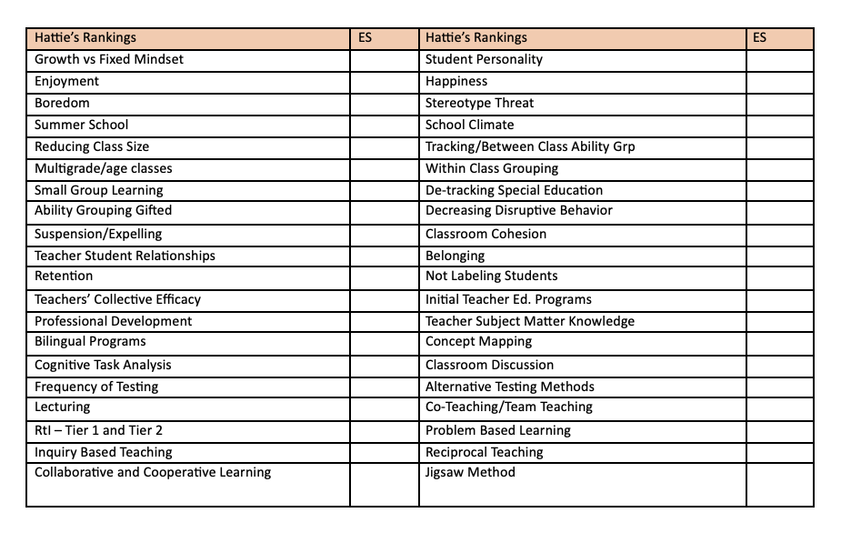
Determine High Potential for Impact, Low Potential for Impact or Neutral

Slide 13
Steps for Hattie Activity
Take each strategy and place in pile of
  Greatest Impact on Student Learning
  Least Impact on Student Learning
  Neutral Impact on Student Learning
Share out your results…
Check for accuracy

Slide 14
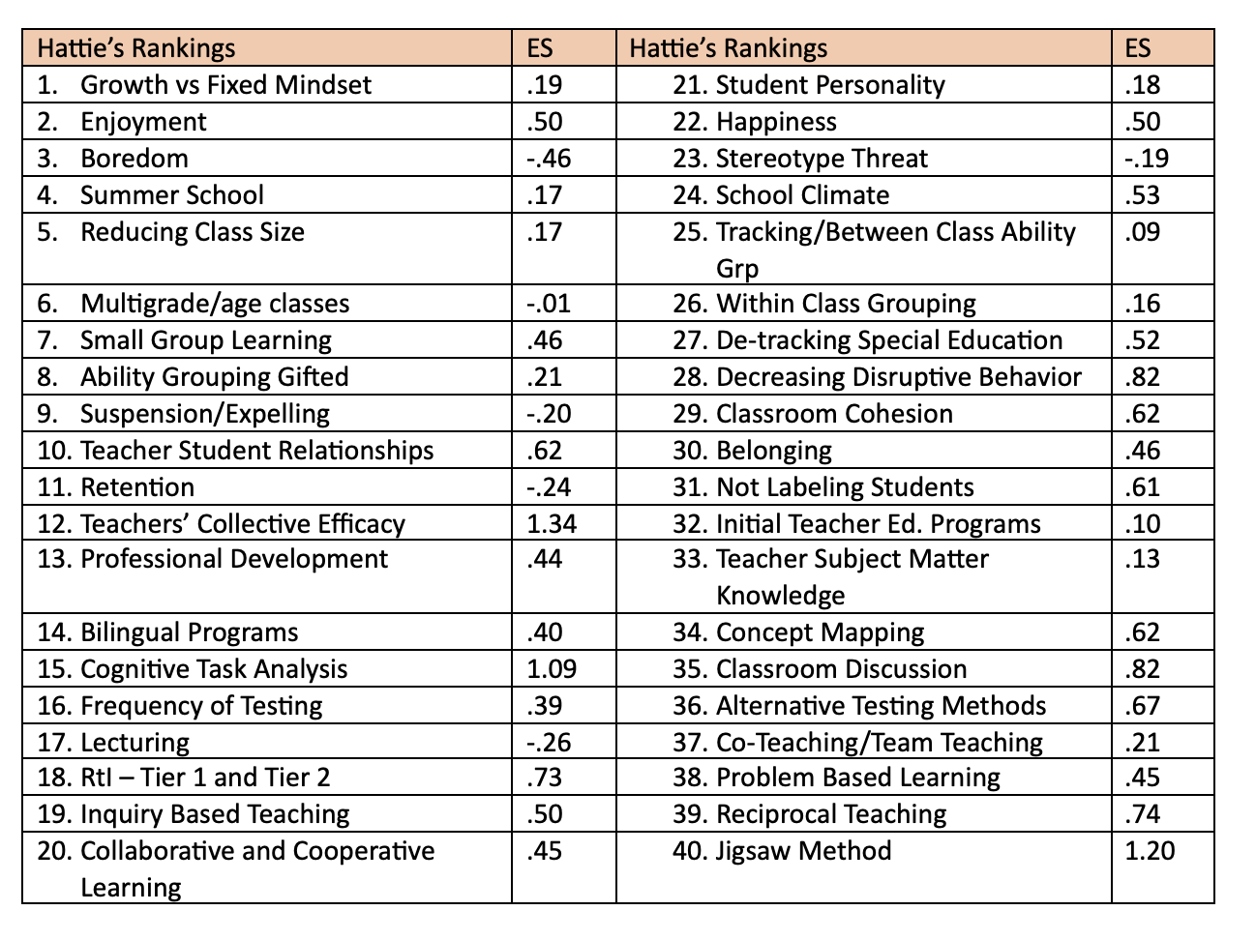

Slide 15
Now… What Do Practices Look
Like in Your District
On Shared Paper and Screen – Create a Table:
  Create 3 Columns
    In Column 1 Delineate all the practices you see within your school that fall below .40
    In Column 3 Delineate all practices you see within your school that fall above .40
    In the Middle Column – Delineate what you can substitute the practices below .40 with out of Hattie’s effective strategies

Slide 16
Digital Module 9/Step 9: IRTL Agenda
Research Based Instructional Practices
Heterogeneous Small Group Instruction
A Word on Universal Design for Learning and Backward Mapping
Identity Relevant Instructional Practices
Creating Lessons that Lift the Learning of All Learners

Slide 17
Importance of Small Heterogenous Grouping
1. Promotes ‘deep’ learning: Encourages deep learning and higher order cognitive activities, such as analysis, evaluation and synthesis. Engage by being active participants in the learning process, as opposed to passively “absorbing” information.
2. Develops critical thinking skills: Allows students to develop critical thinking by exploring issues together and testing hypotheses that are difficult to do well in a lecture. This practice develops problem-solving skills.
3. Promotes discussion and communication skills: Environment is conducive to discussion. Students do not feel exposed or hidden, but are comfortable. Each student is encouraged to actively participate and share their understandings and inquiry.
4. Active learning: Help identify what a student does not understand, and discussion aids understanding by activating previously acquired knowledge. Students are encouraged to reflect on their experiences and develop self-regulatory skills.

Slide 18
Importance of Small Heterogenous Grouping
5. Self-motivation: Encourages involvement in the learning process, increasing motivation and learning. By taking responsibility for their learning, they become self-motivated rather than being motivated by external factors e.g., the lecturer (teacher-centered approaches usually do not facilitate self-directed learning).
6. Develops transferable skills: Helps develop skills necessary for e.g., leadership, teamwork, organization, prioritization, providing support and encouragement for peers, problem solving and time management.
7. Application and development of ideas: Yields opportunities to apply ideas and consider potential outcomes. Making connections during group discussion enhances student understanding.
8. Tutor as a role model: A logical and systematic tutor approach demonstrating ‘transferable’ skills motivates student learning and development.

Slide 19
Importance of Small Heterogenous Grouping
9. Recognizes prior learning: Students are encouraged to surface their own prior knowledge, including their own perceptions (and misconceptions) of material previously covered.
10. Social aspects of learning: Participation and social aspects of small group learning means that learning is more enjoyable than solitary approaches.
11. Encourages alternative viewpoints: Encourages an awareness of different perspectives on various topics and can therefore increase learning based on the diversity of the learners.
References: Kitchen, 2012; Dent & Harden, 2005; Crosby, 1997; Entwhistle, Thompson & Tait, 1992; Walton, 1997

Slide 20
Importance of Small Heterogenous Grouping
In your teams –discuss the 11 key features and any reasons why we should not place students in heterogeneous grouping patterns for educational benefit?

Slide 21
Digital Module 9/Step 9: IRTL Agenda
Research Based Instructional Practices
Heterogeneous Small Group Instruction
A Word on Universal Design for Learning and Backward Mapping
Identity Relevant Instructional Practices
Creating Lessons that Lift the Learning of All Learners

Slide 22
A Word on Universal Design for Learning
The Higher Education Opportunity Act (HEOA, Public Law 110-315, August 14, 2008) supports Universal Design for Learning as “a scientifically valid framework for guiding educational practices”:
  (A)“Provides flexibility in the ways information is presented, in the ways, students respond or demonstrate knowledge and skills, and in the ways, students are engaged...”
  (B)“Reduces barriers in instruction, provides appropriate accommodations, supports, and challenges, and maintains high achievement expectations for all students, including students with disabilities and students who are limited English proficiency.”

Slide 23
Digital Module 9/Step 9: IRTL Agenda
Research Based Instructional Practices
Heterogeneous Small Group Instruction
A Word on Universal Design for Learning and Backward Mapping
Identity Relevant Instructional Practices
Creating Lessons that Lift the Learning of All Learners

Slide 24
According to Irvine and Armento (2001), Discuss the 4 Myths Relative to
What You Learned in Cornerstone 1:
Myth #1: Culturally relevant pedagogy is a new and special type of pedagogy that is relevant only to students experiencing poverty and students who identify as black or brown.
Myth #2: In schools with diverse student populations, teachers of color are better able to demonstrate the essential elements of a culturally relevant pedagogy.
Myth #3: Culturally relevant pedagogy is a “bag of tricks” that minimizes the difficulty of teaching a diverse student population.
Myth #4: Culturally relevant pedagogy requires teachers to master the details of all the cultures of students represented in the classroom.

Slide 25
Digital Module 9/Step 9: IRTL Agenda
Research Based Instructional Practices
Heterogeneous Small Group Instruction
A Word on Universal Design for Learning and Backward Mapping
Identity Relevant Instructional Practices
Creating Lessons that Lift the Learning of All Learners

Slide 26
Create or Adopt the Lesson Plan Format Provided – Confirming the Following Requirements:
Define the cluster of standards or essential learning targets (both foundational and content standards)
Provide clarity of what will be introduced in large group instruction that is only 10% of the instructional time
Share appropriate information from the ICS Skills at a Glance for each student
Define what will be achieved in heterogeneous small groups by interest 90% of the instructional period
Define what engagement, instruction and assessment will look for each heterogeneous small group
Clarify what staff will facilitate learning and where – staff schedules
Sign off on the lesson for all C3 Team members

Slide 27
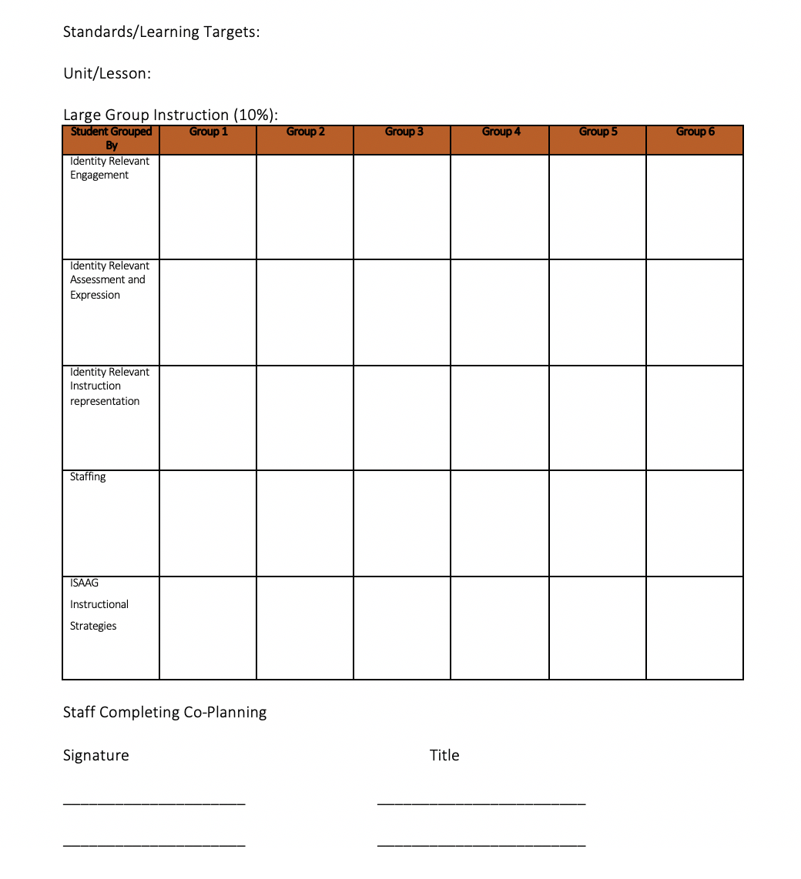

Slide 28
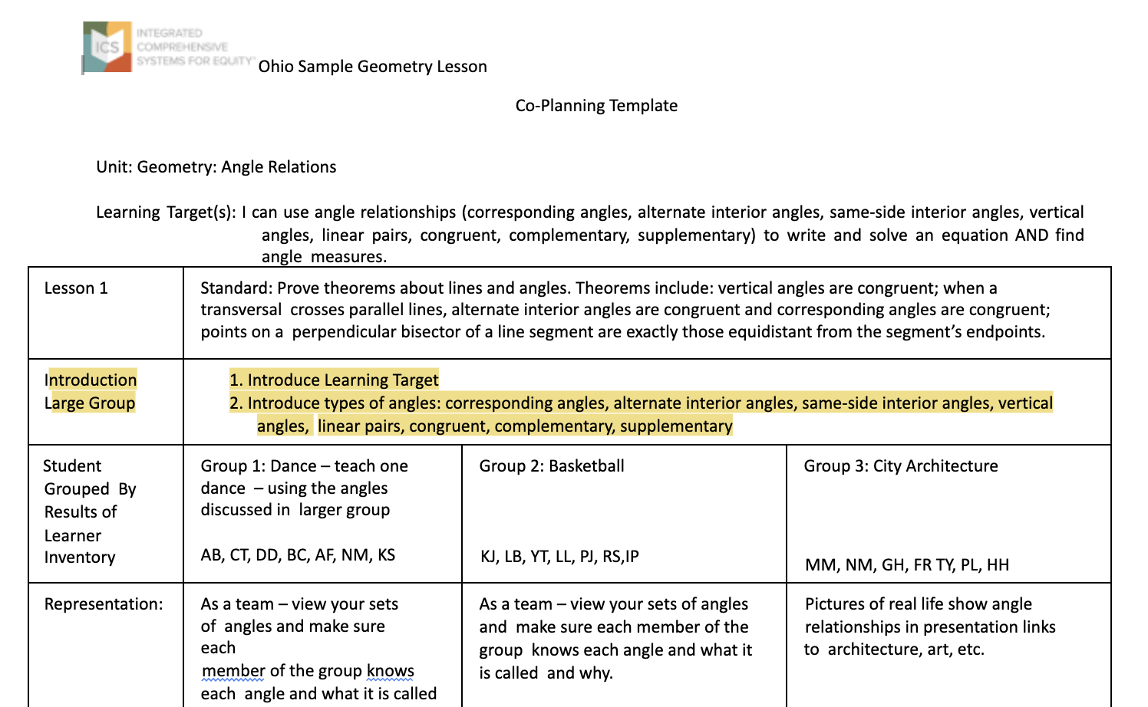

Slide 29
Discuss the Benefits of a Lesson Plan
Template for C3 Teams
Using the 7 points of the Geometry Lesson Plan attached to Module 8 and 9.
Discuss the Benefits of such a Lesson Plan for Heterogeneous Groups of Students.
We will share out in large group.

Slide 31
